Slide 1
Farming wheat

Slide 2
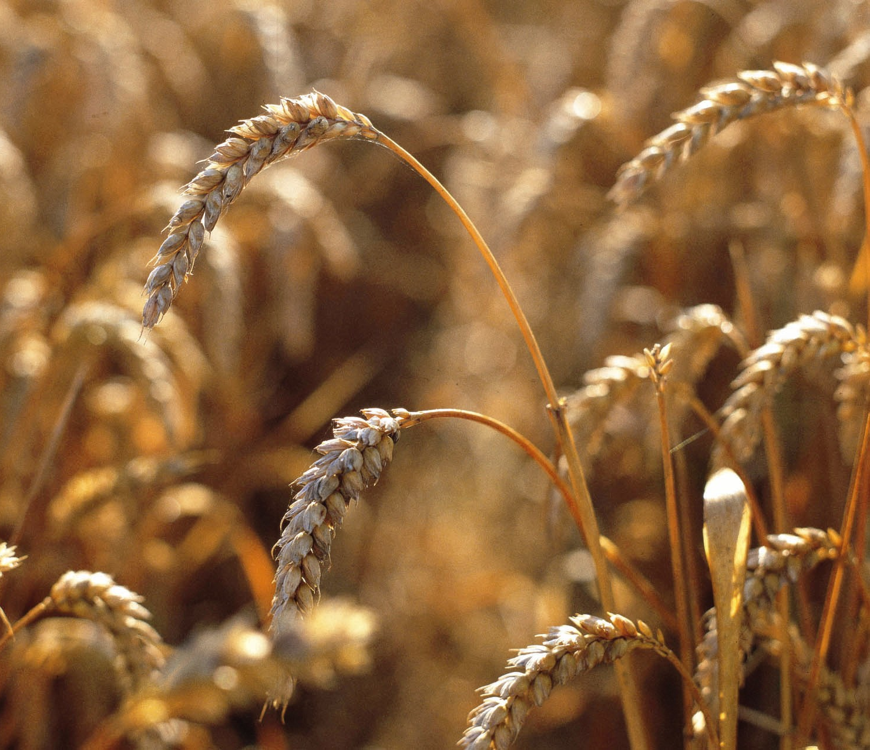
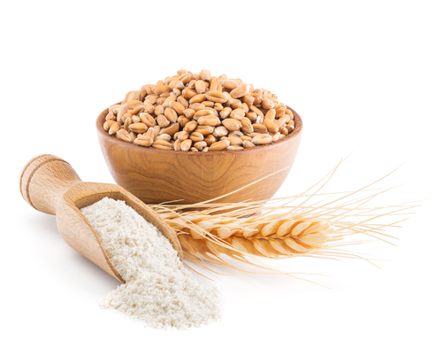
How do farmers grow wheat?
Let’s find out!

Slide 3
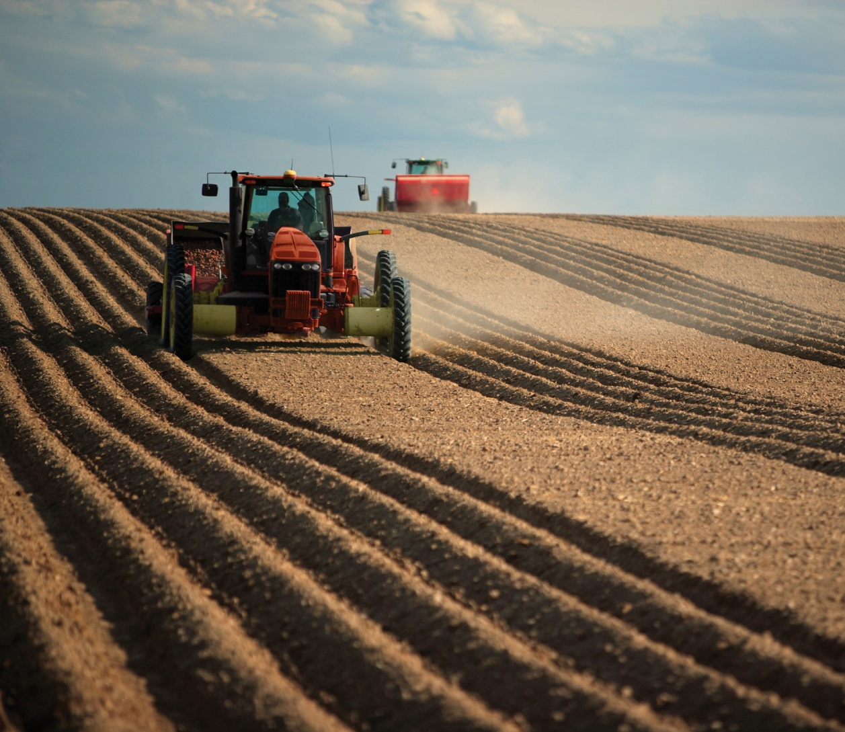
Autumn/winter
In the autumn/winter, the farmer ploughs the field to break up the soil.

Slide 4
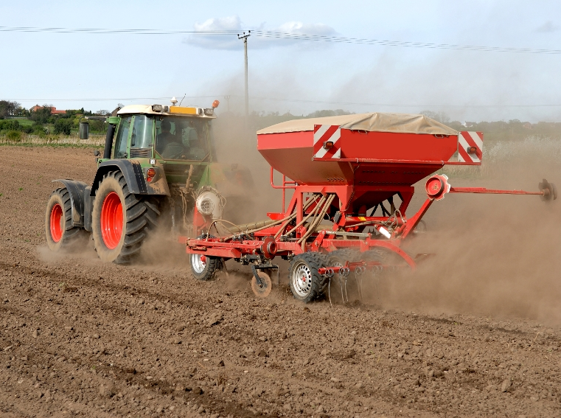
Autumn/winter
The wheat seed is sown.
Sown means planted.

Slide 5
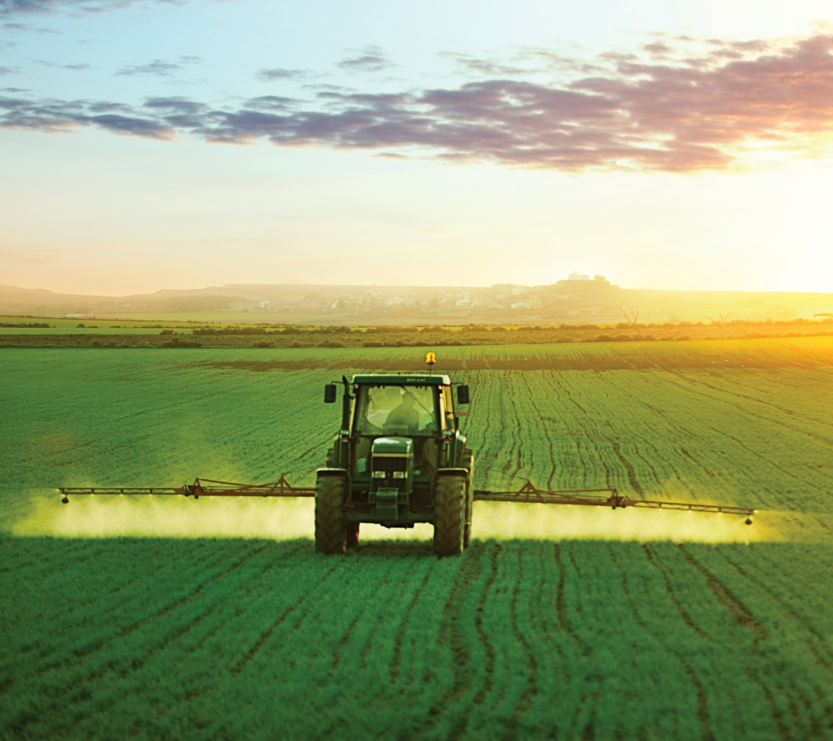
Growing
The wheat needs water, warmth, light and fertiliser to help it grow.
Fertiliser is like extra food for the wheat.

Slide 6
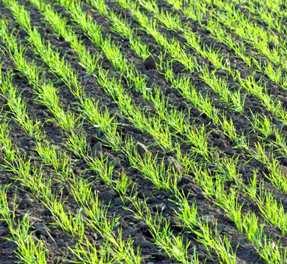
Growing
Here is some young wheat.
What does it look like?

Slide 7
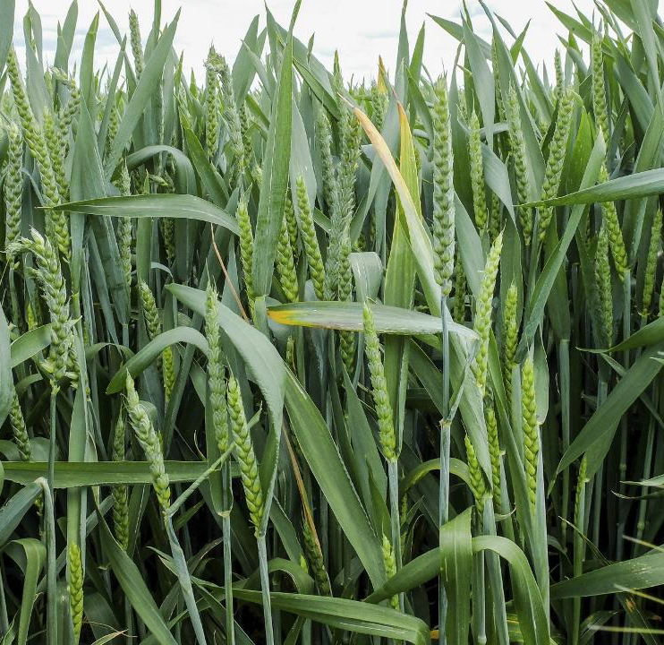
Spring
In the spring, the wheat starts to grow faster.
What colour are the ears of wheat?

Slide 8
Summer
In the summer, the wheat ripens.
What colour are the ears of wheat now?

Slide 9
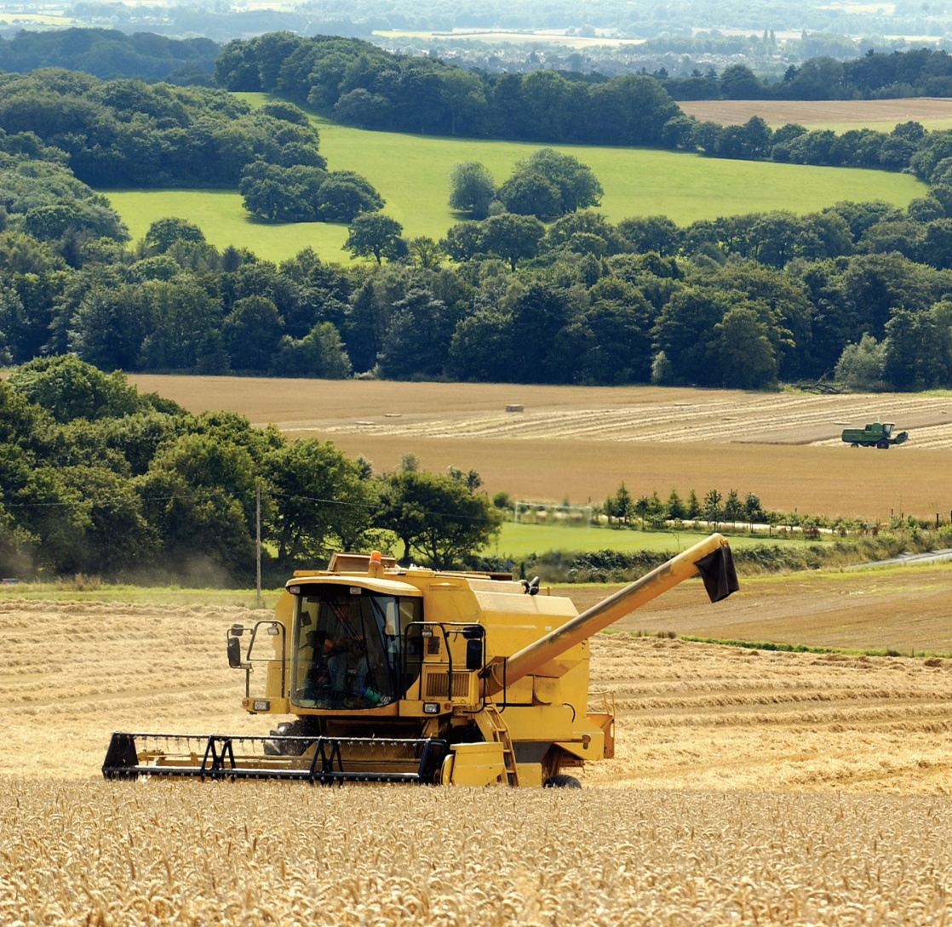
Summer
In August, the wheat is harvested by a combine harvester.

Slide 10
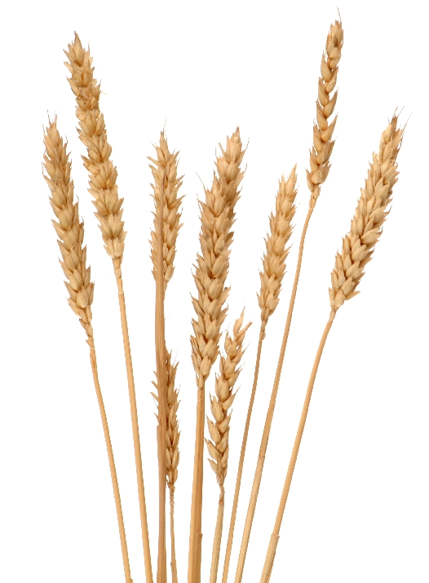
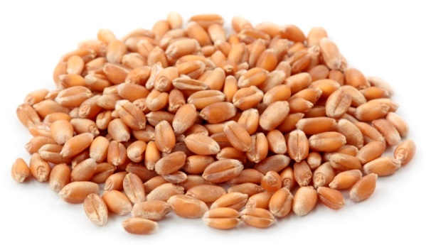
Grain
The combine harvester separates the grain from the rest of the wheat plant.

Slide 11
For further information, go to:
www.foodafactoflife.org.uk

