Slide 1
Nutrients

Slide 2
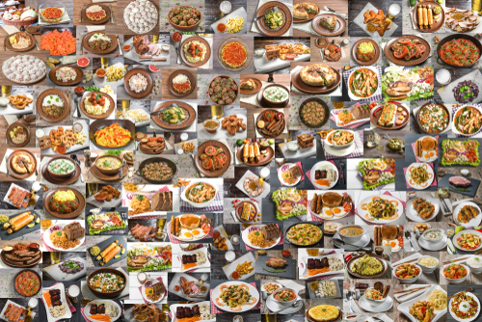
Nutrients
Food and drinks contains different substances that are needed for health.
These are nutrients and water.

Slide 3
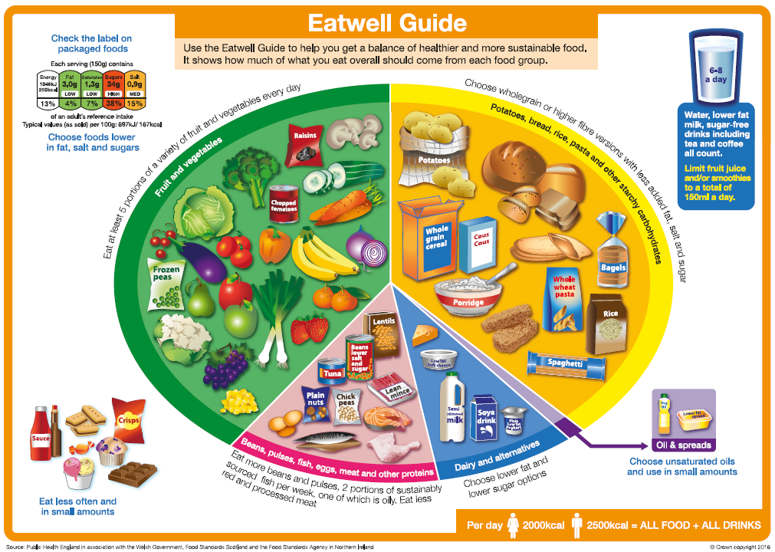
Nutrients
Different types of food provides nutrients in different amounts.
To help us get all the nutrients we need, we should eat a variety of food from the Eatwell Guide food groups.
Let’s take a look at the Eatwell Guide food groups and the main nutrients each group provides.

Slide 4
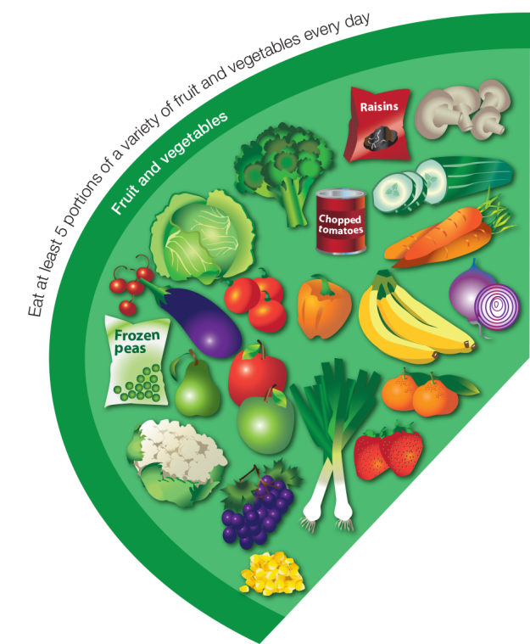
Fruit and vegetables
This food group provides a range of vitamins and fibre.
Vitamins are needed for general good health. Some vitamins have special jobs:
Vitamin A is needed for night vision;
Vitamin C is needed for the maintenance of healthy skin.

Slide 5
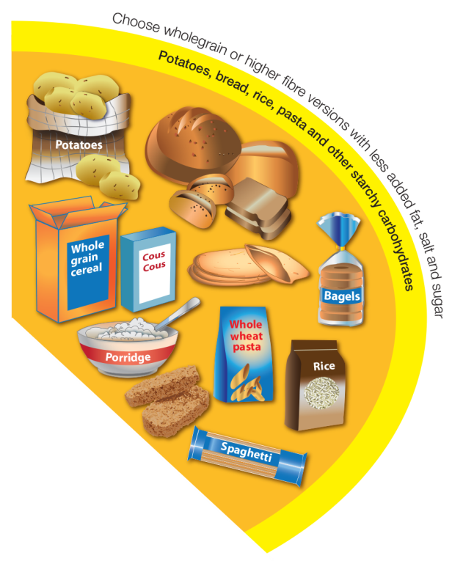
Potatoes, bread, rice, pasta and other starchy carbohydrates
This food group is the main source of carbohydrate.
Carbohydrate is the main source of energy for the body.

Slide 6
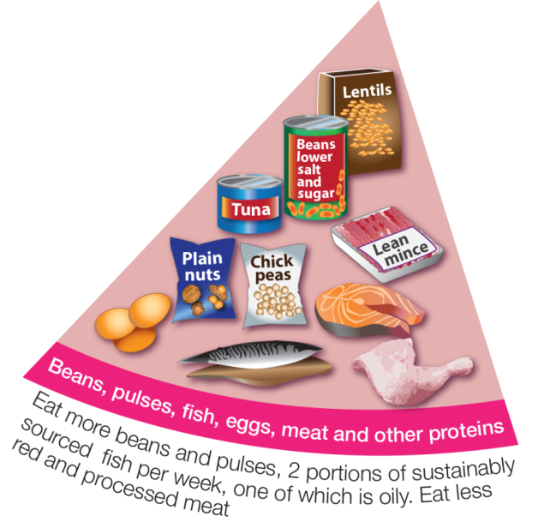
Beans, pulses, fish, eggs, meat and other proteins
This food group provides protein, as well as minerals.
Protein is needed for growth and repair.
One mineral needed is called iron. It is needed for healthy blood and helping to transport energy around the body.

Slide 7
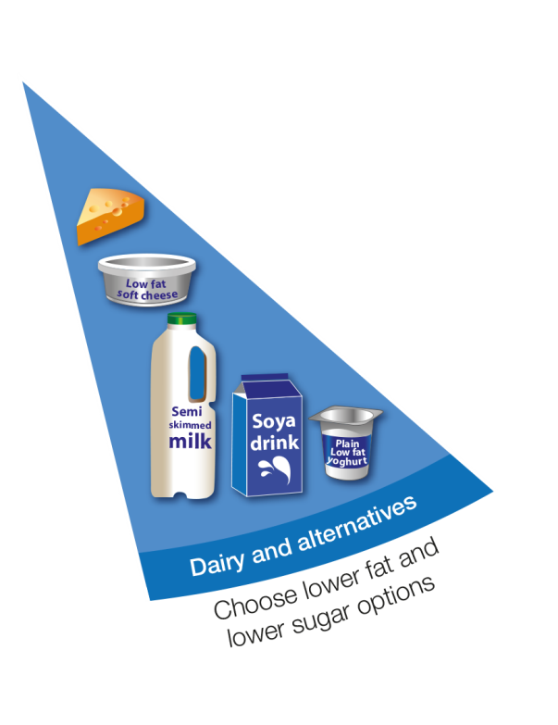
Dairy and alternatives
This food group provides a range of minerals.
Calcium is a mineral which is needed for the growth and maintenance of strong bones and teeth.

Slide 8
Oil and spreads
Oil and spreads are types of fat.
Fat is needed for health, but in small amounts.

Slide 9
Foods high in fat, salt and sugars
The Eatwell Guide includes another group of foods that sit outside of the main image.
This group is the foods high in fat, salt and/or sugars.
These foods are not needed in the diet so, if they are included, they should only be eaten infrequently and in small amounts.

Slide 10
Fibre
Fibre helps keep the digestive system healthy.
Fibre can be found in food from the:
fruit and vegetable food group;
potatoes, bread, rice, pasta and other starchy carbohydrates food group;
beans, pulses, fish, eggs and meat food group (in the beans and pulses).

Slide 11
Water
We need water to stay alive.
Water is found in food and in drinks.
In addition to any water provided in the food we eat, such as fruit and vegetables, we also need at least 6-8 drinks every day – more when we are active, or the weather is warm.

Slide 12
Nutrients
The main nutrients are:
Carbohydrate (including fibre);
protein;
fat;
vitamins, e.g. vitamin A, vitamin C;
minerals, e.g. calcium, iron.

Slide 13
Energy and nutrients
The following main nutrients are also a source of energy for the body:
carbohydrate;
protein;
fat.
The following nutrients are not a source of energy for the body, but are important to keep the body healthy:
vitamins, e.g. vitamin A, vitamin C;
minerals, e.g. iron, calcium.

Slide 14
Nutrients
For further information, go to:
www.foodafactoflife.org.uk
This resource meets the Guidelines for producers and users of school education resources about food.

