Slide 1
Finnish fruit plait
Complexity: medium

Slide 2
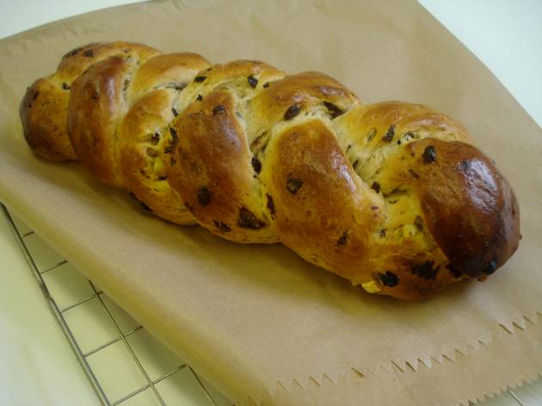

Slide 3
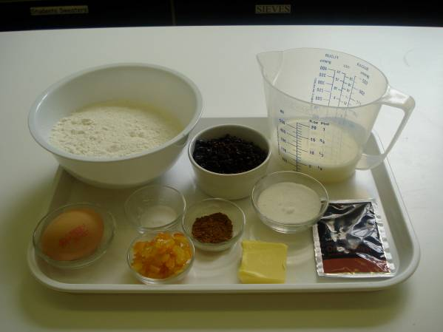
Ingredients
250g white strong plain flour
1 x 15ml spoon mixed spice or cinnamon
½ x 5ml spoon salt
75g currants
25g mixed peel
1 x sachet quick acting yeast (7g)
25g caster sugar
15g butter or soft spread
125ml lukewarm milk
1 egg (medium)

Slide 4
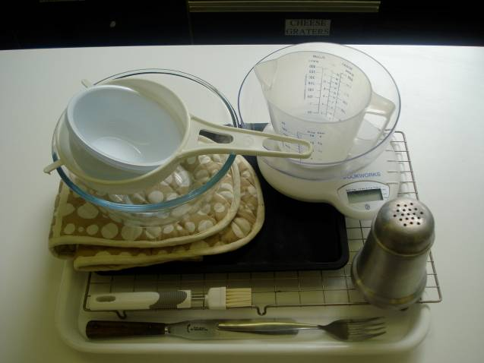
Equipment
Baking tray
Pastry bush
Weighing scales
Sieve
Mixing bowl
Measuring jug
Palette knife
Small bowl
Fork
Flour dredger
Cooling rack

Slide 5
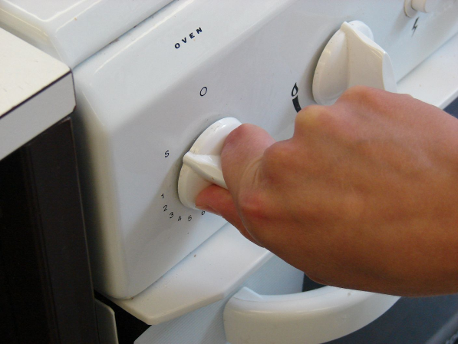
Method
Preheat the oven to 200°C or gas mark 6.

Slide 6
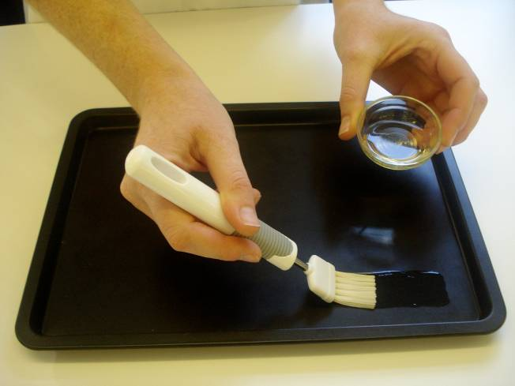
Grease or line the baking tray.

Slide 7
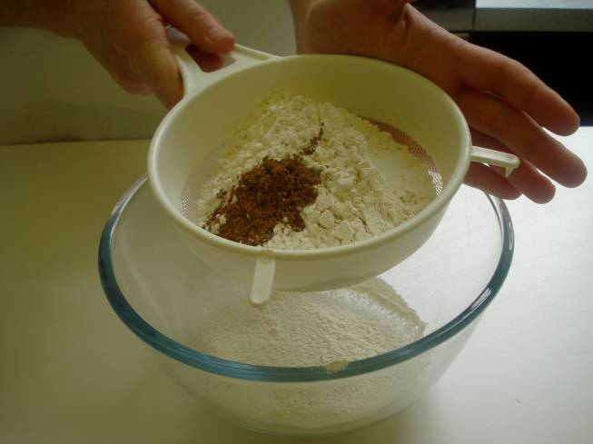
Sift the flour and spice into the mixing bowl and add salt.

Slide 8
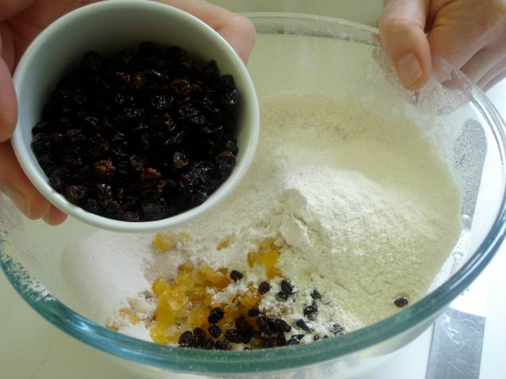
Stir in the currants, peel and yeast.

Slide 9
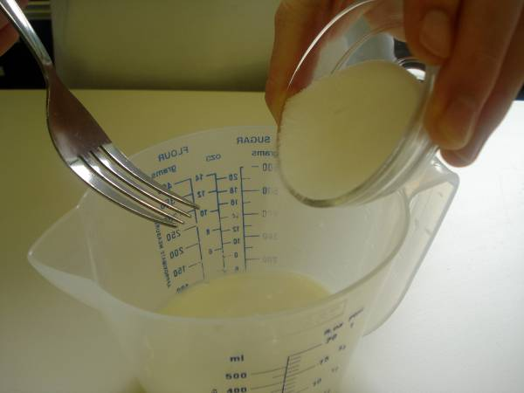
Stir the sugar into the milk in the measuring jug. Stir until the sugar has dissolved.

Slide 10
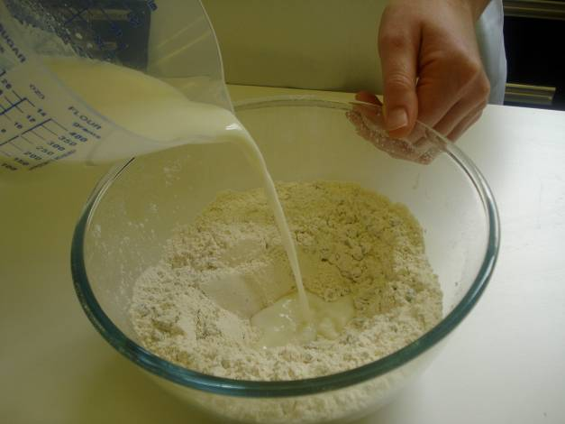
Make a well in the centre of the flour and pour in the milk.

Slide 11
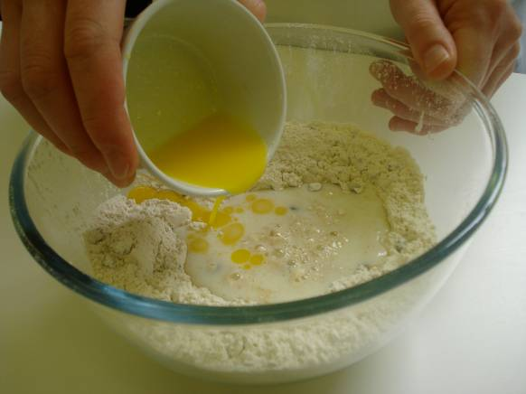
Melt the butter or spread and add to the flour.

Slide 12
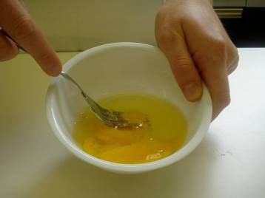
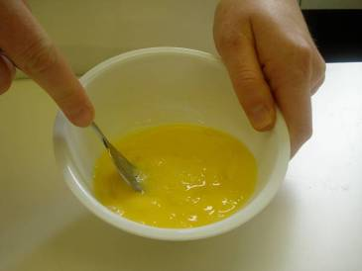
Break the egg into the small bowl and beat with the fork.

Slide 13
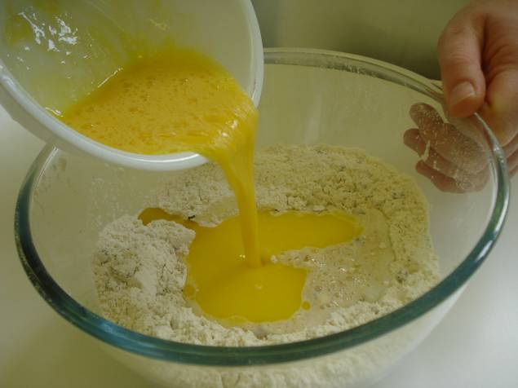
Add half the beaten egg.

Slide 14
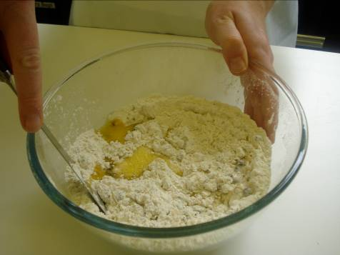
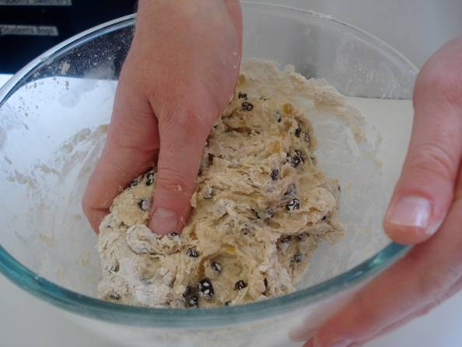
Mix to a soft dough using the palette knife.

Slide 15
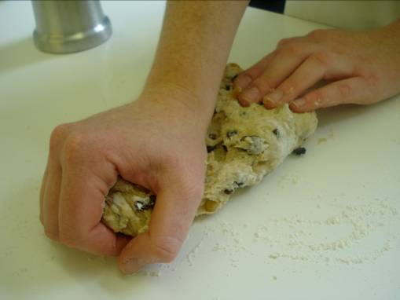
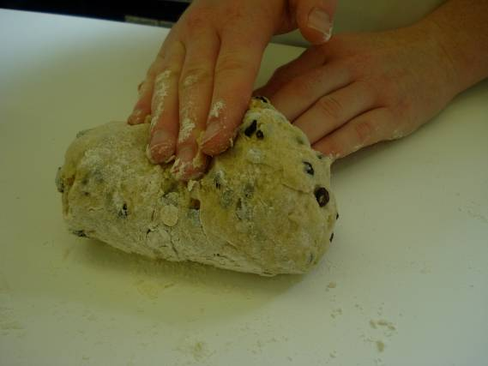
Turn out onto the lightly floured surface and knead for 5 minutes.

Slide 16
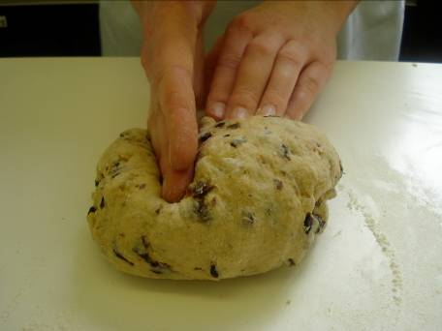
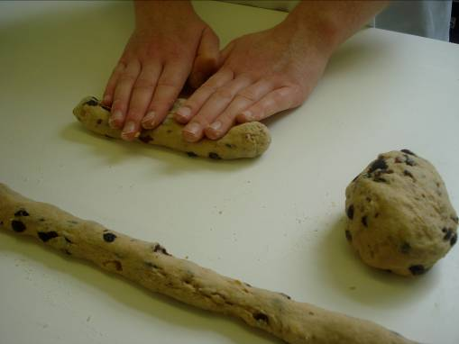
With lightly floured hands, divide the mixture into three portions and roll into sausage shapes the length of the baking tray.

Slide 17
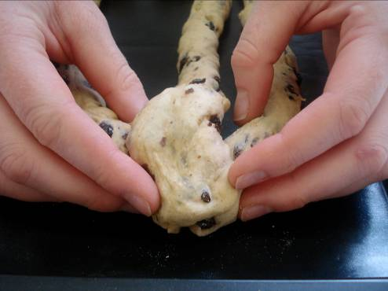
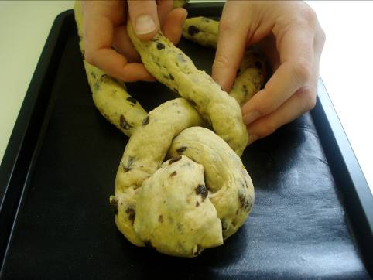
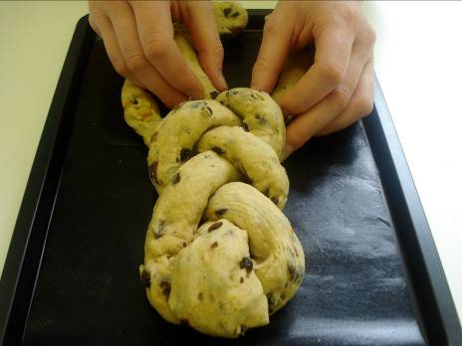
Place the lengths onto the baking tray and neatly plait together, tucking in the ends.

Slide 18
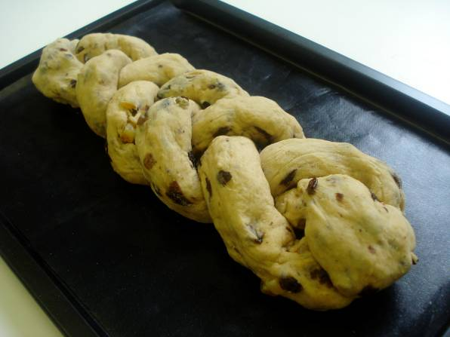
Cover the plait with cling film and leave in a warm place to prove until doubled in size.

Slide 19
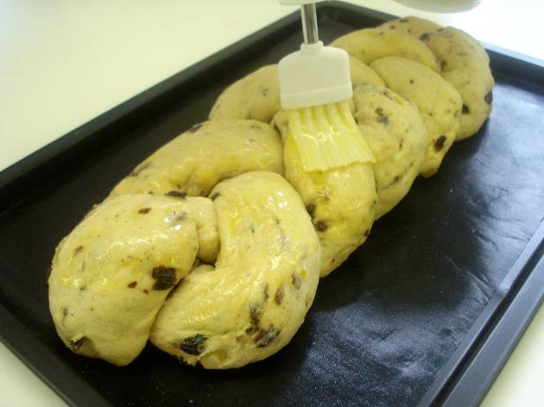
Brush with the remaining egg.

Slide 20
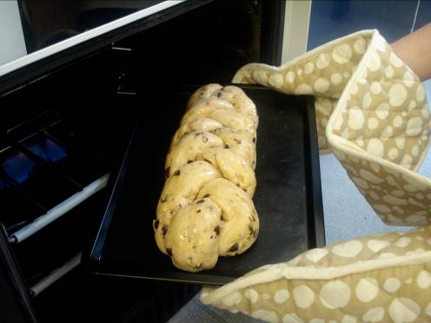
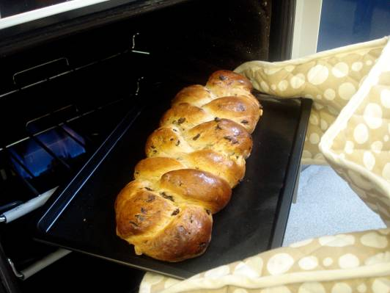
Bake for 10 minutes. Reduce the oven temperature to 170°C or gas mark 4, and bake for a further 10-15 minutes.

Slide 21
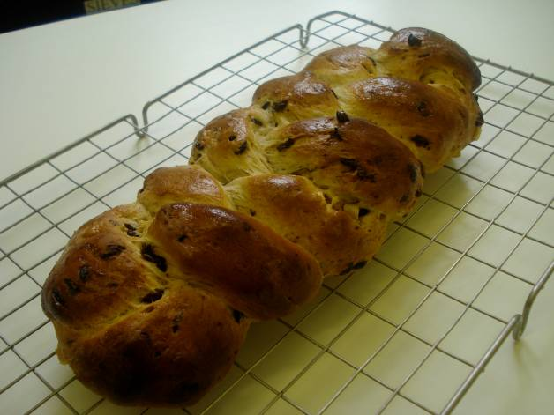
Remove the plait and transfer to the cooling rack.

Slide 22
Top tips
Food skills
A thin icing may be made to cover the plait for an occasional treat.
The dough can be divided into smaller portions to create mini fruit plaits. These will cook slightly quicker if you are limited on time.
Weigh.
Measure.
Sift.
Mix, stir and combine.
Melt.
Beat.
Knead.
Prove.
Form and shape.
Glaze.
Bake.

Slide 23
Finnish fruit plait
For further information, go to:
www.foodafactoflife.org.uk

