Slide 1
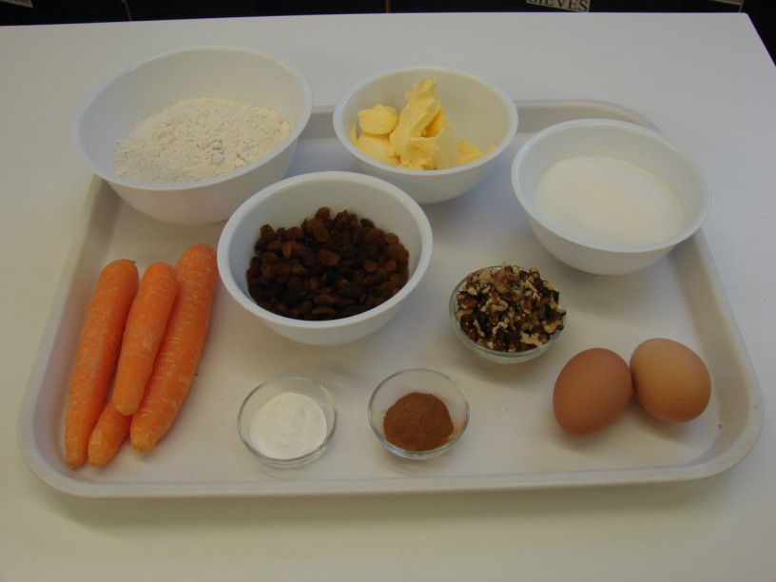
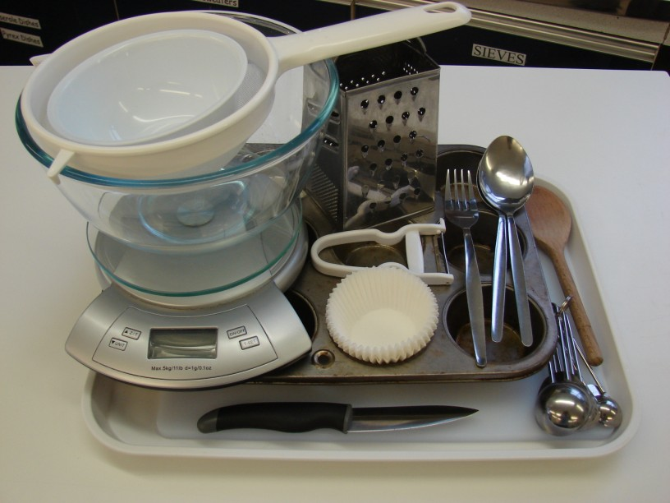
This recipe is from the original Licence to Cook programme and is provided under the Open Government Licence.
Mini carrot cakes
Ingredients
150g butter or soft baking spread
250g carrots
200g sugar
200g flour
2 x 5ml cinnamon
2 x 5ml baking powder
2 large eggs
125g sultanas
50g nuts
Equipment
Chopping board
Knife
Vegetable peeler
Grater
Measuring spoons
Weighing scales
Small bowl
Mixing bowl
Wooden spoon
Sieve
Muffin tray
12 muffin cases
2 large spoons
Fork
© Food – a fact of life 2019
www.foodafactoflife.org.uk

Slide 2
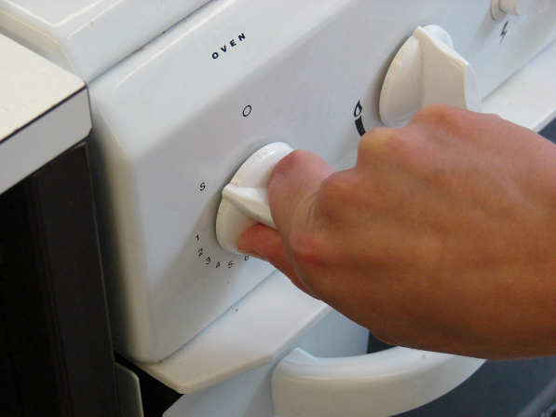
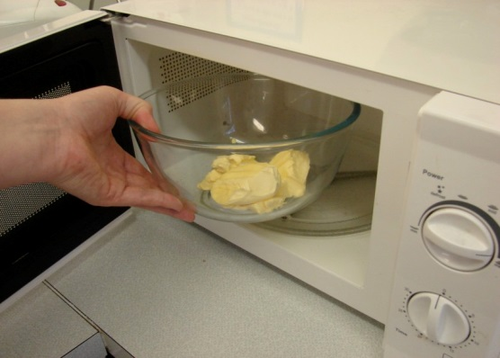
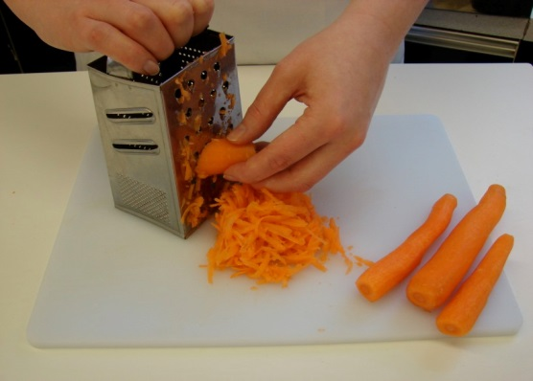
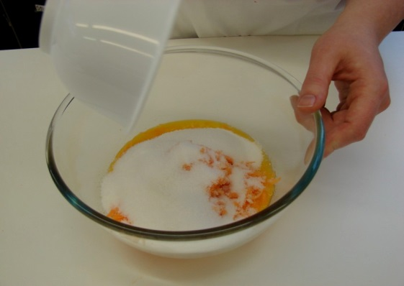
This recipe is from the original Licence to Cook programme and is provided under the Open Government Licence.
Method
Preheat oven to 200°C or gas mark 6.
Melt the fat in the microwave.
Top and tail and then peel and grate the carrots.
Combine the carrots, sugar and fat in the mixing bowl.
© Food – a fact of life 2019
www.foodafactoflife.org.uk

Slide 3
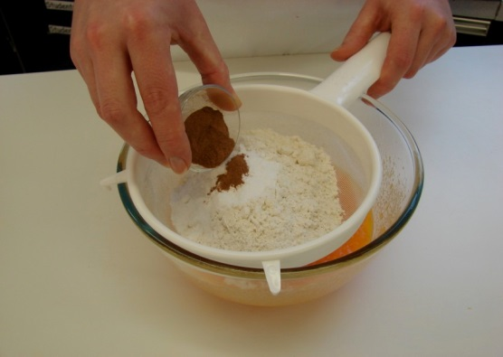
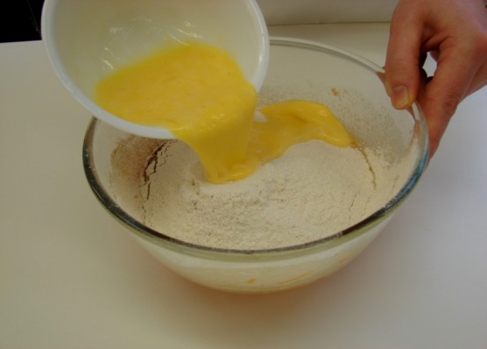
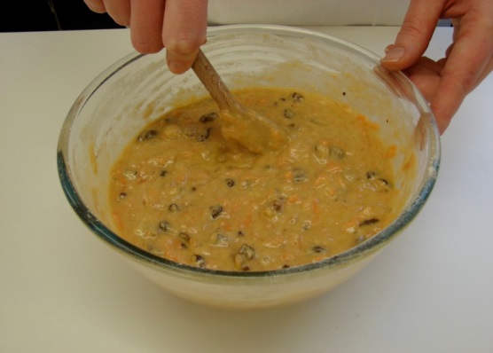
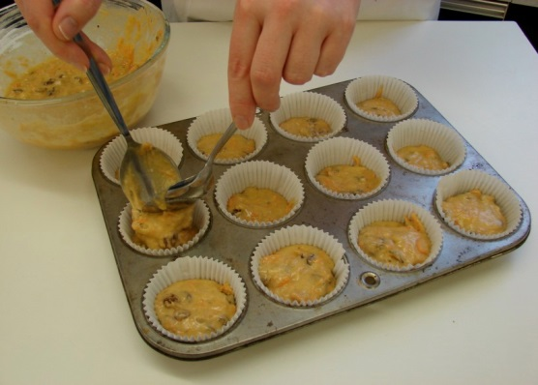
This recipe is from the original Licence to Cook programme and is provided under the Open Government Licence.
Method
Sift in the flour, cinnamon and baking powder.
Beat the eggs in a small bowl, and then add to the mixture.
Mix in the sultanas and nuts.
Divide the mixture equally between the muffin cases, using the 2 metal spoons.
© Food – a fact of life 2019
www.foodafactoflife.org.uk

Slide 4
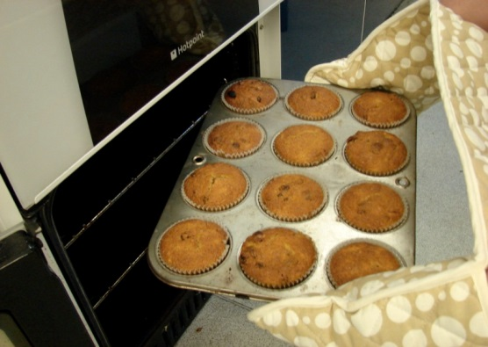
This recipe is from the original Licence to Cook programme and is provided under the Open Government Licence.
Method
Bake for 20 minutes.
© Food – a fact of life 2019
www.foodafactoflife.org.uk

