Slide 1
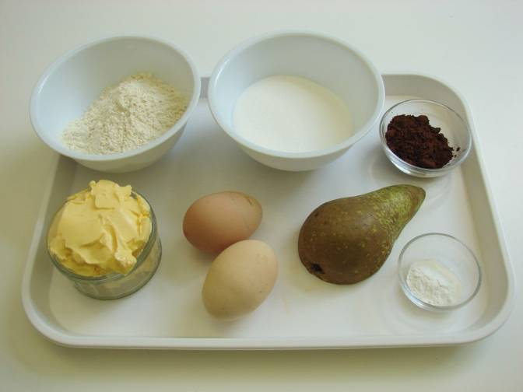
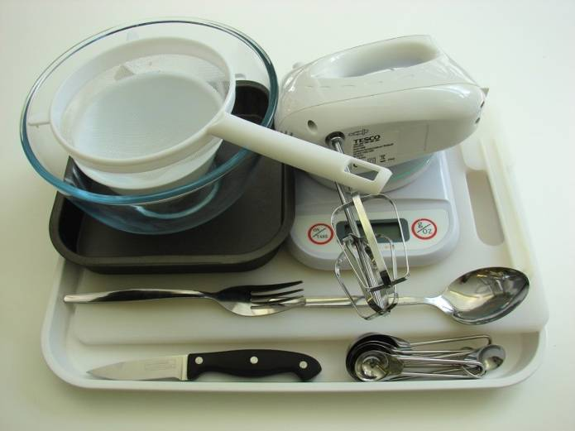
This recipe is from the original Licence to Cook programme and is provided under the Open Government Licence.
Marble pear tray bake
Ingredients
100g caster sugar
100g butter or soft baking spread
2 eggs
100g self raising flour
1 x 15ml spoon coca powder
1 x 5ml spoon baking powder
½ pear
Equipment
Baking tin (20cm square) or foil tray
Weighing scales
Mixing bowl
Electric hand whisk
Small bowl
Fork
Sieve
Spoon
Chopping board
Knife
© Food – a fact of life 2019
www.foodafactoflife.org.uk

Slide 2
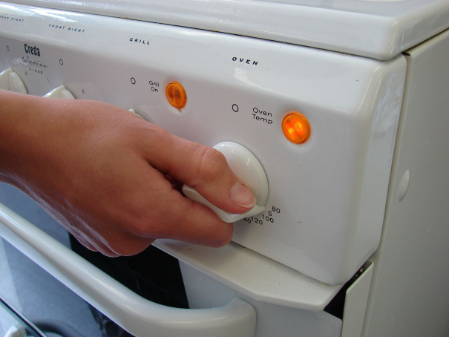
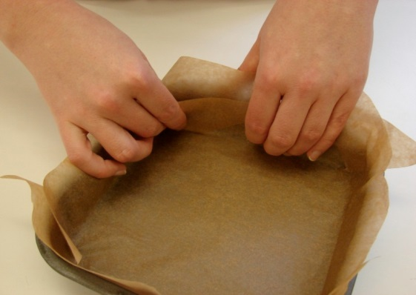
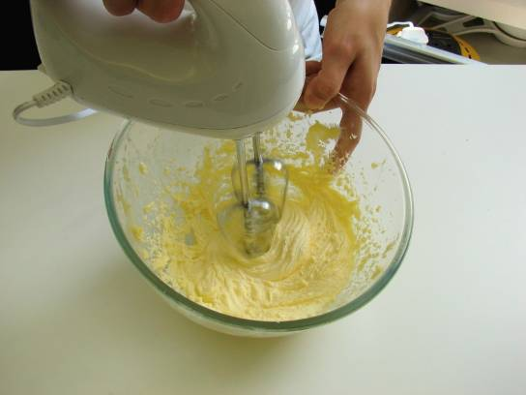
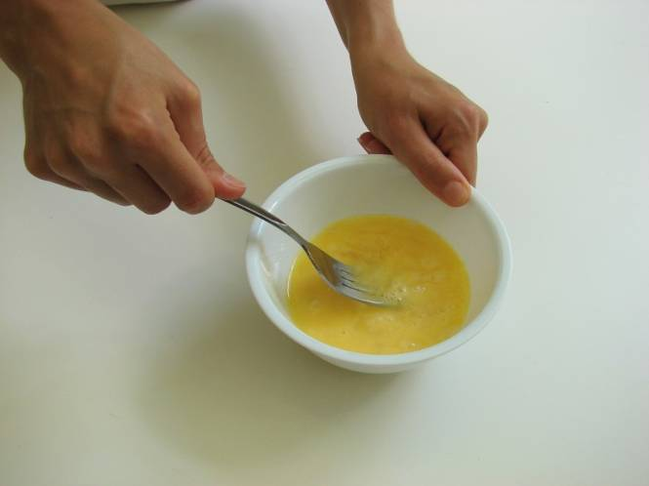
This recipe is from the original Licence to Cook programme and is provided under the Open Government Licence.
Method
Preheat the oven to 180°C or gas mark 4.
Grease and line the cake tin.
Cream the sugar and fat together, ideally using an electric hand whisk, until light and fluffy.
In a small bowl, beat the eggs with a fork.
© Food – a fact of life 2019
www.foodafactoflife.org.uk

Slide 3
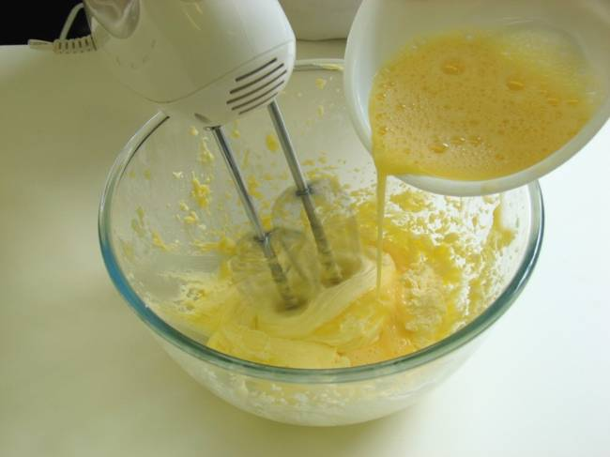
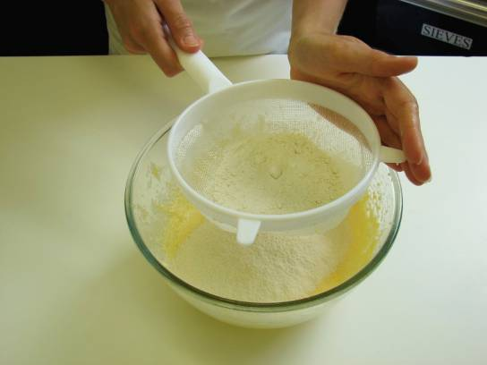
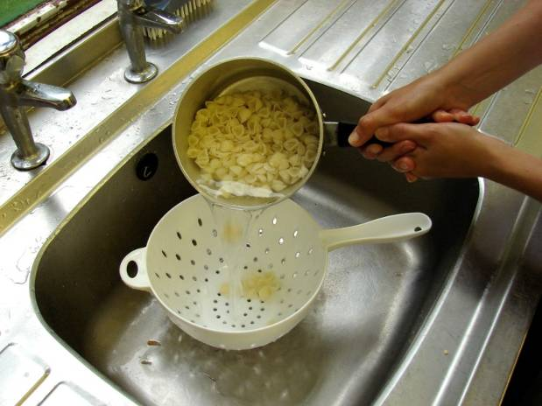
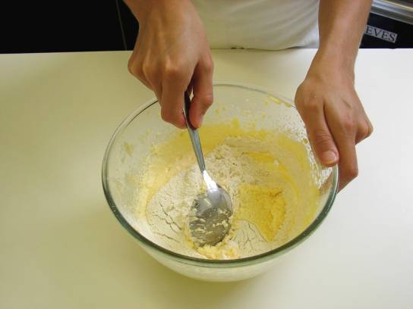
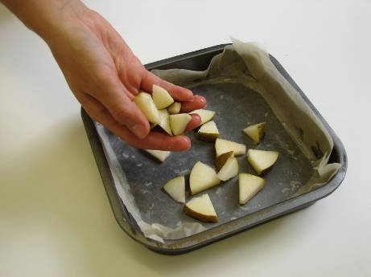
This recipe is from the original Licence to Cook programme and is provided under the Open Government Licence.
Method
Add the beaten egg, a little at a time, to the fat and sugar.
Sieve the flour and baking powder into a bowl.
Slice the pepper into small strips.
Fold the flour and baking powder into the mixture, a spoonful at a time.
Core and chop the pear into small pieces. Scatter pieces of pear into the lined cake tin.
© Food – a fact of life 2019
www.foodafactoflife.org.uk

Slide 4
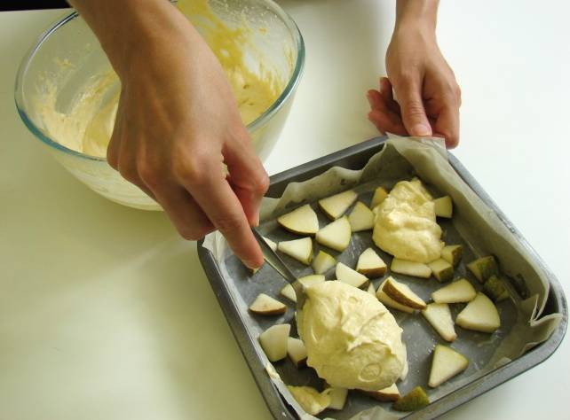
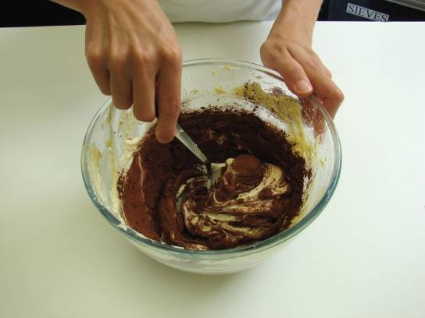
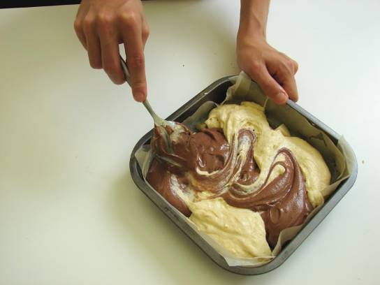
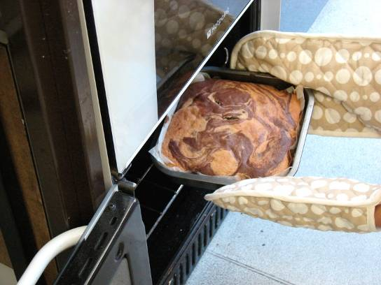
This recipe is from the original Licence to Cook programme and is provided under the Open Government Licence.
Method
Spoon half of the cake mixture into the tin.
Stir in the cocoa to the remaining cake mixture.
Slice the pepper into small strips.
Spoon the chocolate mixture into the baking tin and then swirl the two mixtures together to create a marble effect.
Place in the oven and bake for 20 minutes, until golden brown and springy to the touch.
© Food – a fact of life 2019
www.foodafactoflife.org.uk

