Slide 1
Wheat farming in the UK

Slide 2
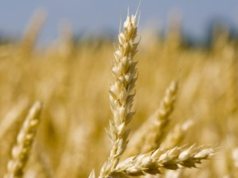
Wheat farming
UK farmers supply most of the requirements of UK millers.
Flour millers depend on farmers to grow enough grain of the right type for milling different kinds of flour.
Most flour produced in the UK is milled from wheat, although small quantities of rye and oats are also milled to make flour.

Slide 3
Wheat farming
Over the last forty years, there have been big improvements in the quality of wheat produced in the UK, meaning that millers now source more than 80% of their supplies from British farmers, compared with less than half that in the late 1970s.
UK growers now produce 14-15 million tonnes of wheat each year, supplying approximately 5 million tonnes to the British milling industry, and also exporting to millers overseas.
Total wheat production in Britain was less than 5 million tonnes in the early 1970s.

Slide 4
Varieties of wheat
Different varieties of wheat are suited to different types of flour, meaning that farmers have to be careful about selecting the right wheat to grow, and then keeping varieties separate at harvest time and in store.
Other key considerations are:
achieving the right technical standards (for example in relation to grain protein content);
making sure it is kept free of insects, other pests and potentially harmful contaminants;
and protecting the environment by ensuring correct usage of fertiliser and pesticides (if necessary).

Slide 5
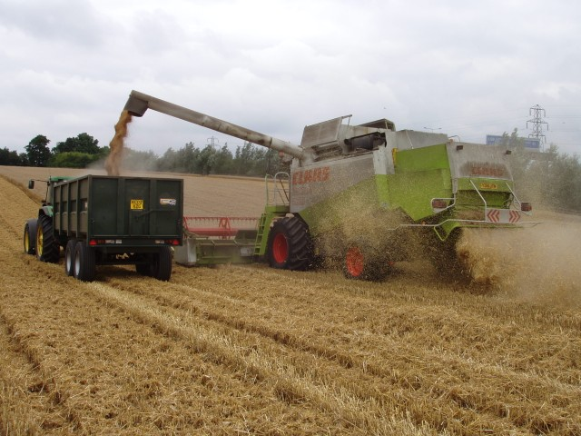
Types of wheat
Most wheat grown in the UK is winter wheat. This is planted in the autumn, generally between September and November. Winter wheat accounts for more than 95% of the UK grain used by millers.
Grain planted in January-March is generally spring wheat. This tends to yield less, but can suit some farms well. Wheat imported from North America, which accounts for 600-700 thousand tonnes each year, is spring wheat used to make breadmaking flour.

Slide 6
Why is wheat imported?
Traditionally, millers used wheat from North America, especially Canada, because it is ideal for making the high risen bread enjoyed in the UK.
Wheat of this type still accounts for a proportion of the breadmaking grist (a grist is the blend of wheat used to make flour).
However, working together, plant breeders, farmers, millers and bakers have found ways to improve the standard of UK grain and adjust the baking process so that a greater proportion of home-grown wheat can be used.
This has had benefits for UK farmers, in that they have a bigger market for their produce, and consumers since imported wheat is more expensive than home-grown. There are advantages for everyone in the chain associated with local supply rather than using imported material: for example transport costs are lower and traceability is easier.

Slide 7
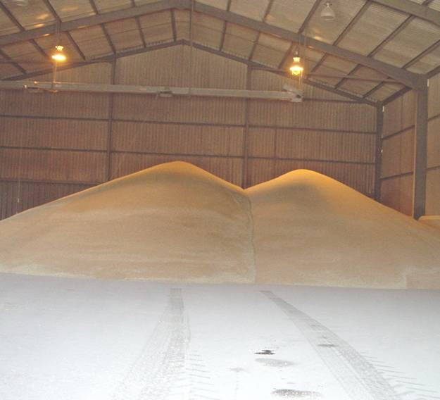
Wheat production
The ‘grain chain’, describes the series of steps involved in producing flour. It can also be extended to include dishes made from flour, such as bread.
There are 3 stages of processing:
• Growing, harvesting
• Primary processing: cleaning, milling.
• Secondary processing: mixing, slicing, proving and baking.

Slide 8
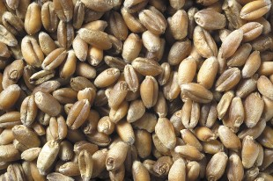
Wheat production
Wheat is sown on two fifths of Britain’s arable land, resulting in a total harvest of 15-17 million tonnes per year.
In the UK, wheat is sown in September, October and November and harvested the following August or September. The harvesting process removes the grains from the plant.
The grain is stored, and when needed transported to the mill.

Slide 9
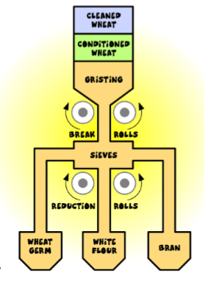
Primary processing
At the mill the wheat is cleaned and conditioned.
Powerful magnets, metal detectors and other machines extract metal objects, stones and other grains and small seeds from the wheat grain. Throughout the cleaning process, air currents lift off dust and chaff.
Conditioning with water softens the outer pericarp (bran) layer of the wheat and makes it easier to remove the floury endosperm during milling.

Slide 10
Primary processing
The wheat is blended with other types of wheat in a process called gristing to make different kinds of flour.
Occasionally, wheat gluten is added to increase the protein content of milled flours.
The grist is passed through a series of fluted 'break' rolls rotating at different speeds.
These rolls are set so that they do not crush the wheat but shear it open, separating the white, inner portion from the outer skins.

Slide 11
Primary processing
The fragments of wheat grain are separated by a complex arrangement of sieves.
White endosperm particles are channelled to a series of smooth 'reduction' rolls for final milling into white flour.

Slide 12
Primary processing
The bran, wheatgerm and endosperm have all been separated out. They can now be blended to make different types of flour.
Wholemeal flour uses all parts of the grain.
Brown flour contains about 85% of the original grain, but with some bran and germ removed.
White flour is made from the endosperm only.
The different flours are packaged and sent to the bakeries.

Slide 13
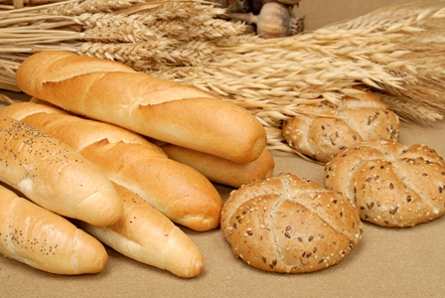
Secondary processing
Secondary processing uses products like flour and converts them into more complex foods like bread, biscuits and cakes.
For bread, this would include:
• Weighing and measuring
• Mixing
• Proving
• Shaping
• Baking

Slide 14
Wheat farming in the UK
For further information, go to:
www.foodafactoflife.org.uk

