Slide 1




Bread shapes
Knot
Hedgehog
Plait
Cottage

Slide 2
Food – a fact of life resources – wheat and dairy Claire Theobald British Nutrition Foundation

Slide 3
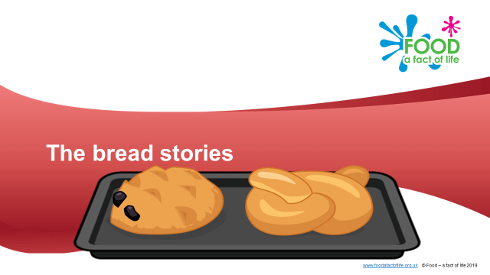
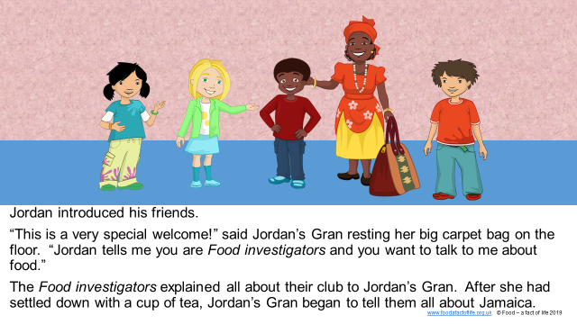
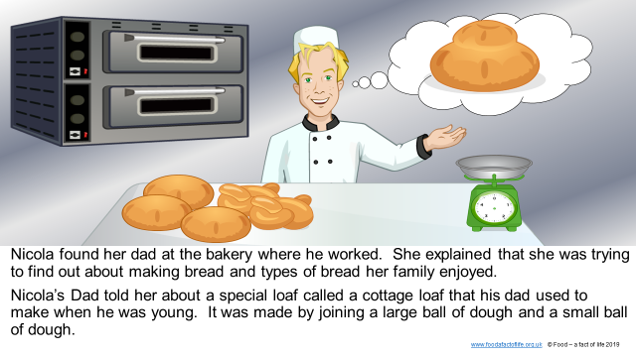
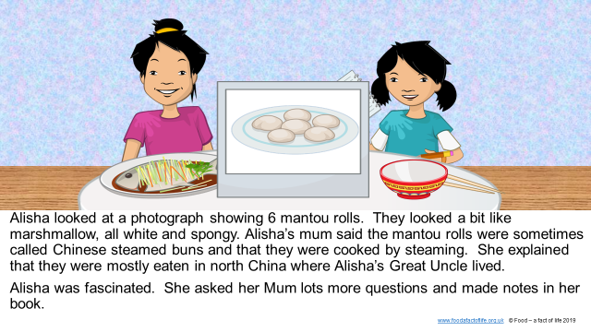
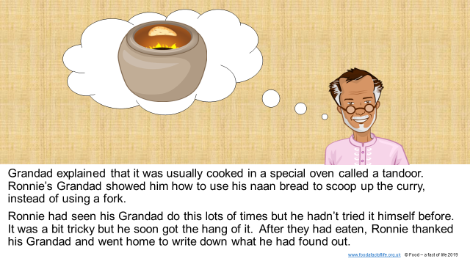
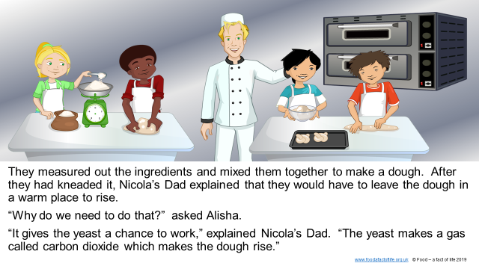
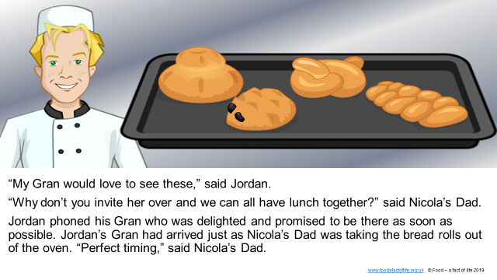
Learn with stories
Stories connecting where food comes from, cooking and healthy eating
Provide a ‘jumping off’ point for topics
Supplemented with activities to support cross-curricular learning, e.g. numeracy, literacy
To find these resources: 5-7 or 7-11 > Activity packs > Learn with stories (The bread stories and The farm visit)

Slide 4
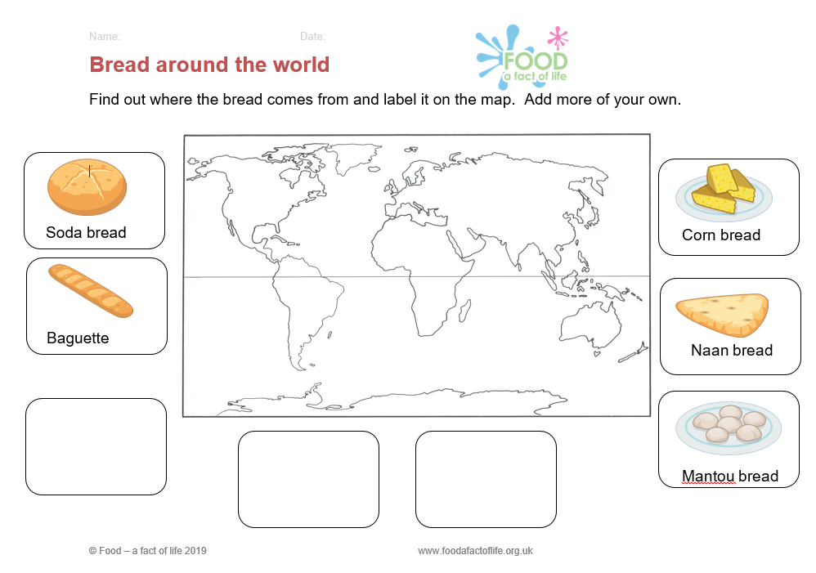
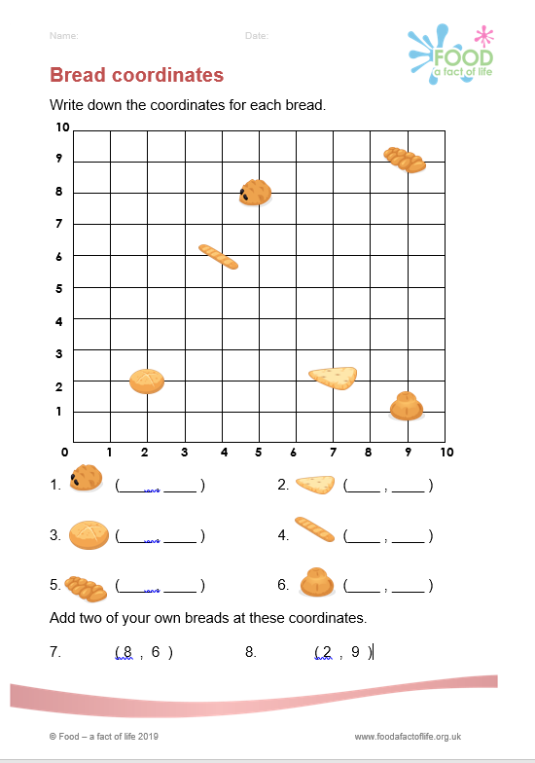
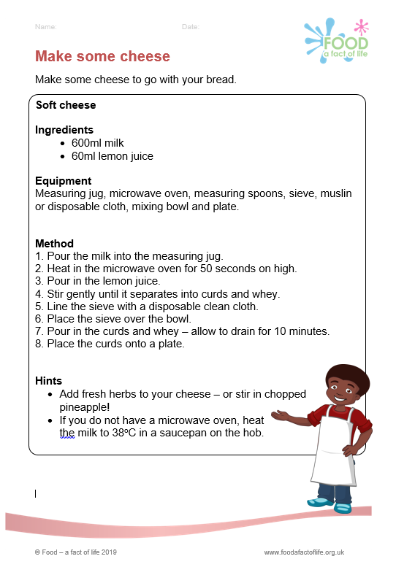
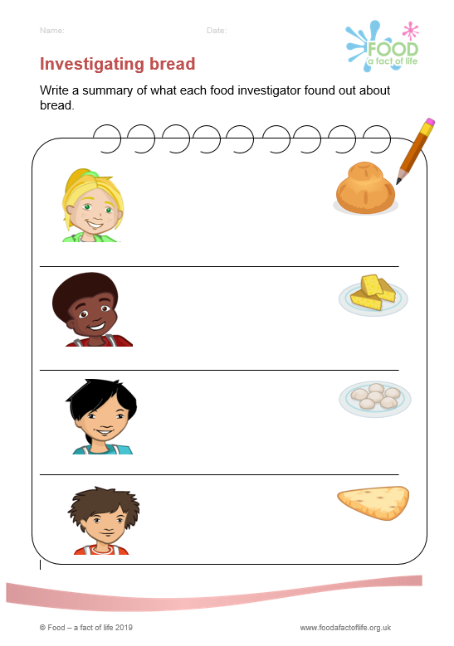
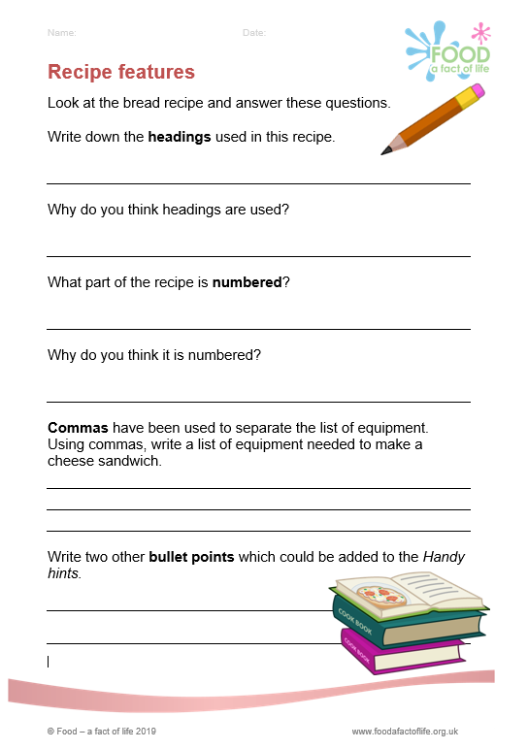
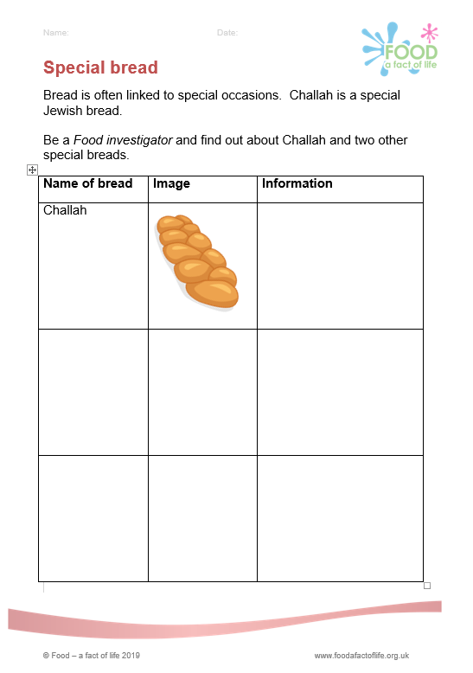

The bread stories- supplementary resources
To find these resources: 7-11 > Activity packs > Learn with stories (The bread stories )

Slide 5
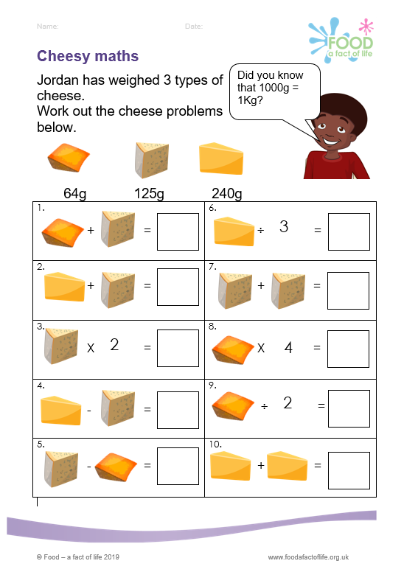
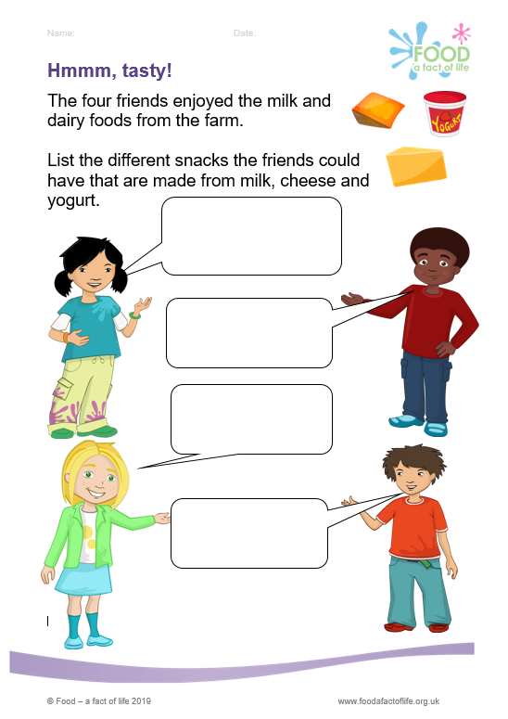
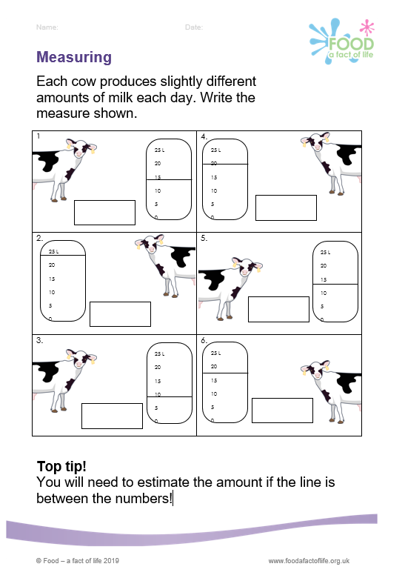
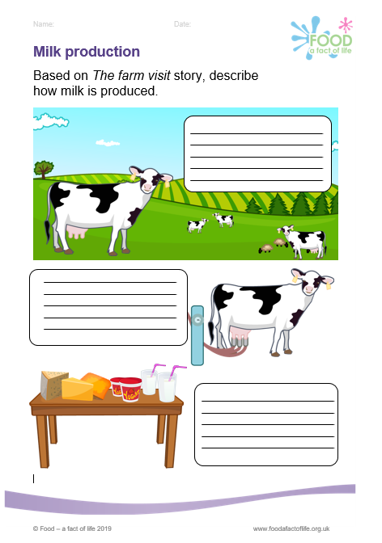
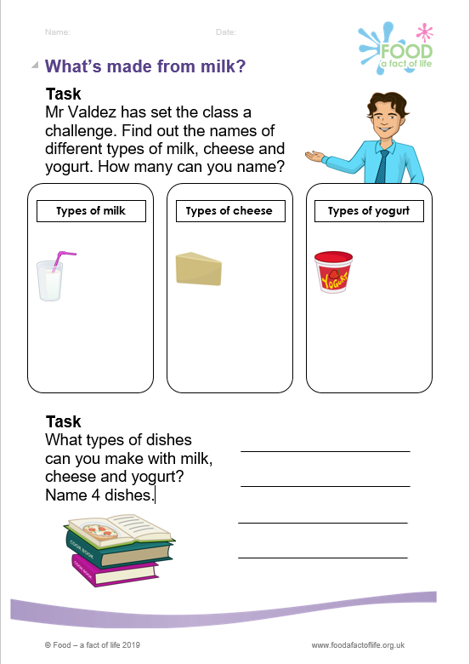
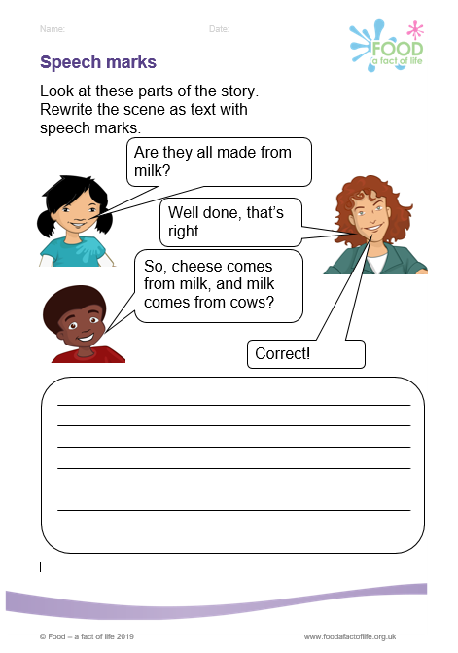
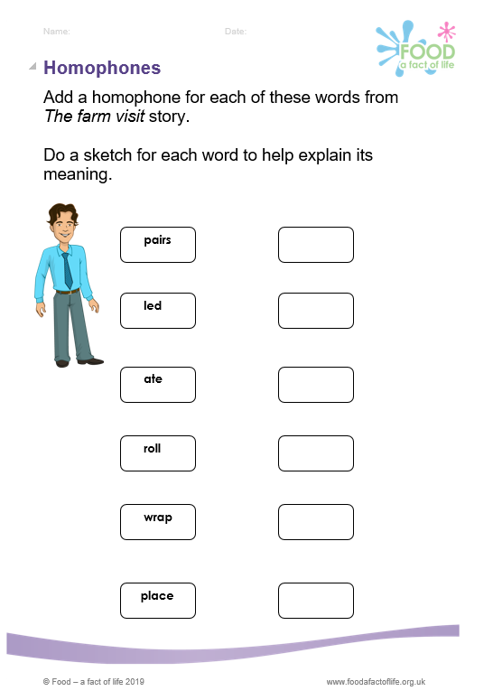
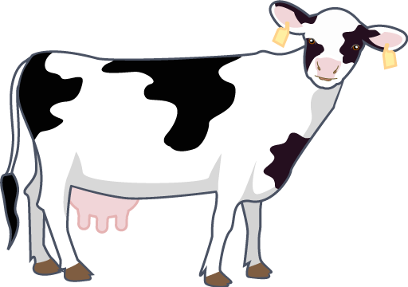
The farm visit - supplementary resources
To find these resources: 5-7 > Activity packs > Learn with stories (The farm visit)

Slide 6
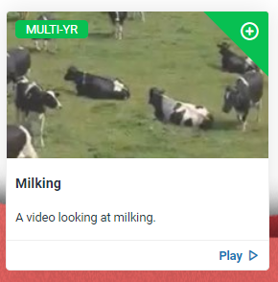
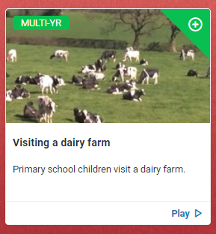
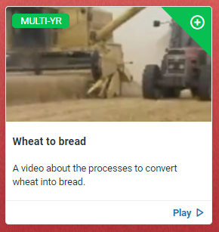
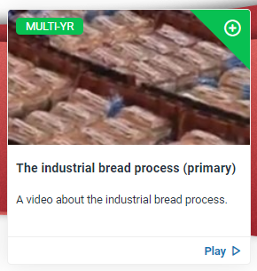
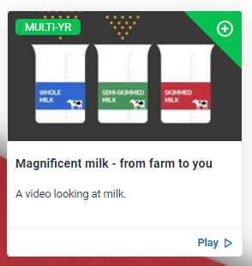
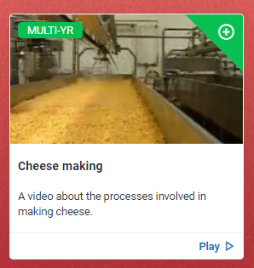
Videos
Dairy – milk, cheese
Wheat - bread
To find these resources: 7-11 > Where food comes from > Videos (Videos)

Slide 7
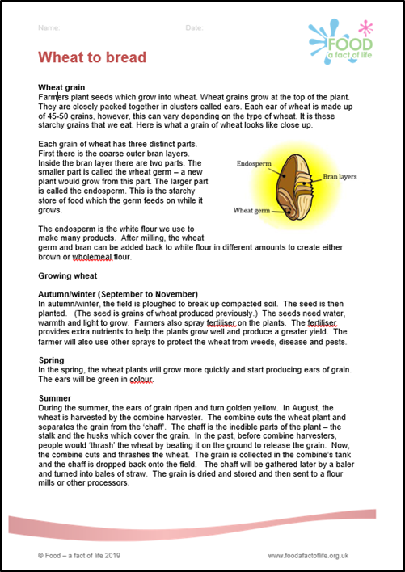
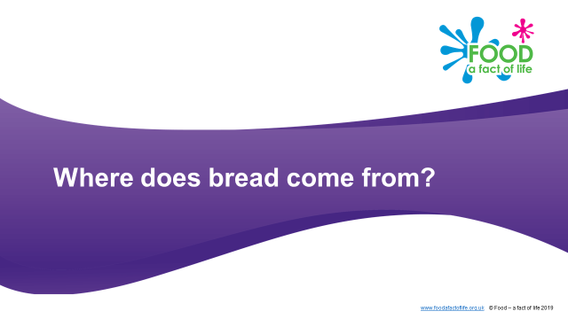
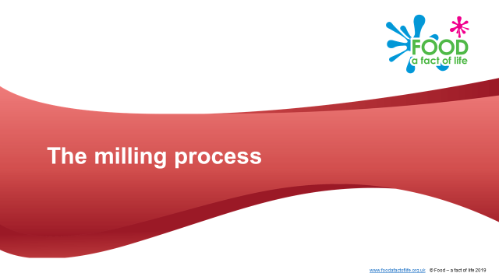
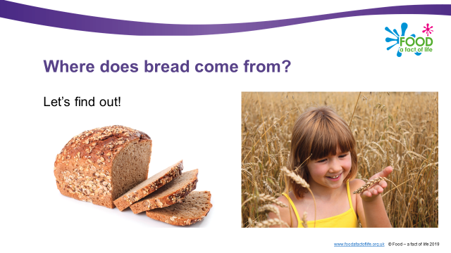
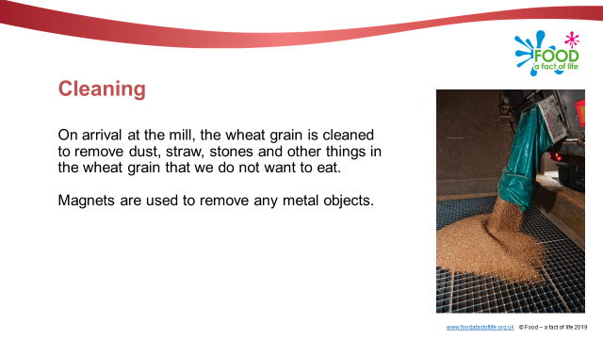
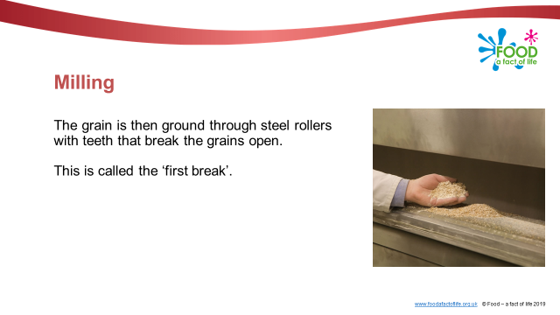
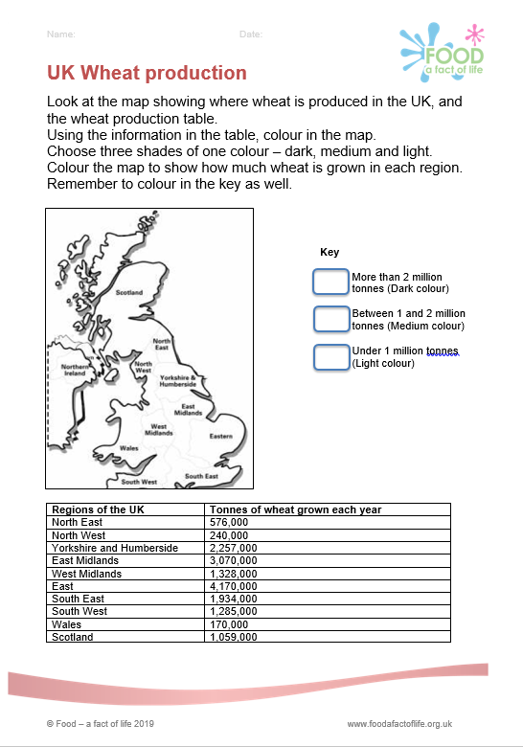
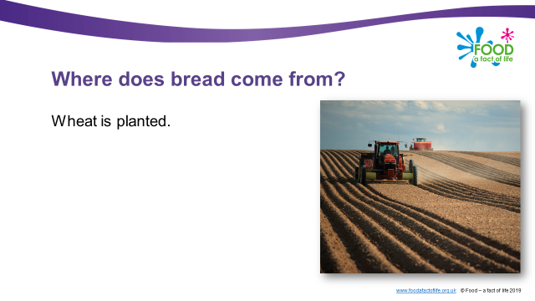
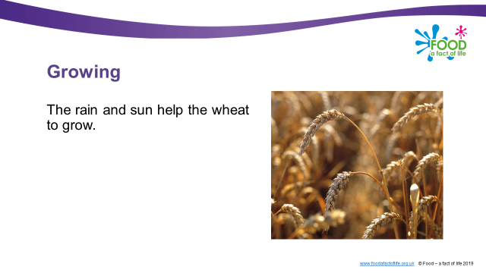
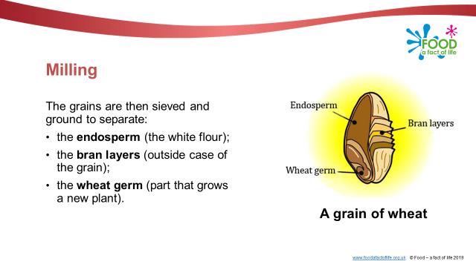
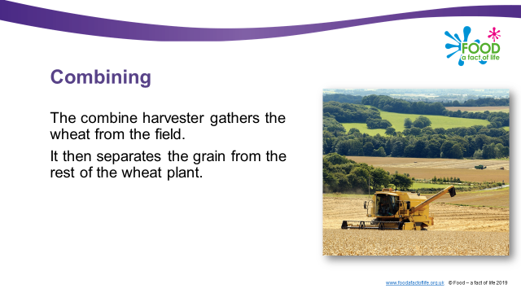
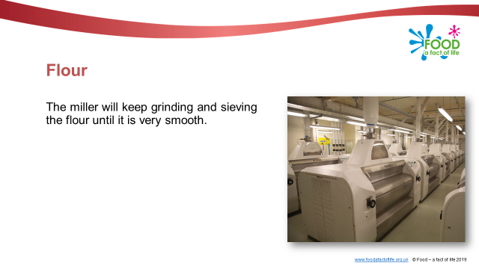
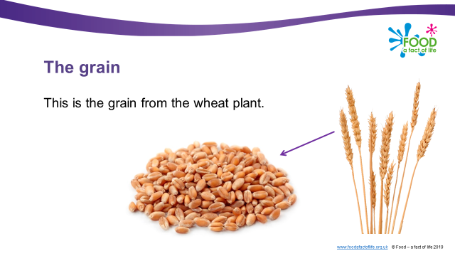
Food commodities – wheat
To find these resources: 5-7 or 7-11 > Food commodities > Cereals (5-7 and 7-11)

Slide 8
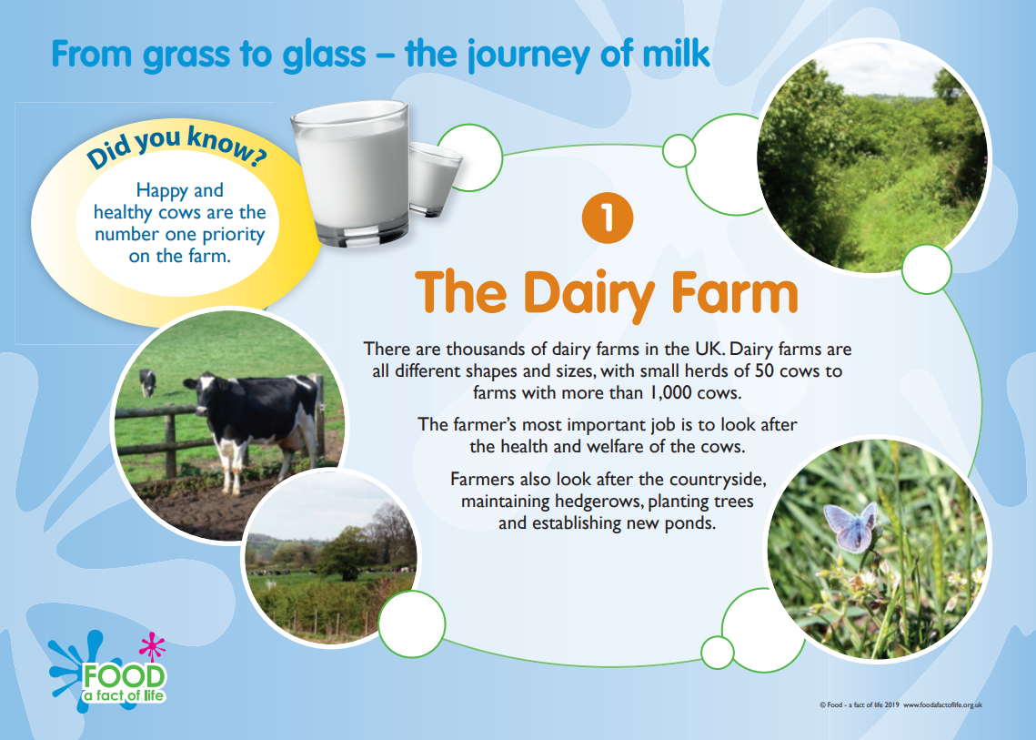
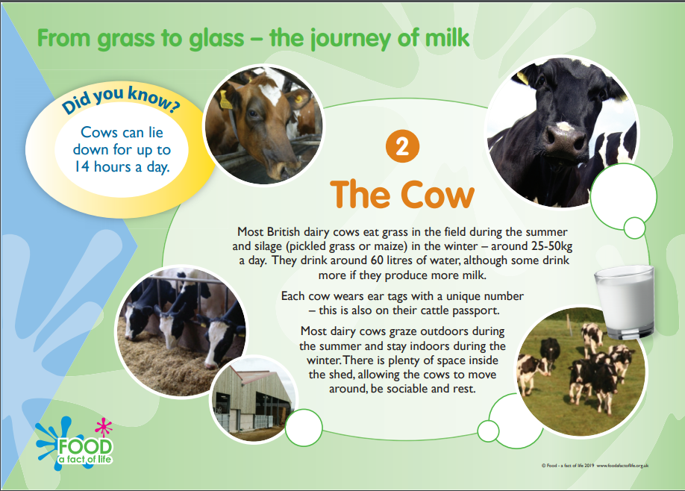
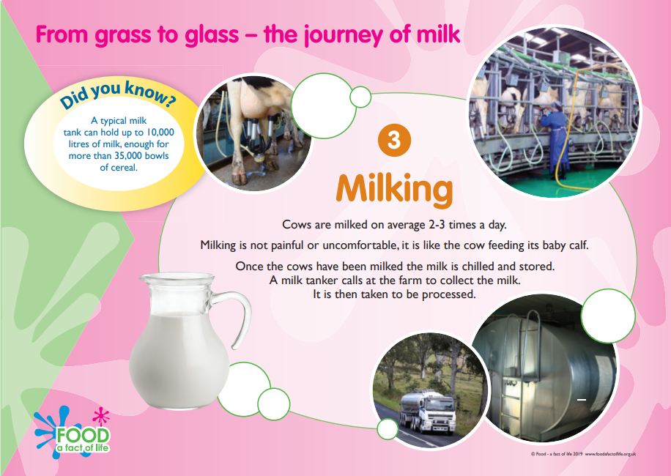
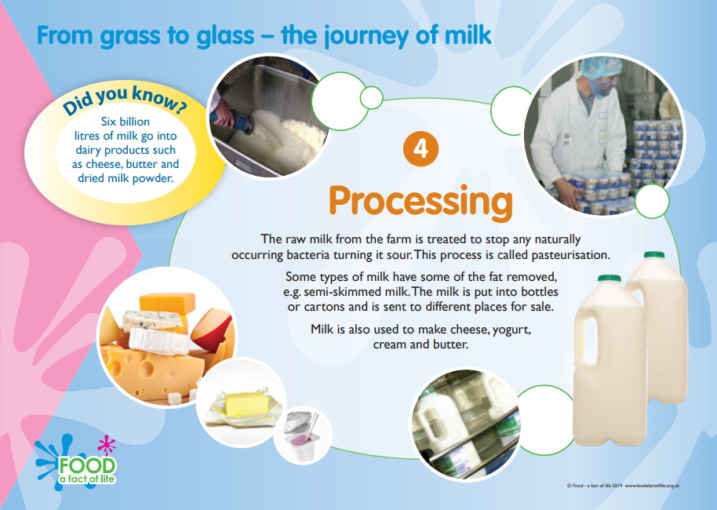
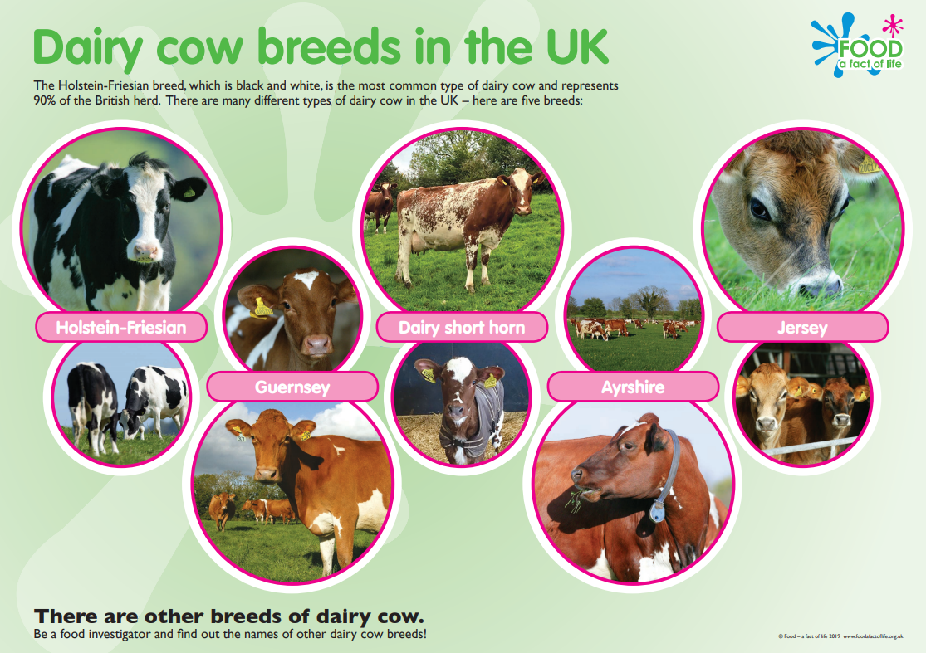
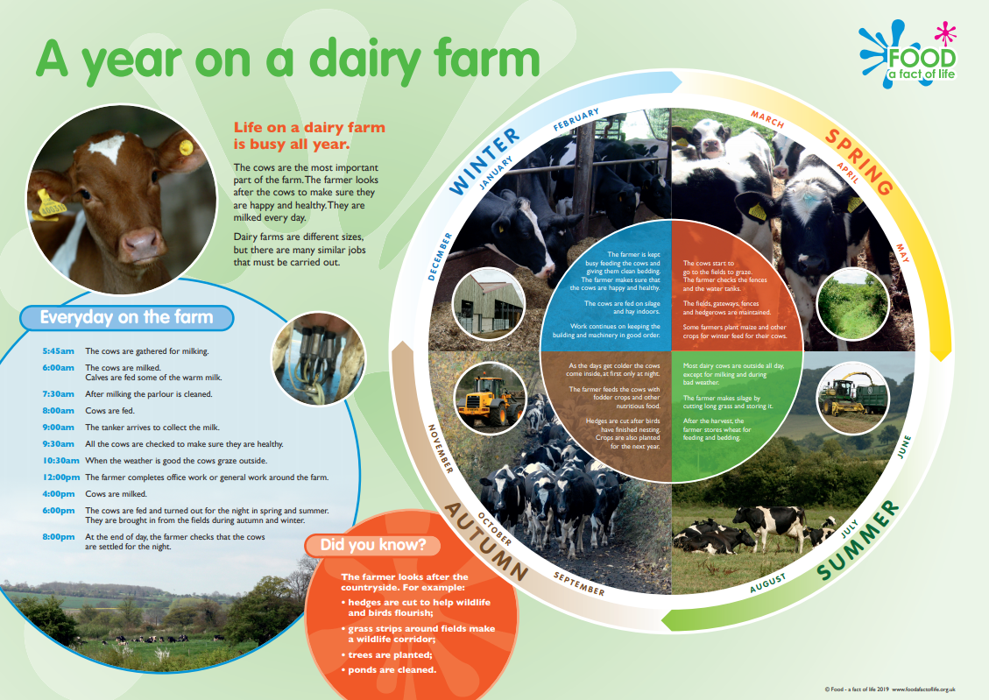
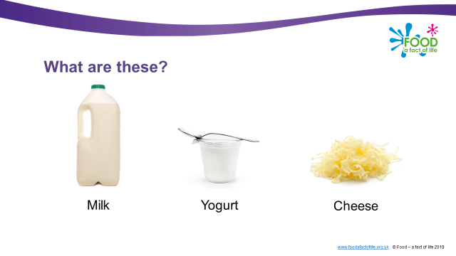

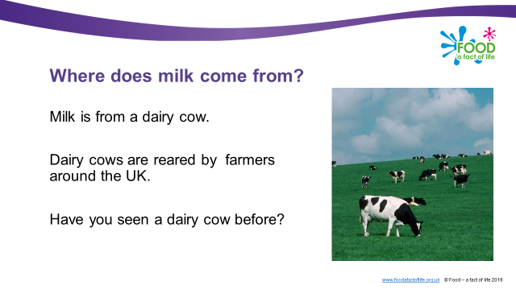
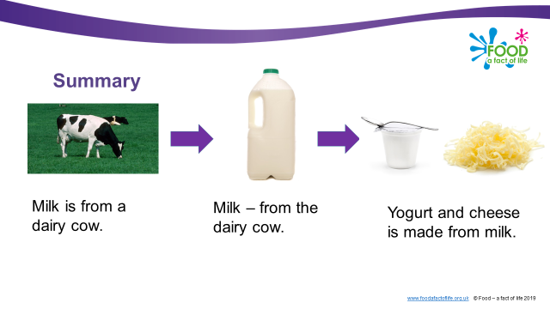
Food commodities - dairy
To find these resources: 5-7 or 7-11 > Food commodities > Dairy (5-7 and 7-11)

Slide 9
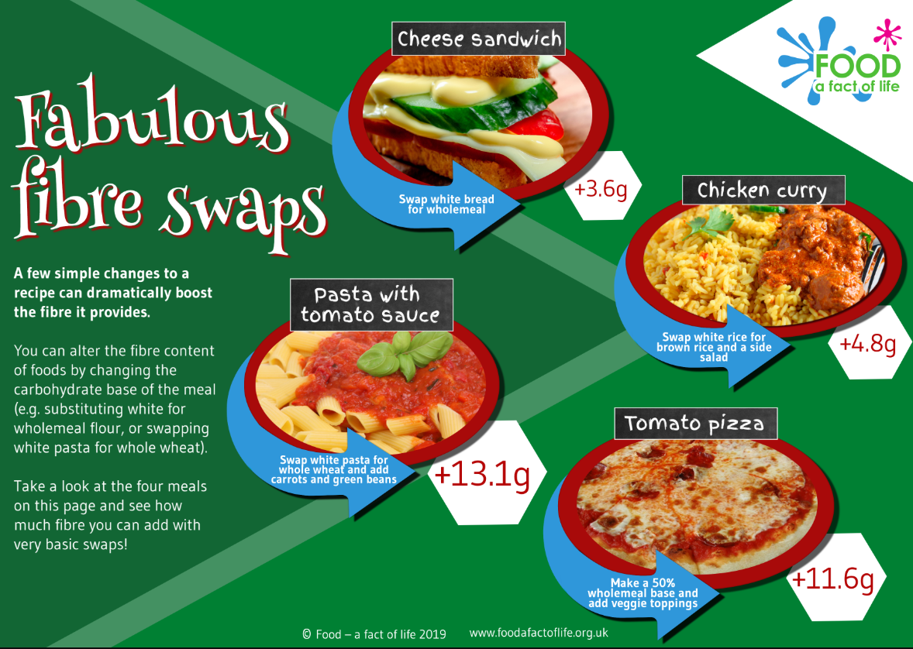





Fibre February
To find these resources: 5-7 or 7-11 > Activity packs > Fibre February

Slide 10








Recipes – wheat and dairy
To find these resources: Recipes (Use the search function). For video recipes: 5-7 and 7-11

Slide 11





Cooking resources
To find these resources: Professional development > Teaching and learning > Planning and teaching > Good food hygiene and safety practices

Slide 12






Tasting resources
Sensory vocabulary cards
Tasting ingredients worksheet
Cheese tasting worksheet
Tasting presentation
Sensory science (secondary) – useful background information, sensory evaluation tests
To find these resources: Use the search function at www.foodafactoflife.org.uk

Slide 13




Dashboard
Register - provide brief details and indicate areas of interest
What is the dashboard?
Register/log-in
Organise and store your resources!
Create a ‘collection’, e.g. Monday - HWB – P3
Find resources and use the top, right + button to add resources to your collections

Slide 14





BNF Healthy Eating Week 8-14 June 2020
Register and receive:
email updates to support planning for the Week;
links to downloadable resources;
a set of printed posters!
The challenges for 2020:
Eat more wholegrains
Vary your veg
Drink plenty
Move more
Be mind kind
Get active together
Eat together
Register at: www.healthyeatingweek.org.uk

Slide 15

Grow Your Own Potatoes
Free potato growing kits for primary schools!
Includes everything needed to grow two crops of potatoes:
instruction leaflet;
2 x nets of seed potatoes (national and regional);
2 x HADO grow-bags;
Chitting tray – built into the lid of the box.
Registration closes end of today! (1/2/20)
Each school can register for 4 kits for 4 classes (different teacher email address required for each).
www.growyourownpotatoes.org.uk

Slide 16

Thanks for listening!

Slide 17
Food – a fact of life resources – wheat and dairy
For further information, go to:
www.foodafactoflife.org.uk

