Slide 1
Uses of dough for other dishes

Slide 2
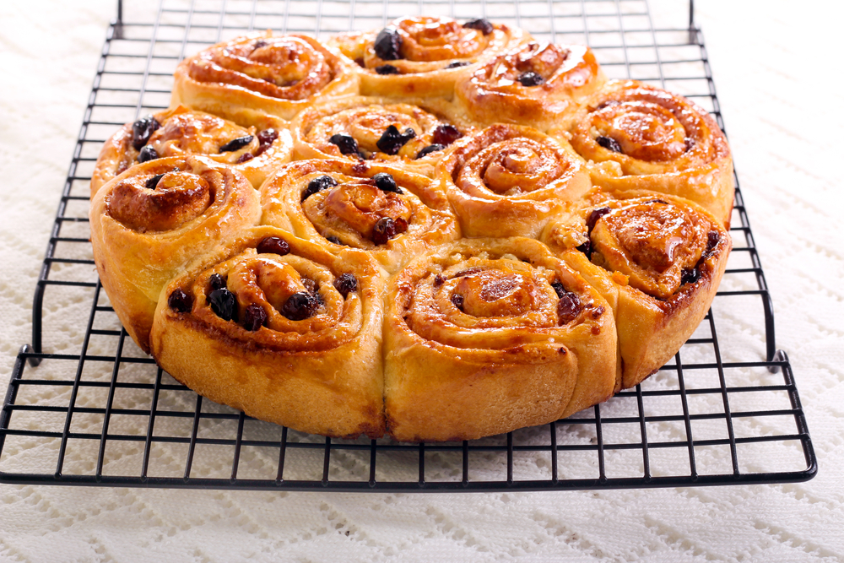
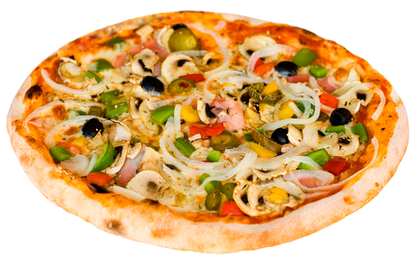
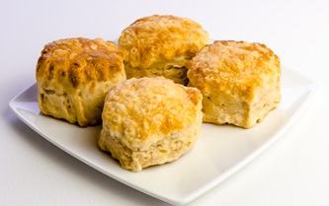
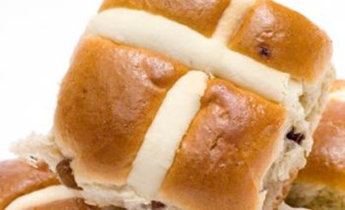
Uses of dough for other dishes
People may think of dough as just being used to make bread, but there are a number of other dishes that use dough.
List as many dishes that use dough as you can.

Slide 3
Pizza
Pizza uses dough.
Describe what part of a pizza is made using dough.

Slide 4
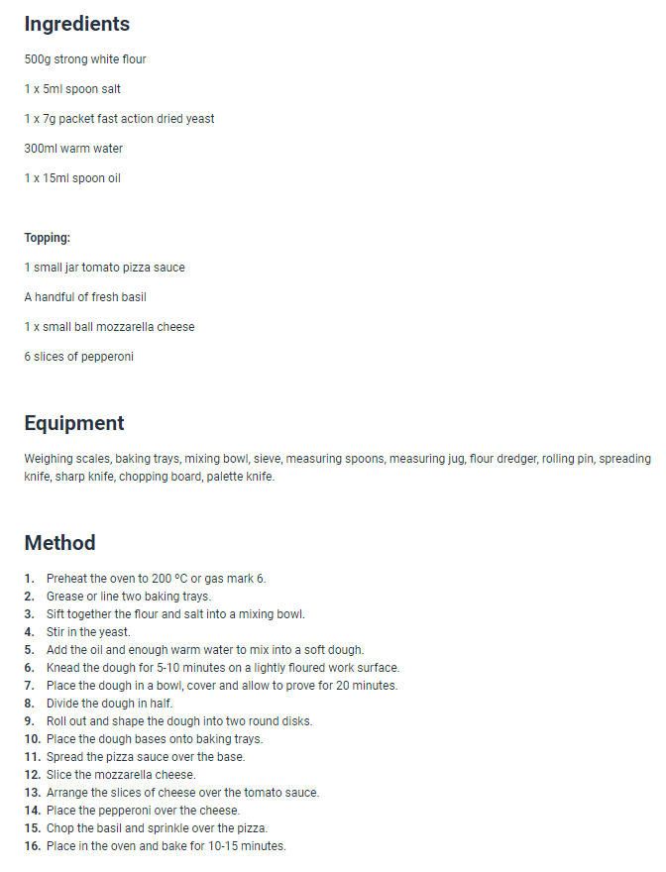
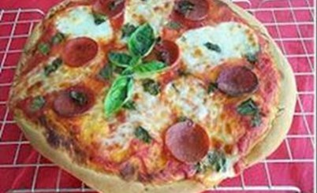
Pizza
Pizza uses dough in the base to create the pizza texture that we know.
On the right, you can see a recipe to make pizza. Show where in the recipe dough is used.

Slide 5
Chelsea buns
Chelsea buns also uses dough.
Describe in what stage of cooking dough is used to make Chelsea buns.

Slide 6
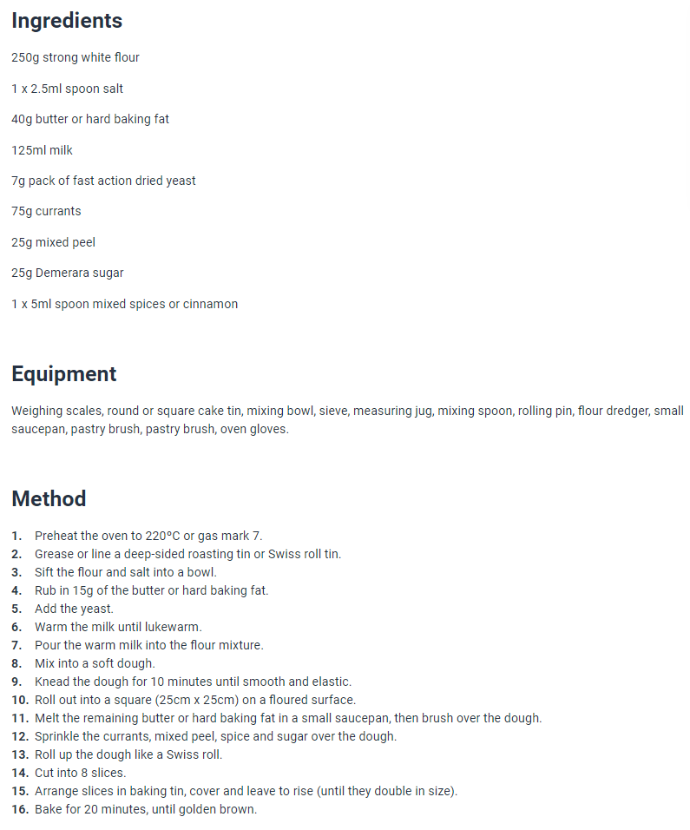
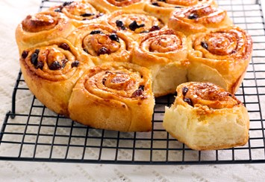
Chelsea buns
Chelsea buns are made and formed from dough, so dough forms the base of the bun.
On the right, you can see a recipe to make Chelsea buns. Show where in the recipe dough is used.

Slide 7
Hot cross buns
Hot cross buns also use dough. They are commonly eaten during the Christian holiday of Easter.
Describe what part of a hot cross bun is made using dough.

Slide 8
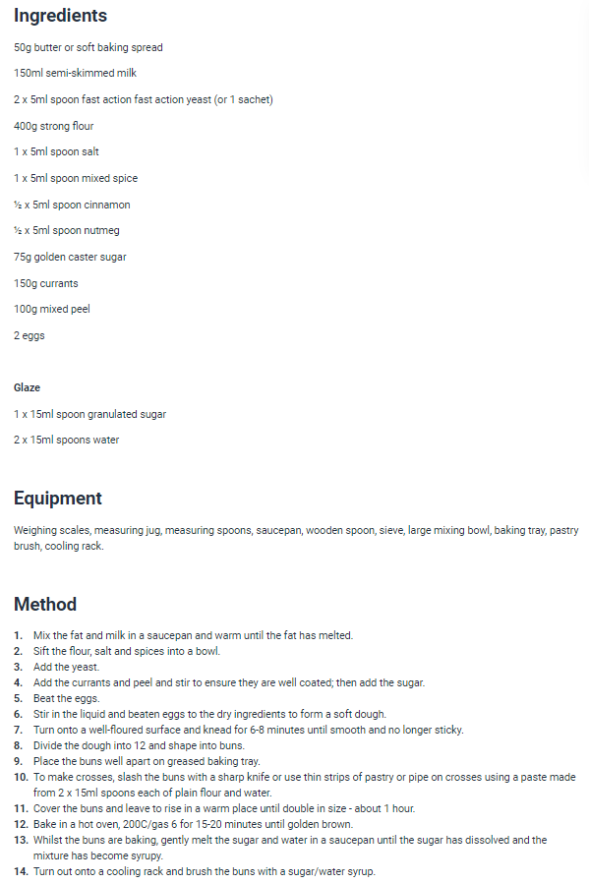
Hot cross buns
Hot cross buns are also made and formed from dough, so dough is used in the stage where the base is made.
On the right, you can see a recipe to make hot cross buns. Show where in the recipe dough is used.

Slide 9
Uses of dough for other dishes
For further information, go to:
www.foodafactoflife.org.uk

