Slide 1









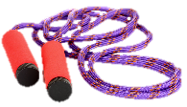
My activity diary
Name: __________________
Record all of the physical activity you did today. Aim for at least 60 minutes, every day!
Name the activity
 | My activities | Did I achieve 60 minutes?
Monday |  | Yes | No
Tuesday |  | Yes | No
Wednesday |  | Yes | No
Thursday |  | Yes | No
Friday |  | Yes | No
Name the activity, based on the equipment shown below:
_____________
_____________
_____________
_____________
_____________
_____________
_____________
www.foodafactoflife.org.uk © British Nutrition Foundation 2020 www.nutrition.org.uk

