Slide 1




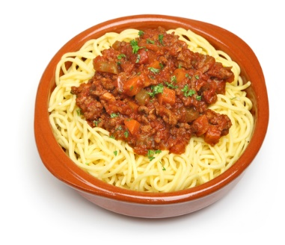
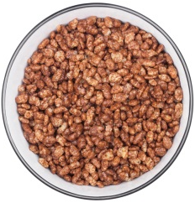
My wholegrain diary
Name: __________________
Each day this week, record what wholegrain food you eat at each meal time. How many wholegrains have you had?
Wholegrain options
What changes could you make to these meals to include wholegrains?
 | Mon | Tue | Wed | Thu | Fri | Sat | Sun
Breakfast
Lunch
Dinner
Other
TOTAL
White bread with strawberry jam
Spaghetti bolognaise with white pasta
Chocolate-coated cereal
www.foodafactoflife.org.uk © British Nutrition Foundation 2020 www.nutrition.org.uk

