Slide 1
Hydration activity

Slide 2
Activity instructions
1. Print copies of the Healthy hydration question sheets (or have on the whteboard).
2. Put the class into groups of 3-4 pupils.
3. Give each group a question sheet and task them to write the answers on their sheet.
Ask each group to nominate a pupil to share their answers with the class.

Slide 3
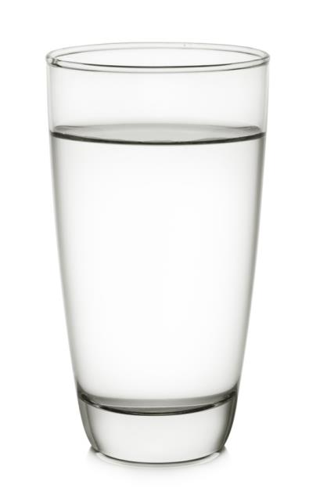
Water
How often is it recommended to be consumed:
Why it can be beneficial for health (may be none):
Why it can be negative for health (may be none):

Slide 4
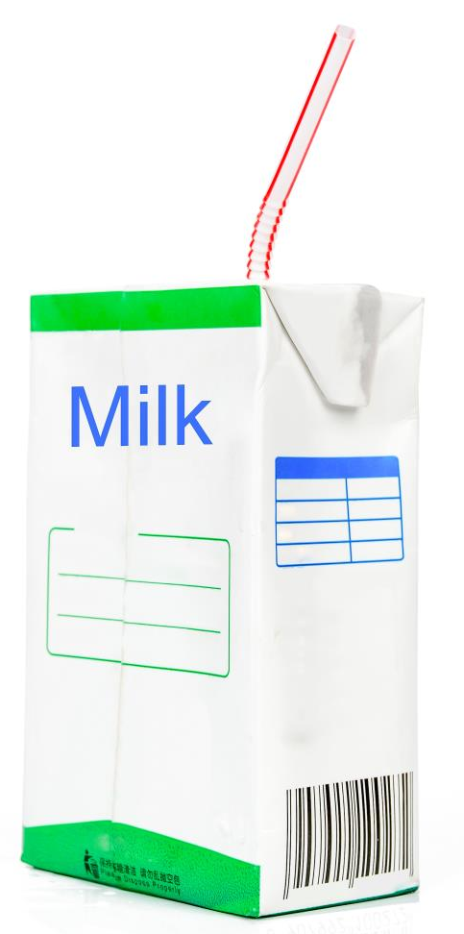
Milk
How often is it recommended to be consumed:
Why it can be beneficial for health (may be none):
Why it can be negative for health (may be none):

Slide 5

Tea and coffee
How often is it recommended to be consumed:
Why it can be beneficial for health (may be none):
Why it can be negative for health (may be none):

Slide 6
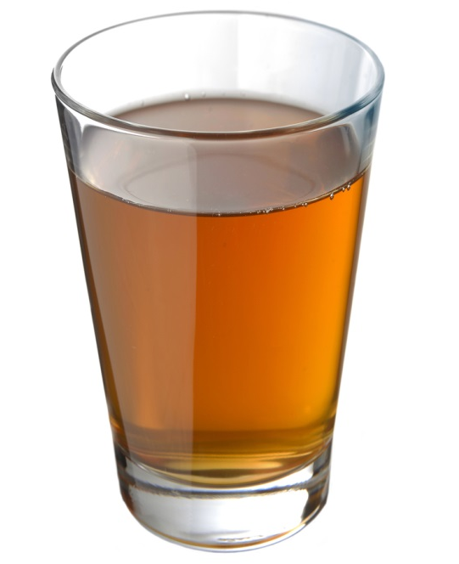
Fruit/vegetable juices and smoothies
How often is it recommended to be consumed:
Why it can be beneficial for health (may be none):
Why it can be negative for health (may be none):

Slide 7

Alcohol
How often is it recommended to be consumed:
Why it can be beneficial for health (may be none):
Why it can be negative for health (may be none):

Slide 8
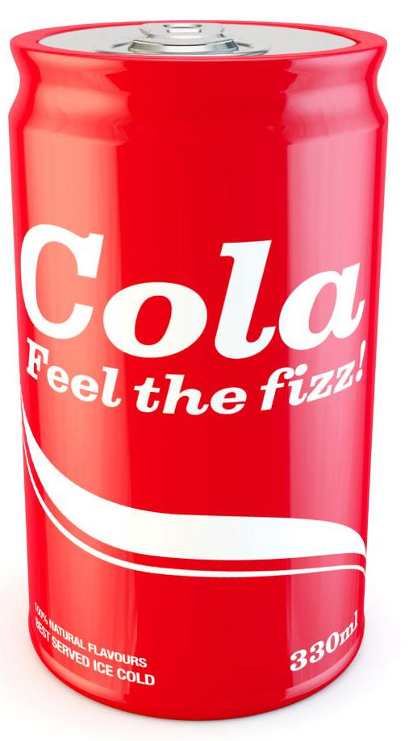
Sugary drinks
How often is it recommended to be consumed:
Why it can be beneficial for health (may be none):
Why it can be negative for health (may be none):

Slide 9
Hydration handouts
For further information, go to:
www.foodafactoflife.org.uk

