Slide 1

Healthy hydration

Slide 2
Healthy hydration for children
Young children have a higher proportion of body water than adults.
They are also less heat tolerant and may be more likely to get dehydrated, especially when being physically active and in hot climates.
Encouraging children to drink fluids regularly is important as children may not remember to have a drink by themselves.

Slide 3

Water
The body is about 60% water so drinking enough fluid to stay hydrated is important.
Water is essential for life and it has many functions in the body:
it acts as a lubricant for joints and eyes;
it is the main component of saliva;
it helps get rid of waste;
it helps regulate body temperature.

Slide 4
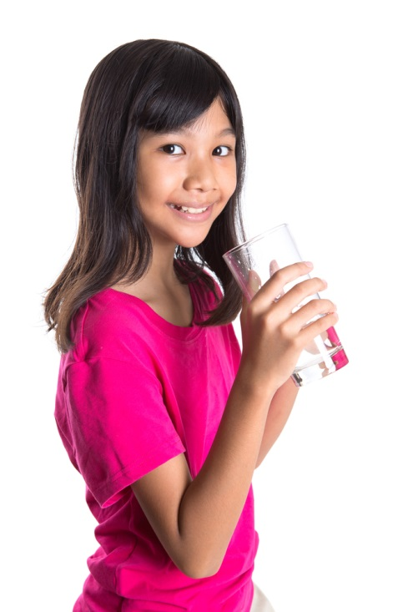
Hydration and health
Water is constantly lost though sweating, breathing and using the toilet. It is important to drink plenty during the day to avoid dehydration.
Mild dehydration may make it difficult to concentrate and may cause headaches and tiredness.
Children need plenty of fluid and they should be encouraged to drink regularly, especially if they are very active and in hot weather.

Slide 5
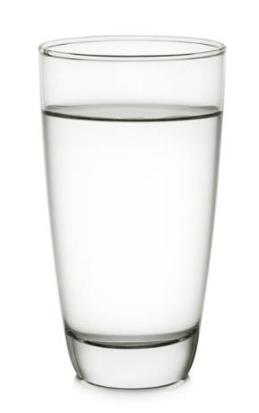
Sources of water
Water is provided by food such as soups, yogurts, fruit and vegetables, as well as drinks such as milk and juice.
It has been estimated that roughly 20% of water consumed is from food (e.g. soups, yogurt, fruit and vegetables), while 80% is from drinks (e.g. water, milk and fruit juice).

Slide 6
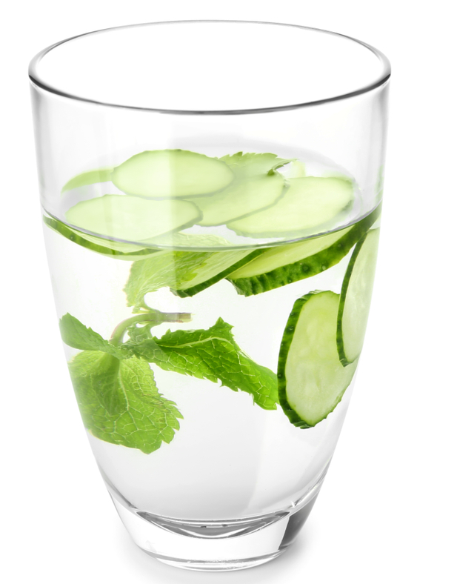
Water
Water is a good choice throughout the day because it hydrates without providing extra energy (calories) or harming teeth. Children should aim to drink water regularly!
Top tip: infuse water with different herbs, fruit or vegetables (e.g. cucumber, berries, mint) to encourage children to drink more.
Drink plenty

Slide 7
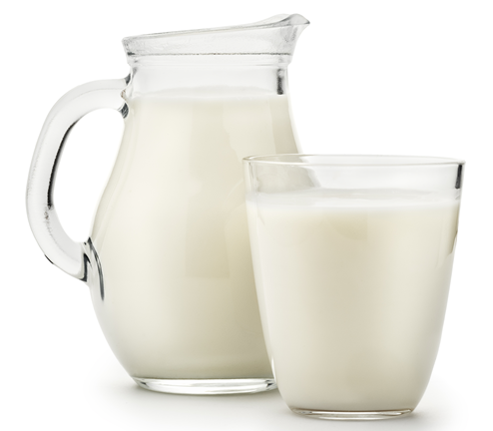
Milk
Milk is a useful source of nutrients, especially protein, B vitamins, iodine and calcium. Most children can have lower fat milks such as 1% or semi-skimmed. Unsweetened, calcium-fortified dairy alternatives can also be included.
Milky drinks containing added sugars such as milkshakes, hot chocolate and malted drinks should be limited.
Have regularly

Slide 8
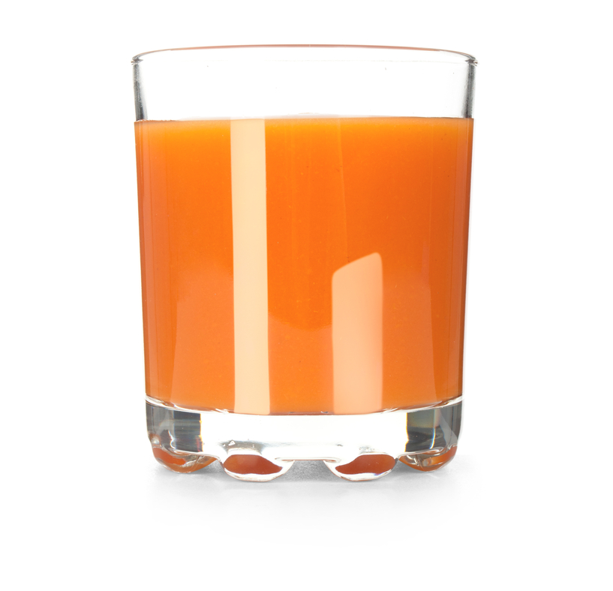
Fruit/vegetable juices
Fruit/vegetable juices and smoothies provide water plus some vitamins, minerals and fibre. However, they are also high in free sugars so it is recommended to limit juiced and smoothies to a combined total of 150ml a day.
Can have 150ml, once a day

Slide 9
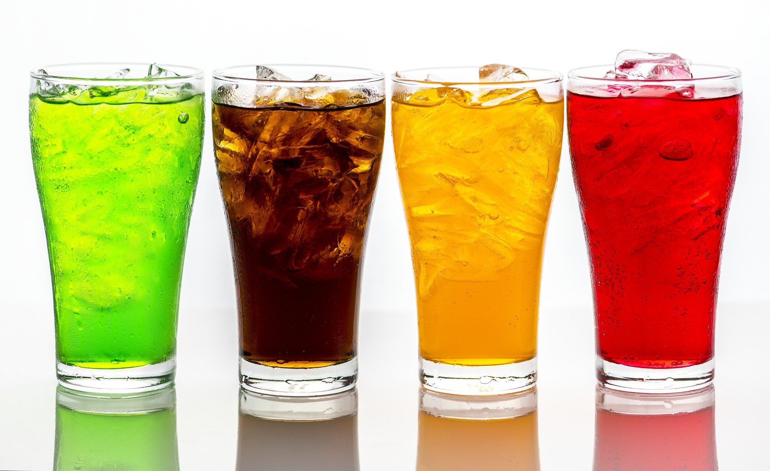
Sugar-free drinks
Sugar-free drinks hydrate without adding extra sugars but it’s a good idea for most drinks to be milk or water. Fizzy drinks may contain acids that can be harmful to teeth. Be aware that some of these drinks also contain caffeine.
Occasionally

Slide 10

Tea and coffee
Caffeine is naturally present in tea and coffee. Small amounts are harmless but high intakes should be avoided, especially for young children.
It’s best for children (aged 5-11) to drink decaffeinated tea and coffee with reduced-fat milks and no added sugars.
Occasionally (and in small amounts if caffeinated)

Slide 11
Sugary drinks
Provide fluid but contain calories from sugars, usually without other nutrients, and can be acidic. Sugars and acidity can both be harmful to teeth. Some of these drinks also contain caffeine.
Avoid

Slide 12
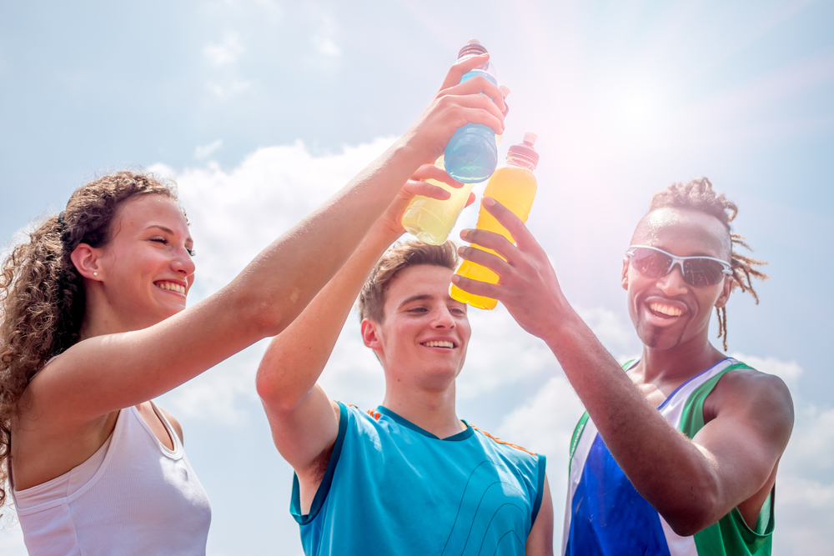
Sports and energy drinks
Sports and energy drinks can be high in sugars and energy drinks may contain high levels of caffeine or other stimulants. These drinks are not suitable for young children.
Not suitable for children

Slide 13
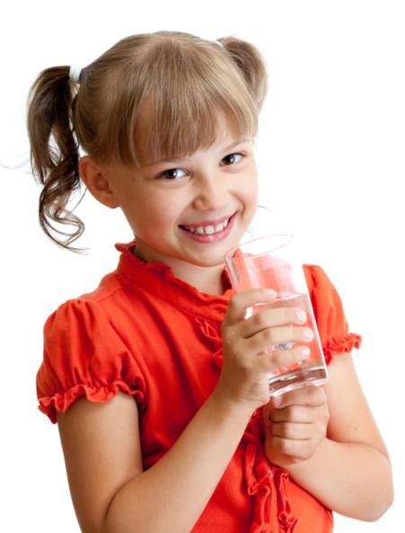
How much water do children need?
The amount of fluid a child needs depends on many factors including their age, their gender, the weather and how much physical activity they do but generally they should aim to have at least 6-8 drinks every day. Younger children usually need smaller drink servings (150-200ml) than older children (250-300ml).

Slide 14
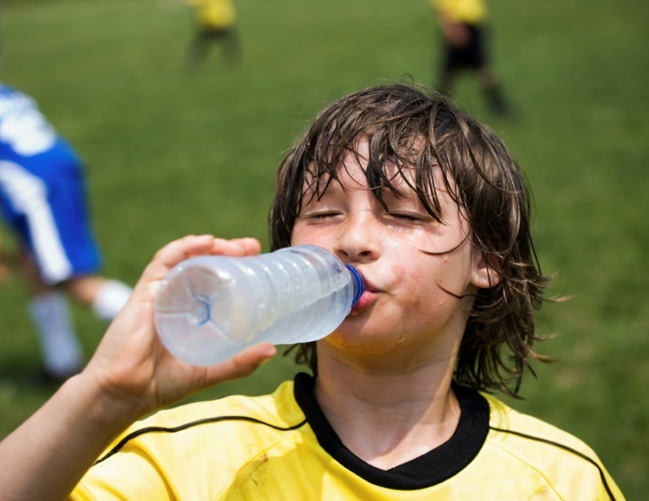
Practical tips to keep children hydrated
Ensure children have a drink before school with their breakfast, during breaks/playtime and after getting home.
Ensure children have a drink when taking part in physical activity.
Offer extra drinks when the weather is hot.
Always pack a water bottle in a school bag or lunchbox for children heading off to school/outings/other activities.

Slide 15
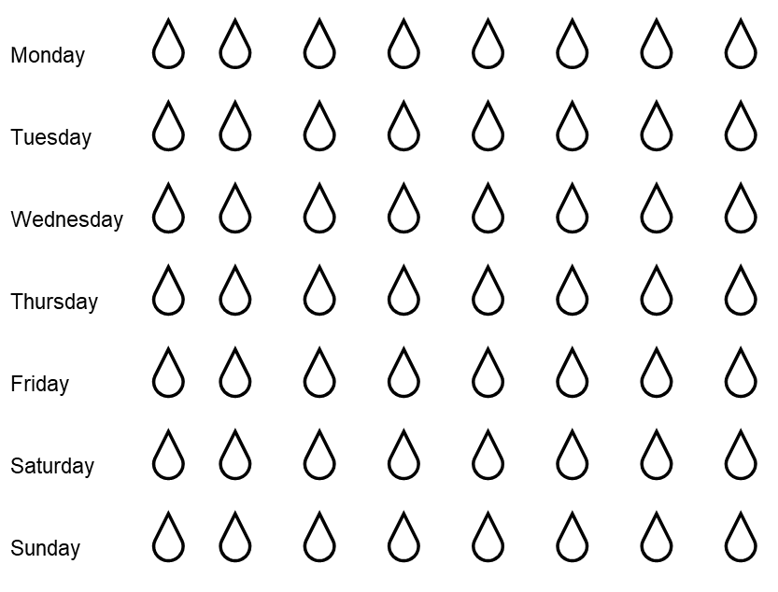
Helping your child drink plenty
Drink plenty chart
Keep a record with your child of the number and type of drinks they have each day. They can use the ‘drinks chart’ to help them with this.

Slide 16
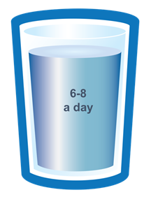
Healthy hydration
The following activities are intended to summarise learning about healthy hydration for children.

Slide 17

Have a think - why water?
It hydrates without harming teeth
It is easily accessible
It hydrates without providing extra energy (calories)

Slide 18
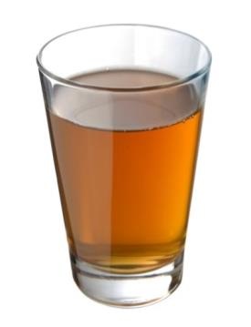

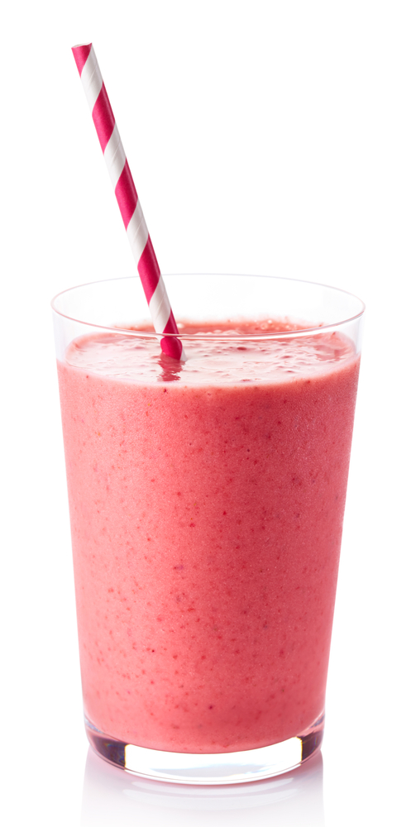



Which of these drinks are good choices for children?
✔
✔
water
150 ml orange juice
330 ml apple juice
caffeinated tea
✔
strawberry milkshake
hot chocolate
sugary drink
milk

Slide 19
For further information, go to:
www.foodafactoflife.org.uk

