Slide 1
Raspberries

Slide 2
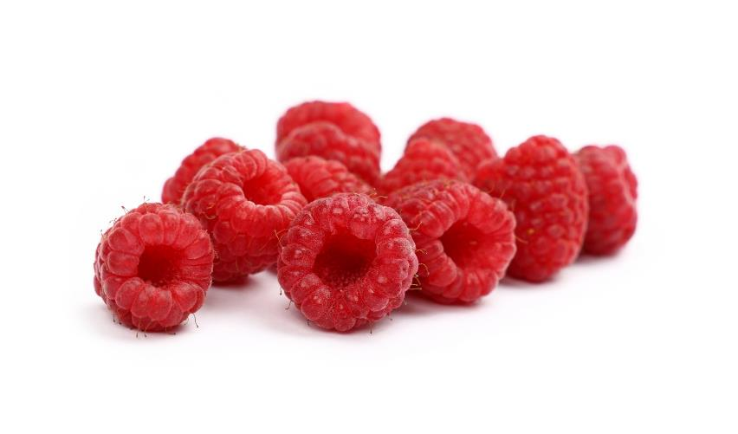
What are these?
These are raspberries, know as ‘berries’*.
A berry is a small, sweet fruit.
They are often coloured red, blue or black. They contain small seeds, which are usually edible, and do not have a large stone.
*Botanically, raspberries are not a true berry (a fruit with many seeds scattered throughout the pulp) but an etaerio (or aggregate fruit) made up of drupelets (individual sections of fruit each with its own seed).

Slide 3
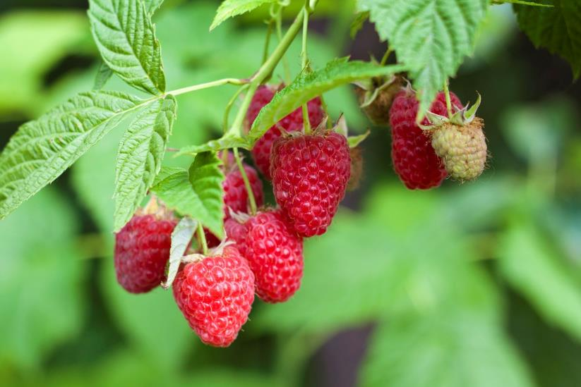
Where do raspberries come from?
Raspberries grow in the UK.
Raspberries are from a plant. These are called raspberry canes.
They grow above the ground.
Raspberries contain small seeds.

Slide 4
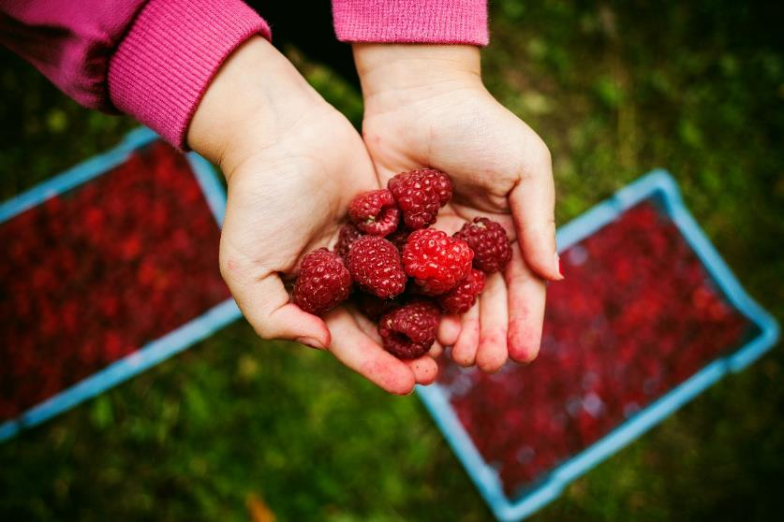
Harvesting
Raspberries may be grown on farms, but many grow in the wild around the UK.
Raspberries are picked when they are ready (ripe).
Raspberries are ready in the summer season – late summer.

Slide 5
Raspberries
Raspberries can be purchased:
fresh;
frozen;
canned.

Slide 6
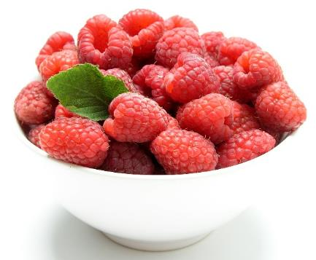
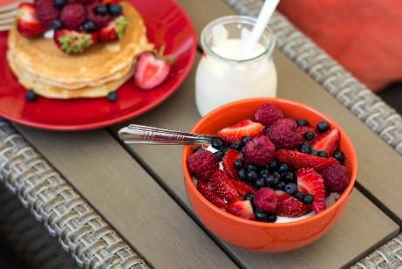
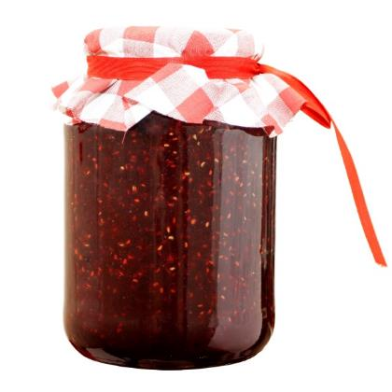
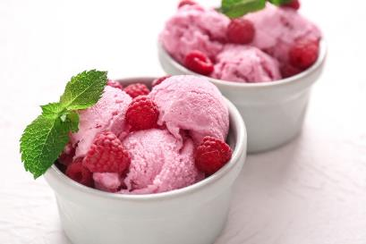
Dishes
Raspberries can be eaten raw – just wash first.
Raspberries can be used in lots of dishes.

Slide 7
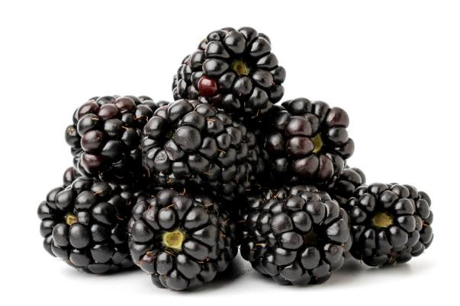
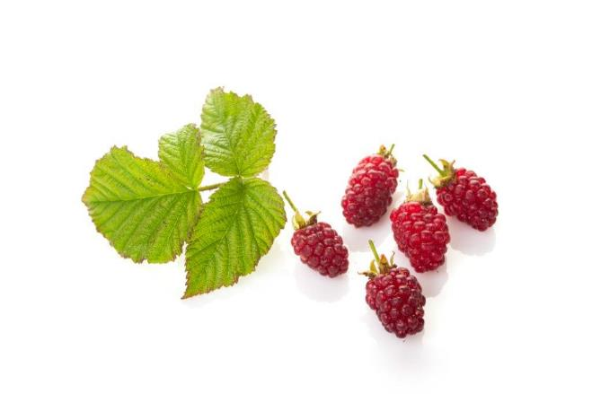
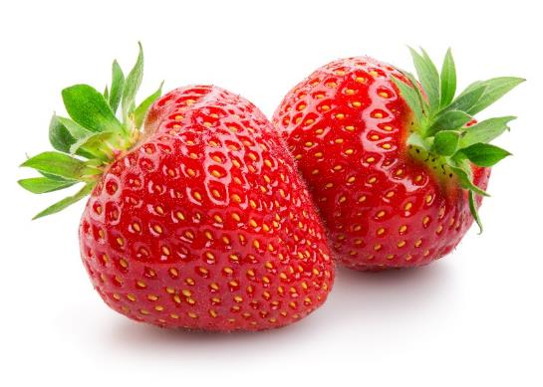
Similar
Blackberries, strawberries and loganberries are similar to raspberries.
Blackberries
Loganberries
Strawberries

Slide 8
Summary
Raspberries are grown for our food.
Raspberries
Lots of dishes use raspberries.

Slide 9
Raspberries
For further information, go to:
www.foodafactoflife.org.uk

