Slide 1
Cauliflower

Slide 2
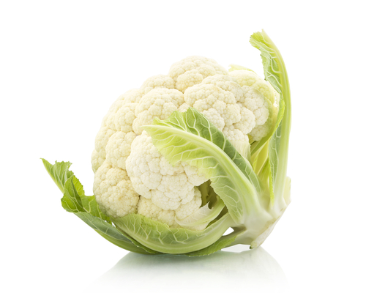
What is this?
This is a cauliflower.
Cauliflower is a vegetable.

Slide 3
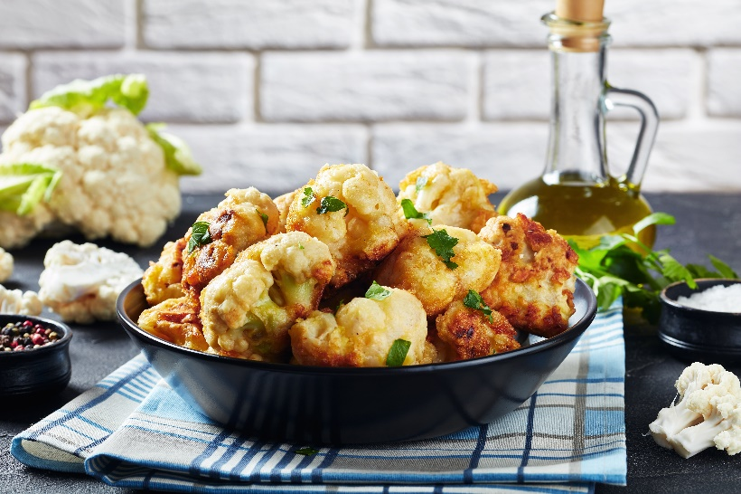
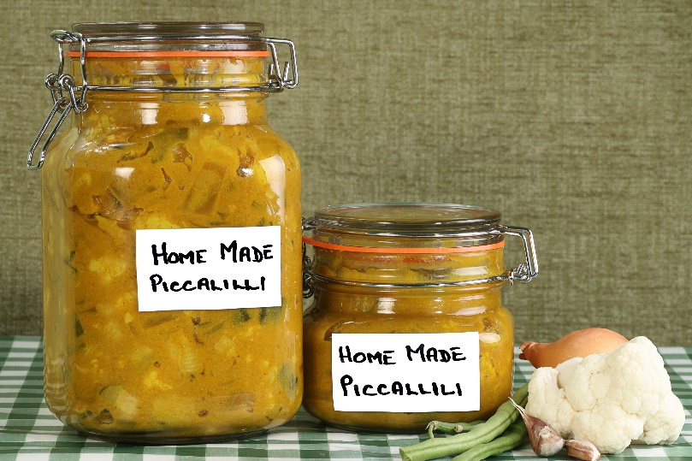
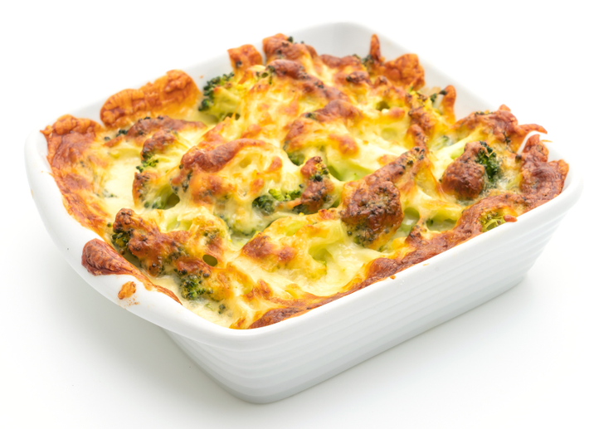
What are these?
They all use cauliflower.

Slide 4
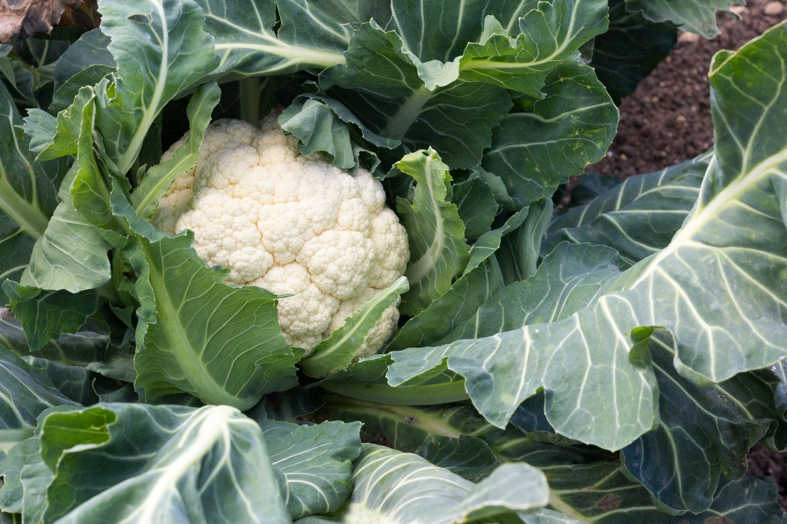
Where does cauliflower come from?
Cauliflowers grow in the UK.
Cauliflower is a plant.
They grow above the ground.
Cauliflower is the flower of a plant.

Slide 5
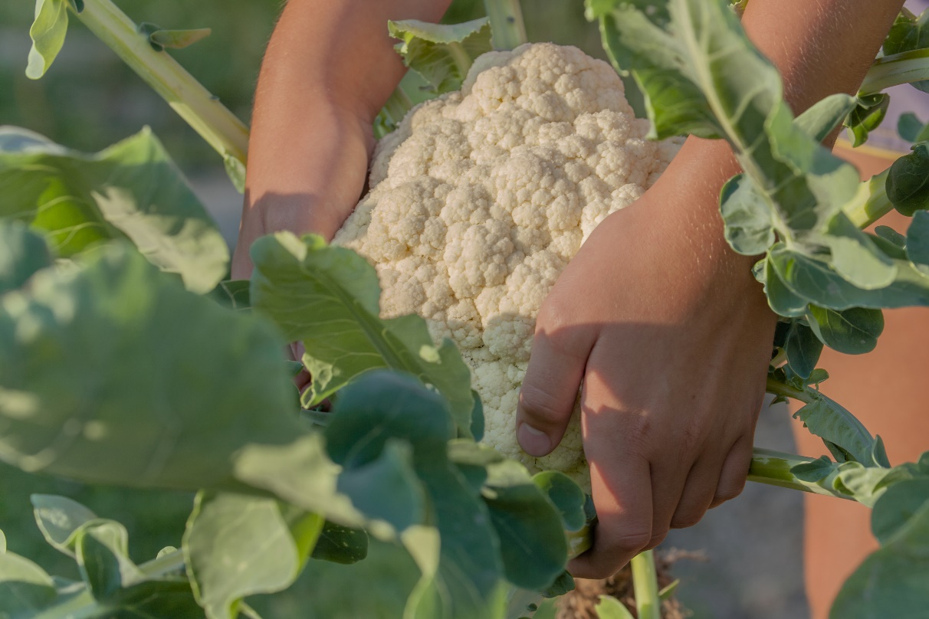
Where do cauliflower come from?
Cauliflowers are picked when ready from a garden or field.
Have you seen cauliflower grow before?

Slide 6
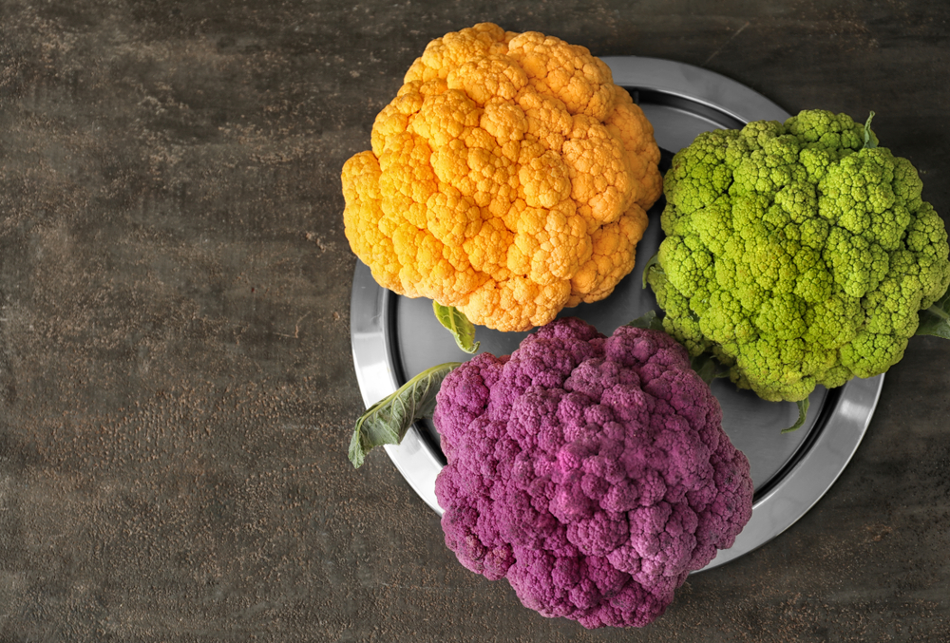
Cauliflower varieties
There are different types cauliflower.
They have different names, such as:
All year round;
Alpha;
Red lion.

Slide 7
Cauliflower
Cauliflower can be purchased:
fresh;
frozen.

Slide 8
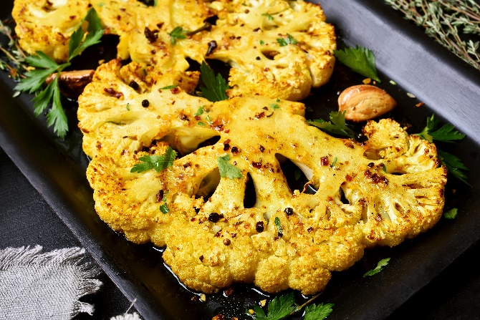
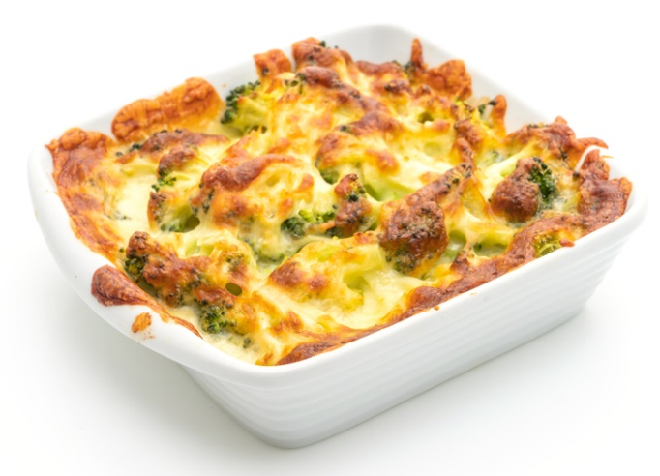
Dishes
Cauliflower can be eaten raw – just wash first.
Cauliflower can be used in lots of dishes.

Slide 9
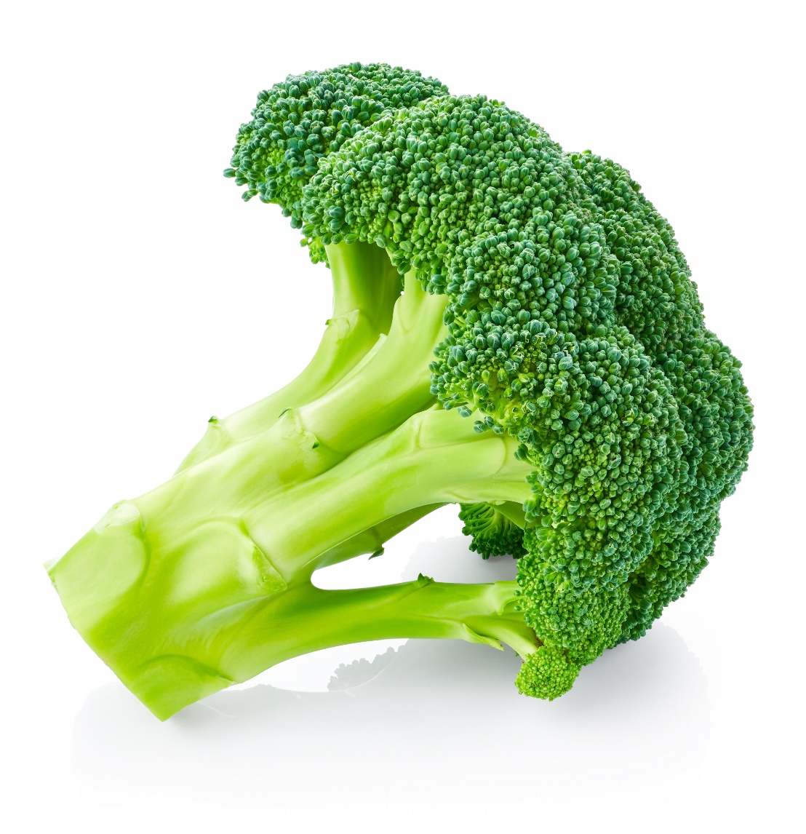
Similar
Broccoli is similar to cauliflower.
They are the flowers of a plant.

Slide 10
Summary
Cauliflower are grown for our food.
Cauliflower
Lots of dishes use cauliflower.

Slide 11
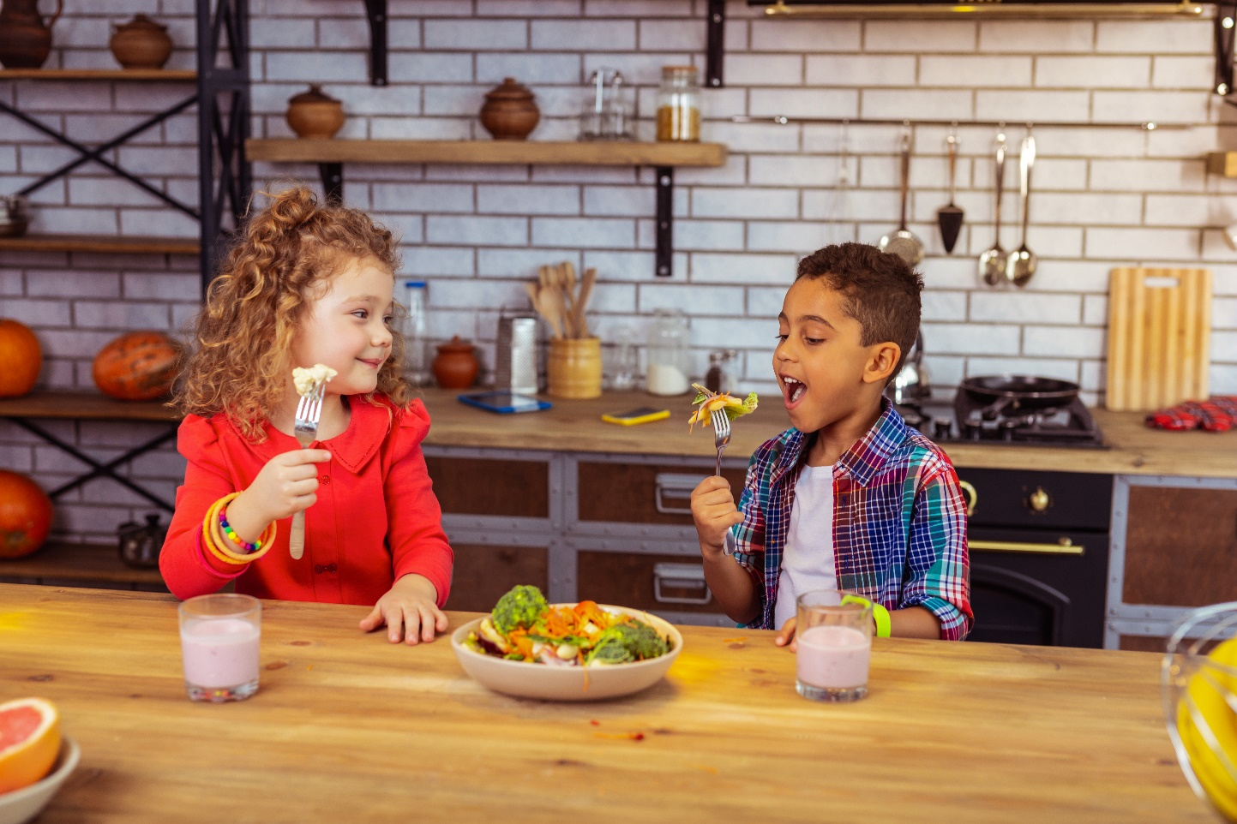
Do you like cauliflower?

Slide 12
Cauliflower
For further information, go to:
www.foodafactoflife.org.uk

