Slide 1
Characteristics of good practice in teaching food and nutrition education to pupils with additional needs
26/05/2021

Slide 2
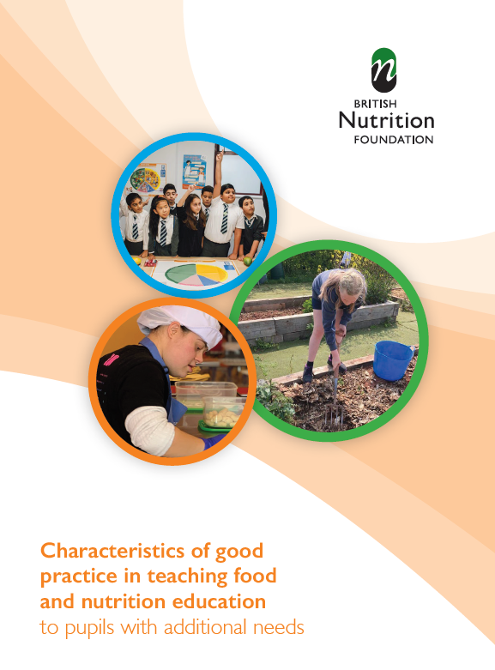
Covered in today’s webinar
Development of the Characteristics of good practice guide.
The 12 Characteristics of good practice.
Supporting pupils to develop skills for independent living and meaningful employment, particularly in catering and hospitality.
Resources for use with pupils with additional needs and professional development support available from Food – a fact of life.
Suggestions for further reading and sources of information.

Slide 3

Development of the Characteristics guide
Showcase good practice
Support pupils with additional needs, via teachers
Focus on food and nutrition education
Build on work in two previous guides (primary and secondary)
Work with an expert panel (teachers, awarding organisations, training providers ...)
Talk to teachers, obtain case studies
Focus on the individual needs of the pupil
Use in special and mainstream schools
UK wide (additional needs)

Slide 4
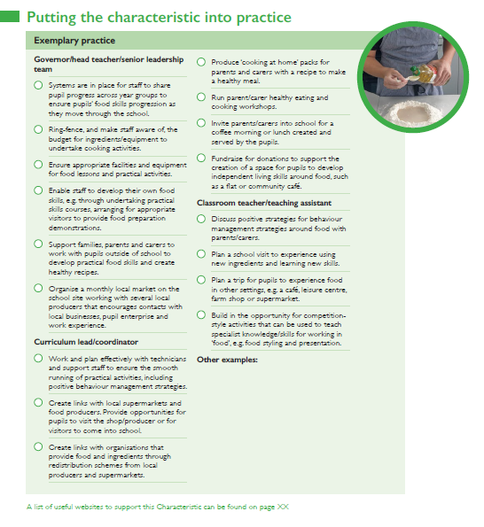
What does the guide aim to do?
• Define the key characteristics of good practice that are specific to teaching food and nutrition to pupils with additional needs.
• Exemplify these characteristics of good practice in UK schools, both special and mainstream.
• Identify exemplary practice and the school staff who could take responsibility for leading or enabling the practice, e.g. governor/head teacher/senior leadership team; curriculum lead/coordinator; special needs coordinator (SENCo); or class teacher/teaching assistant.

Slide 5
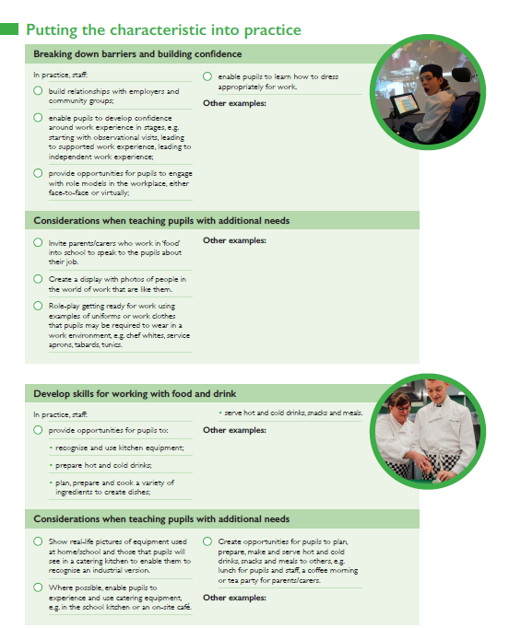
What does the guide aim to do?
Highlight the key features of achieving these characteristics, showing how these can be put into practice, with case studies and suggestions of how to develop these for the future.
• Support teachers that teach pupils with additional needs, especially those who are newly qualified.
• Enable practising teachers to audit their own practice, to plan and implement personal and professional development goals.

Slide 6
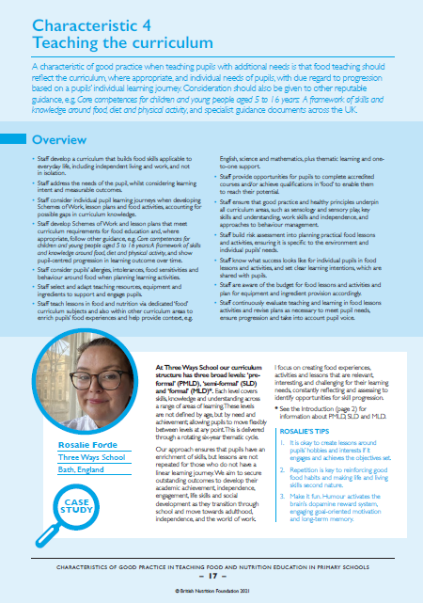
The Characteristics - overview
The guide sets out 12 key characteristics, with exemplification, but it is acknowledged that other characteristics and practice exists.
The guide is not an exhaustive or static list to be followed rigorously. It is a starting point to support reflection of current practice in order to further develop teaching and learning.
Considerations for teaching pupils with additional needs are also included for each key characteristic.
Four sections per characteristic: Overview, Case study, Putting the characteristic into practice, and Exemplary practice.

Slide 7
The 12 Characteristics
1. Developing professional competence
2. Taking a whole school approach
3. Knowing your pupils
4. Teaching the curriculum
5. Developing skills for independent living
6. Developing skills for work
7. Running practical food lessons
8. Establishing food hygiene and safety practice
9. Developing practical food skills
10. Explore where food comes from
11. Healthy eating
12. Making choices

Slide 8
How can the guide be used?
The guide could be used in a variety of ways, such as:
ensuring that the teaching of food and nutrition is pupil-centred and appropriate for a pupil’s own learning journey;
developing pupils’ skills for independent living and the world of work, especially within catering and hospitality;
showcasing good practice through defined characteristics;
encouraging the consideration of other characteristics of good practice, leading to further discussion and implementation;
promoting lifelong personal and professional development, helping individuals to audit their knowledge and skill set;
developing the management of food and nutrition teaching;
acknowledging the role of the teacher in the whole school approach to health and wellbeing.

Slide 9
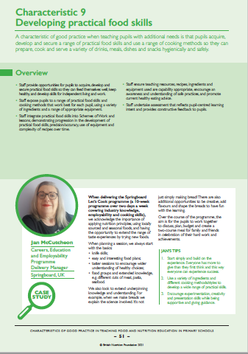
The Characteristics of good practice
How can you use this guide in practice?
Governors, head teachers and senior leadership teams – ensure provision is inclusive, pupil and family-centred, and appropriately funded.
Trainee and newly qualified teachers/teaching assistants – determine your future practice.
More experienced teachers/teaching assistants – check and reflect on your current practice and identify future actions.
Teacher training providers – design your programmes, set assignments, use as a framework for classroom observations or trainee assessment.
The guide supports the aims of the Early Careers Framework.

Slide 10
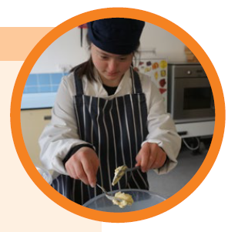
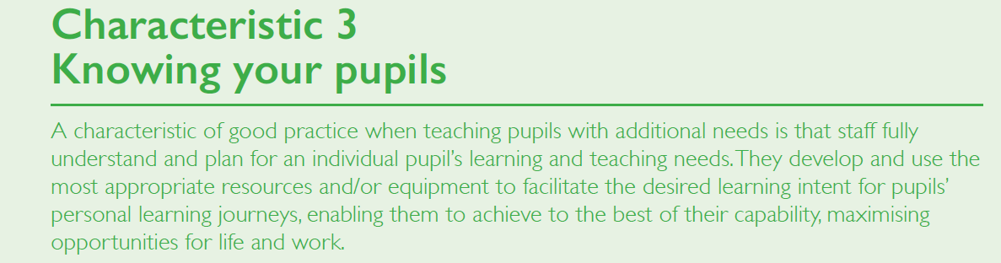
Knowing your pupils
Is the key!
Ensures inclusion and enables staff to understand what success looks like for each individual.
Allows for personalisation and adaptation.

Slide 11
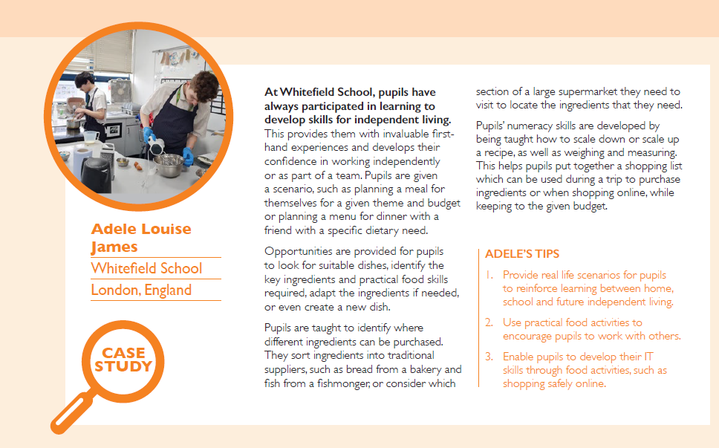
Developing skills for independent living
Activities should be pupil-centred and focus on being able to feed themselves well and keep healthy.
Food can be used as a context to:
develop numeracy and literacy skills;
keep themselves and others safe;
make choices and use information;
work with others and understand social situations.

Slide 12
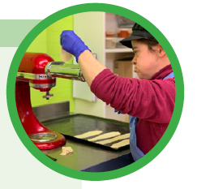
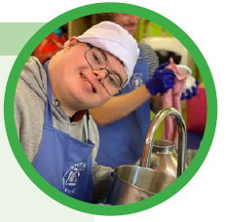
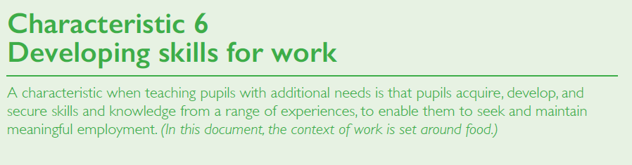
Developing skills for work
Young people with additional needs can be valuable, reliable members of a catering or hospitality team working in a wide variety of roles.
Preparation is key.
Research local employers and build relationships.
Develop confidence in stages to ensure success for all.

Slide 13
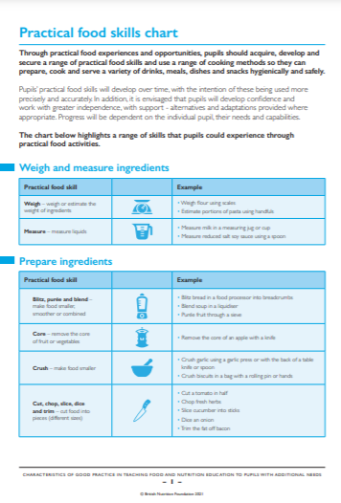
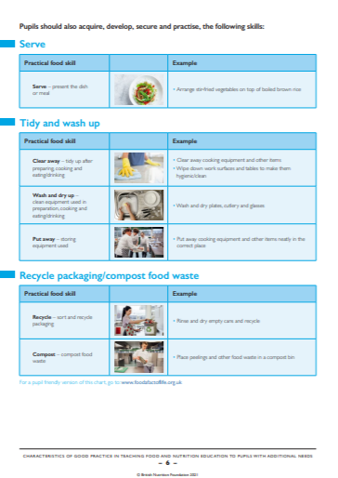
Practical food skills chart
A new chart identifying the practical food skills that pupils can acquire, develop and secure through activities and experiences.
Pupil friendly version coming soon.
Practical food skills chart

Slide 14
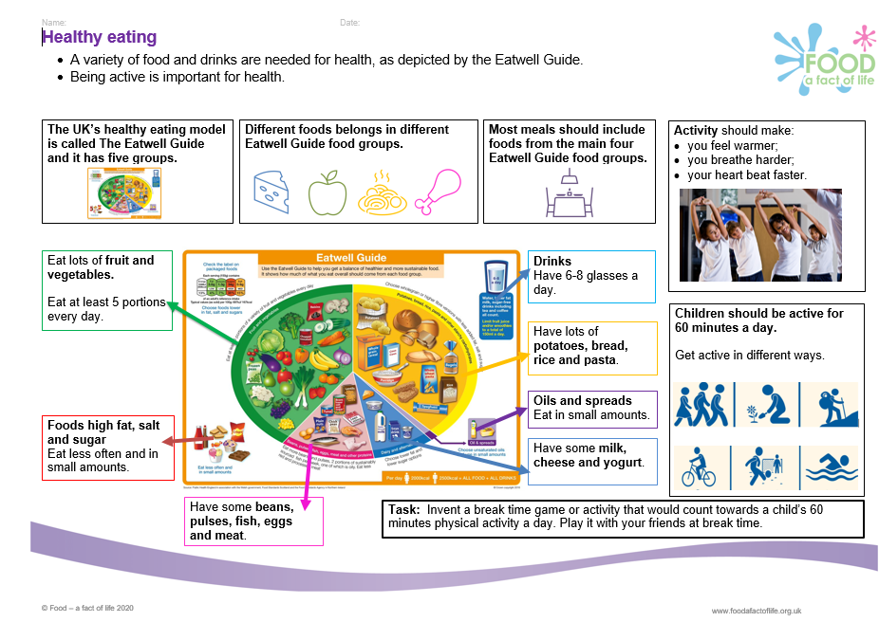
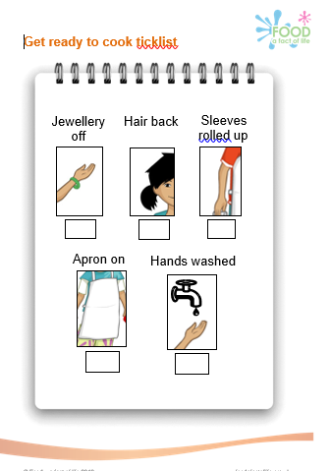
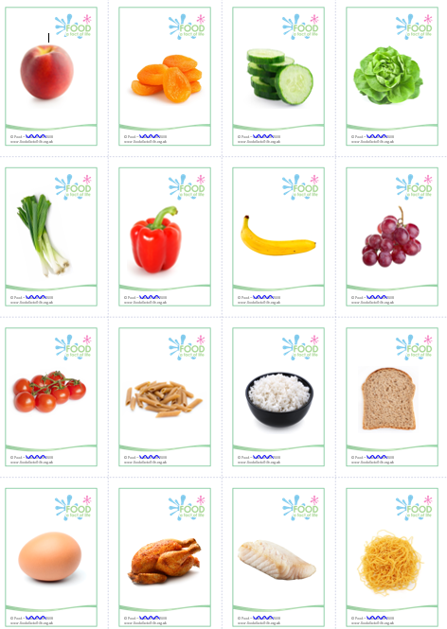
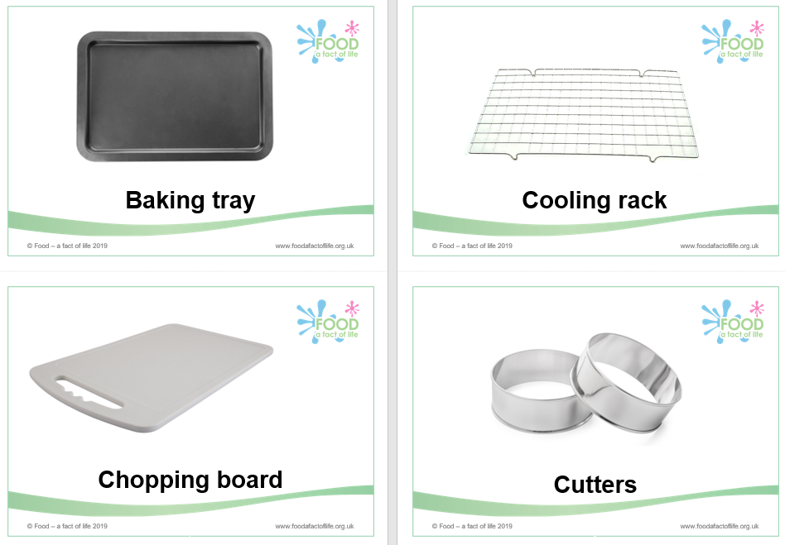
Food – a fact of life resources
All Food – a fact of life resources are editable!
Resources cover healthy eating, cooking and where food comes from, for ages 3-5 years to 14-16 years – you choose the resources to suit your pupils’ needs.
Knowledge organisers.
Activity packs.
Learn with stories.
Videos and interactive games.
BTEC Home Cooking skills Level 1 and 2 resources mapping document.

Slide 15
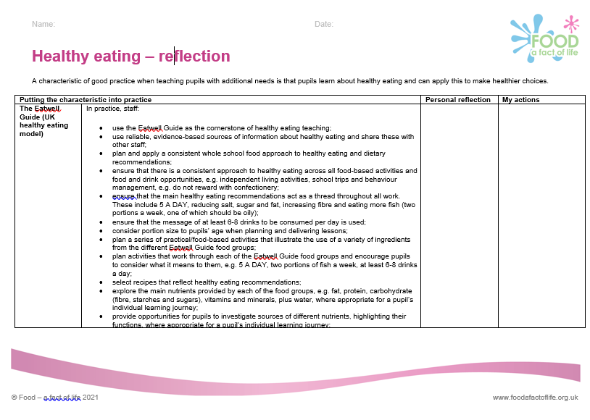
Support for your professional development
Reflection documents
Help develop reflective practice.
Ideal for staff at all career stages.
Provide an opportunity to reflect on personal practice and identify future actions.
There are also resources to support needs analysis and planning your own professional journey based on the Teaching food in primary/secondary schools: A framework of knowledge and skills.
Reflection documents

Slide 16
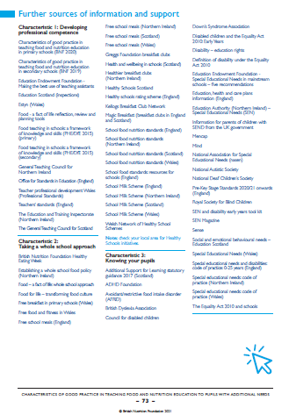
Sources of support and further information
Three pages of websites and useful information/documents that support each of the characteristics can be found at the end of the guide.

Slide 17
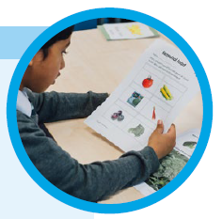
The future
We are planning to develop resources … what would be useful?
What should be our focus, as we know that there are many needs?
For example:
Communication skills – numeracy and literacy, via food context?
Step-by-step recipes?
Simple worksheets, which are editable
Series of photos and illustrations (with labels)

Slide 18
Characteristics of good practice when teaching food and nutrition education to pupils with additional needs
For further information, go to:
www.foodafactoflife.org.uk

