Slide 1
BNF Healthy Eating Week 2021
Primary school assembly
Monday 14 June 2021, 10.00am
BNF Healthy Eating Week is developed by the British Nutrition Foundation and supported by the Agriculture & Horticulture Development Board (AHDB), Old El Paso, Green Giant, innocent drinks, Waitrose & Partners and Warburtons.

Slide 2
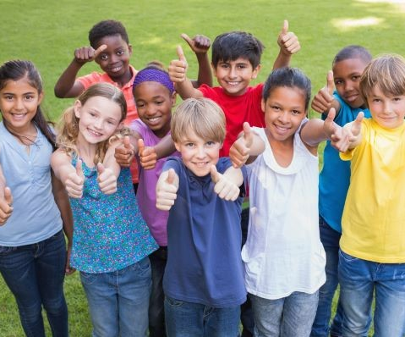
Find your healthier you!
How healthy are you?
Let’s see!
Stay standing if…
Stand up carefully and quietly.

Slide 3
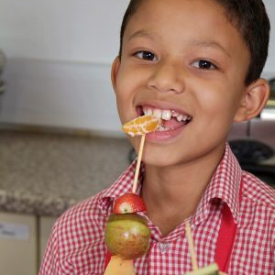
Know the facts
Fruit and vegetables
How many portions of fruit and vegetables do we need each day?
At least 5!
After the count of three, show me with your hands!

Slide 4
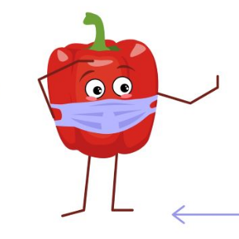





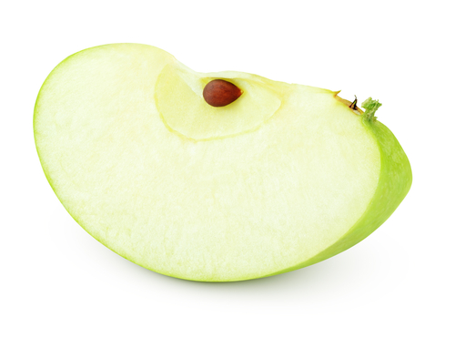
How much is a portion?
A
B
C
After the count of three, show me with an action!

Slide 5

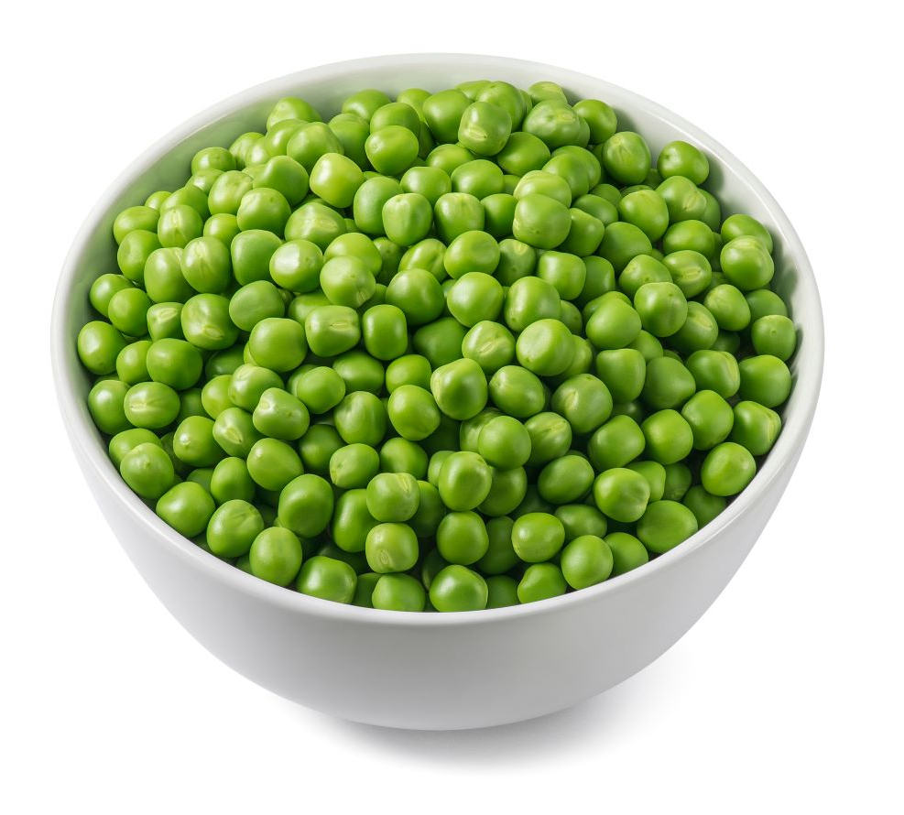
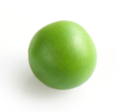
How much is a portion?
A
B
C
After the count of three, show me with an action!

Slide 6


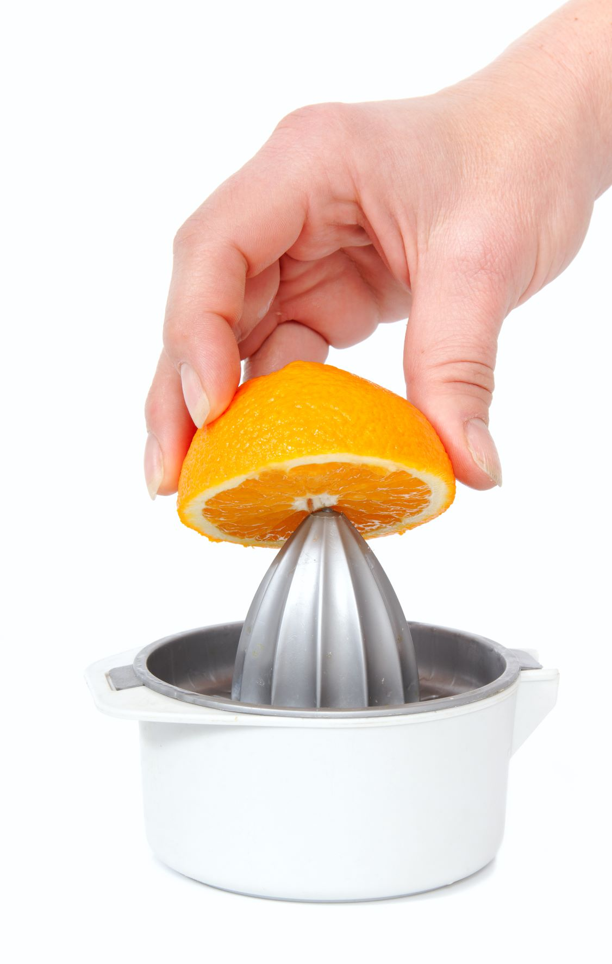

How much is a portion?
A
B
C
After the count of three, show me with an action!

Slide 7
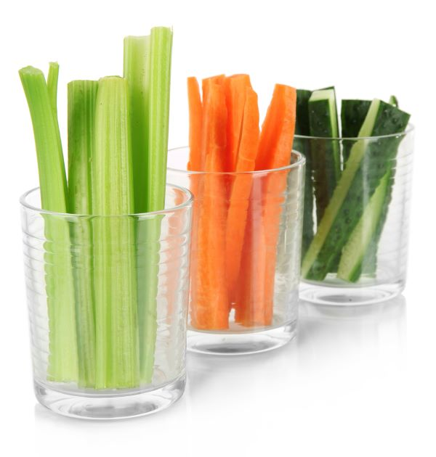

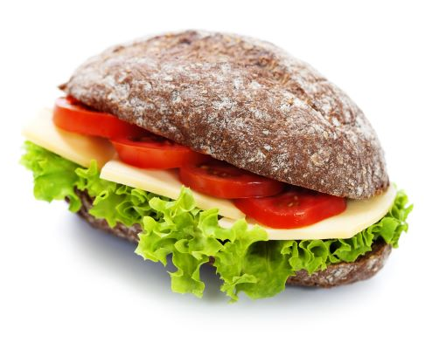
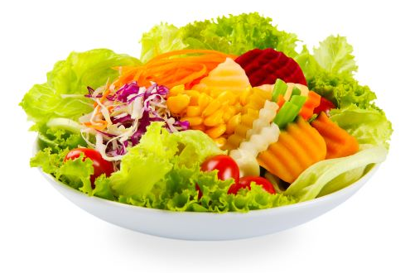
What can you do this week?
Have at least 5 A DAY every day!
At breaktime… have fruit or vegetables as a snack
At lunchtime… have a side salad or add salad to your sandwich

Slide 8
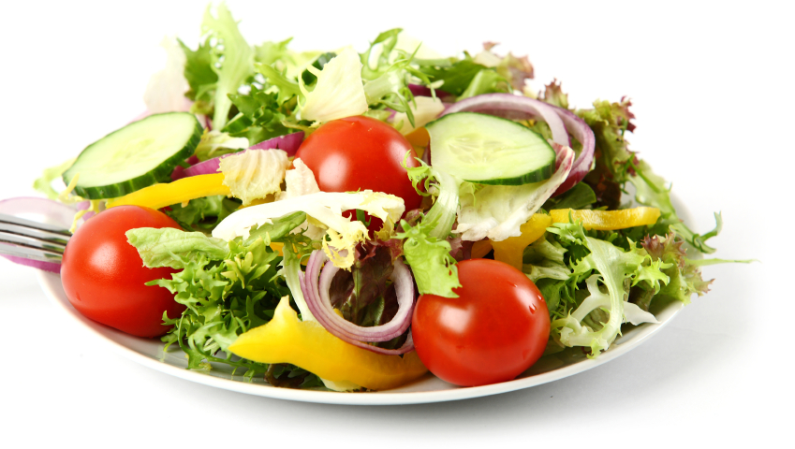


How many different vegetables can you see here?
When the pepper lands, show me with your hands!

Slide 9
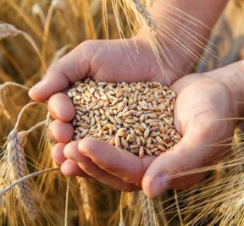

Know the facts
Wholegrain
What is wholegrain food?
Why choose wholegrain?

Slide 10
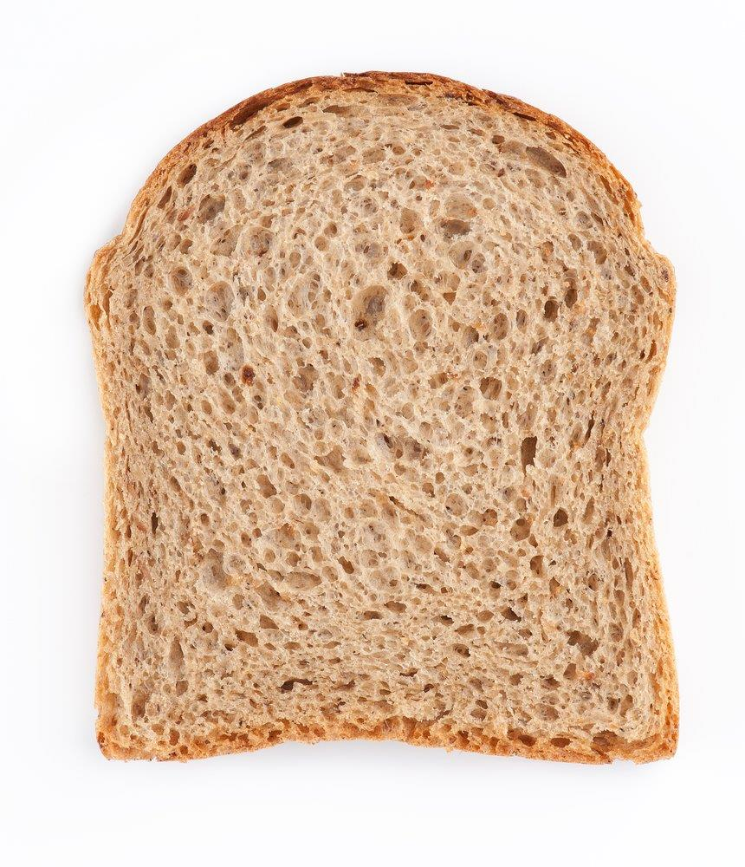
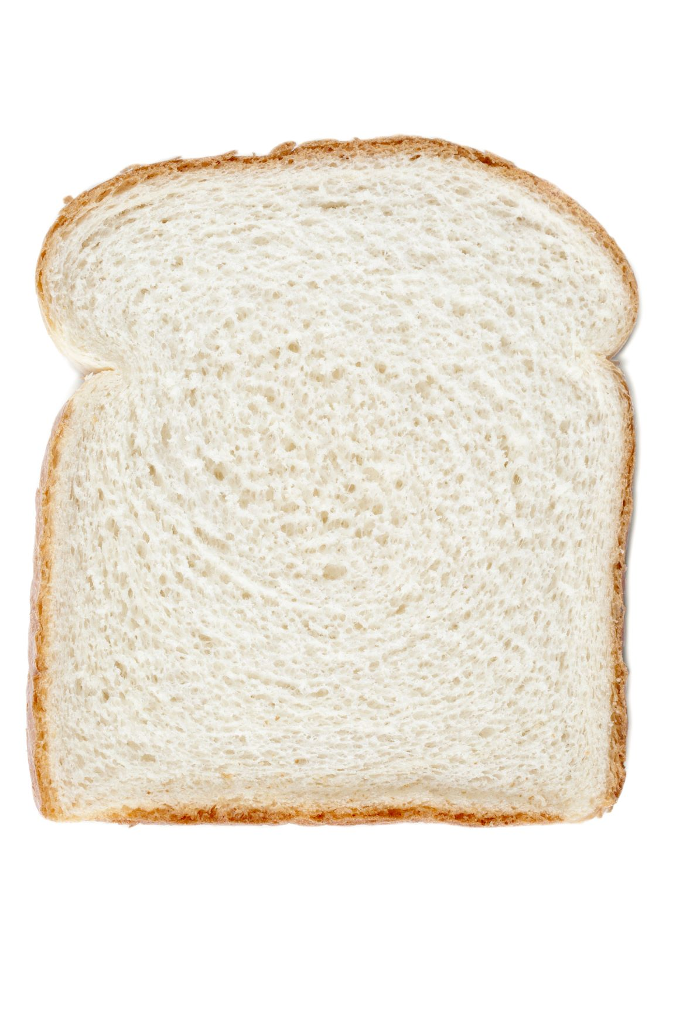

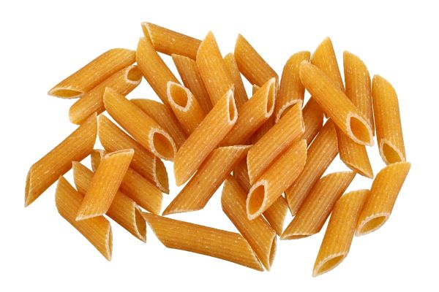
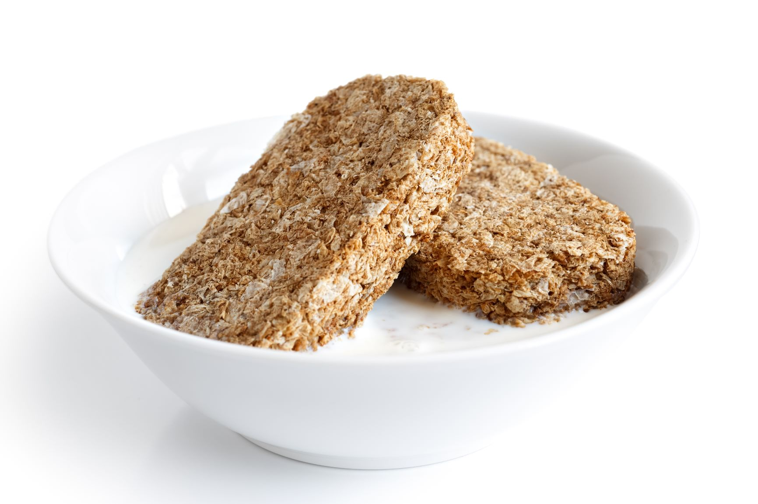
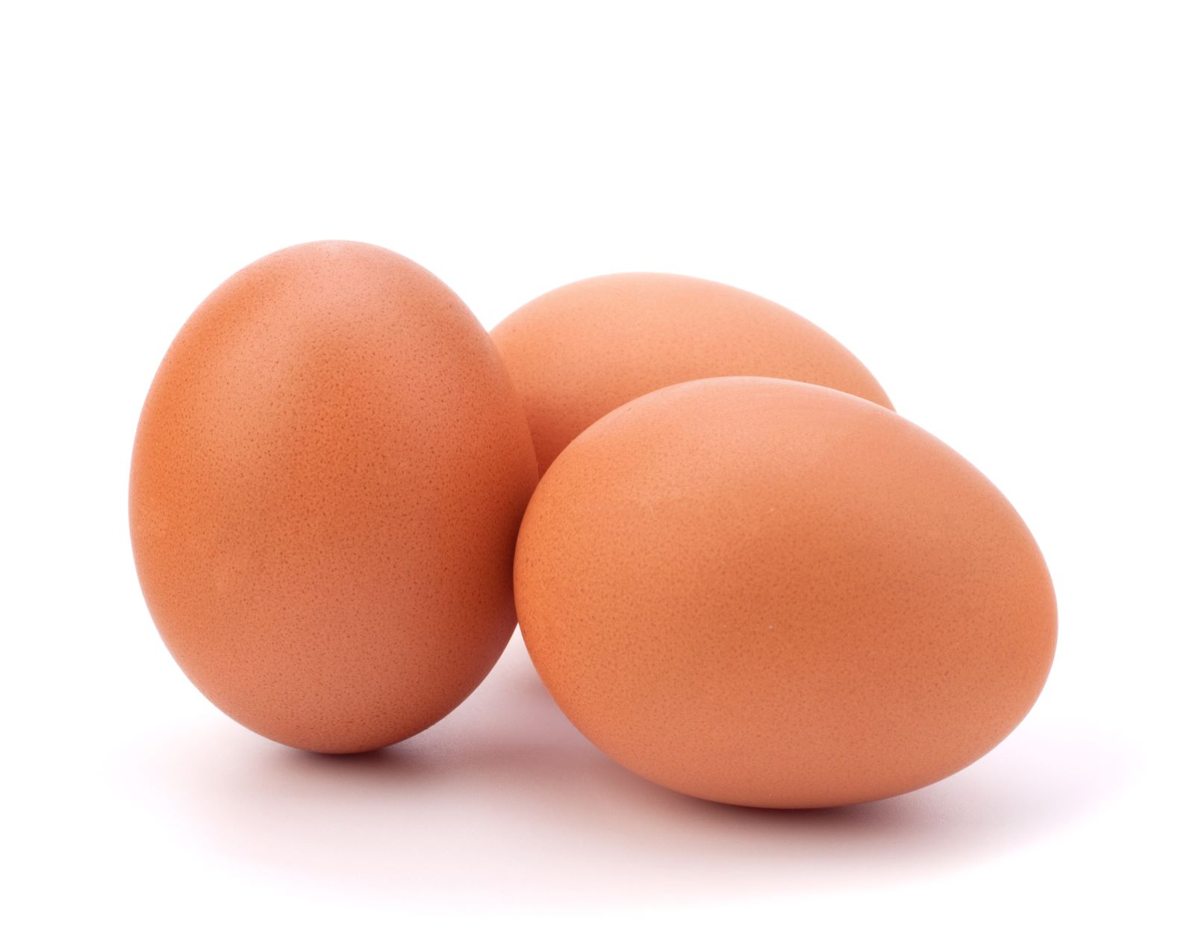
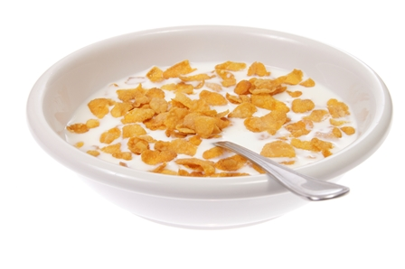

How many are wholegrain?
When the pepper lands, show me with your hands!

Slide 11
How much fibre?
4.25g
1g
3.25g
7.5g
2g
5.5g
Primary school aged children need 20g of fibre a day.

Slide 12
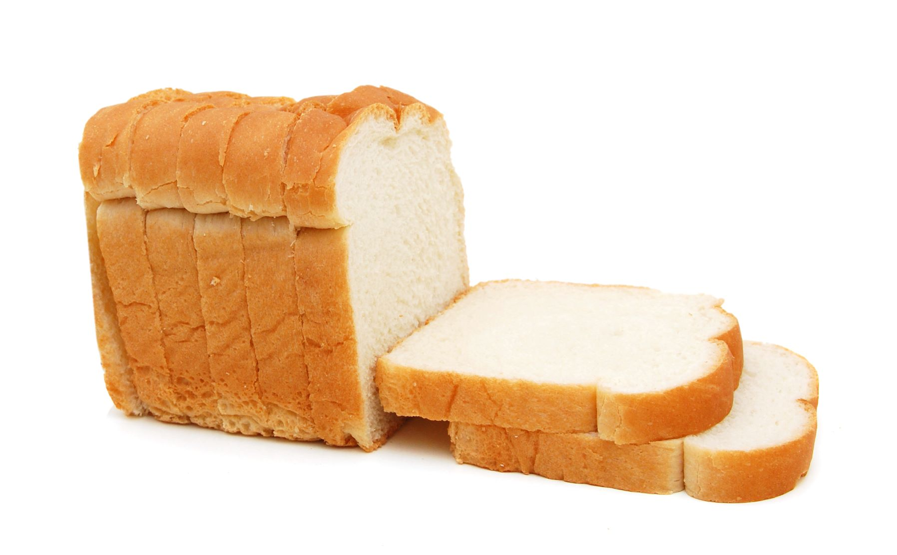
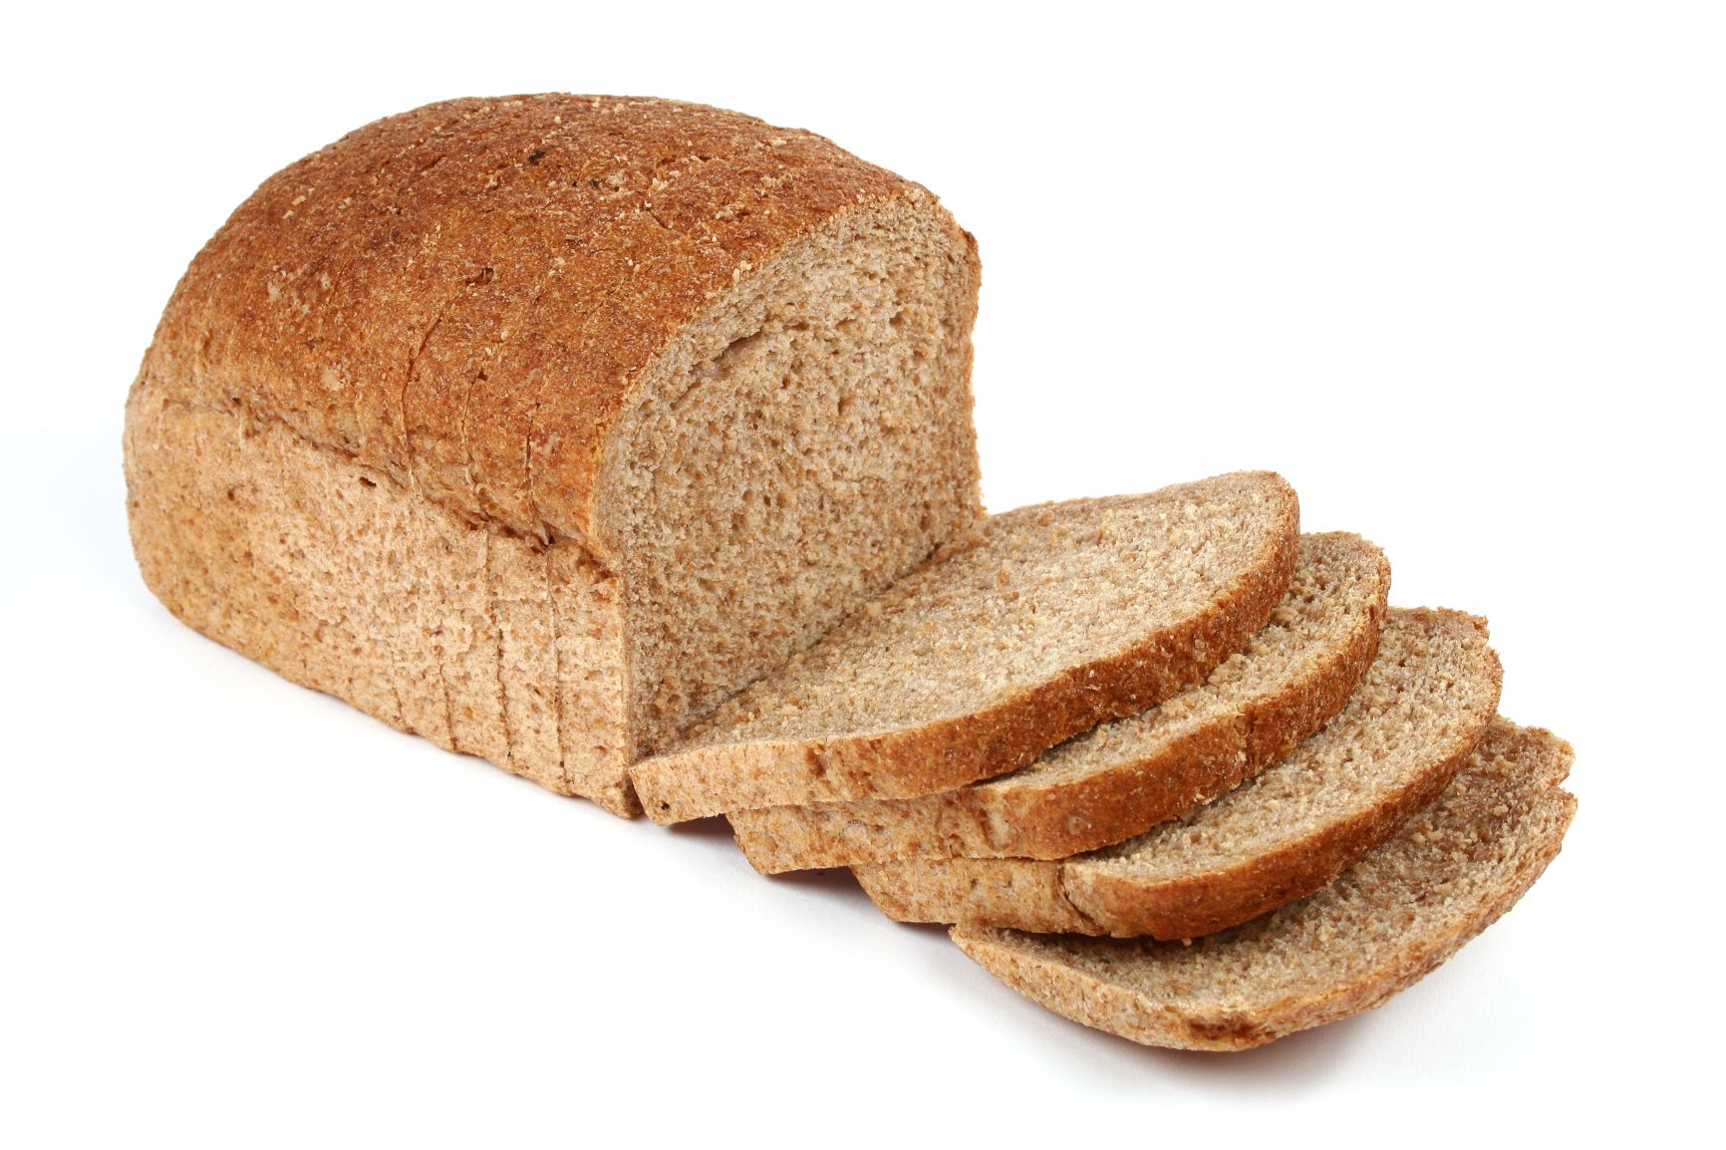
What can you do this week?
Make a swap to wholegrain!
At breakfast time…
At lunchtime…

Slide 13
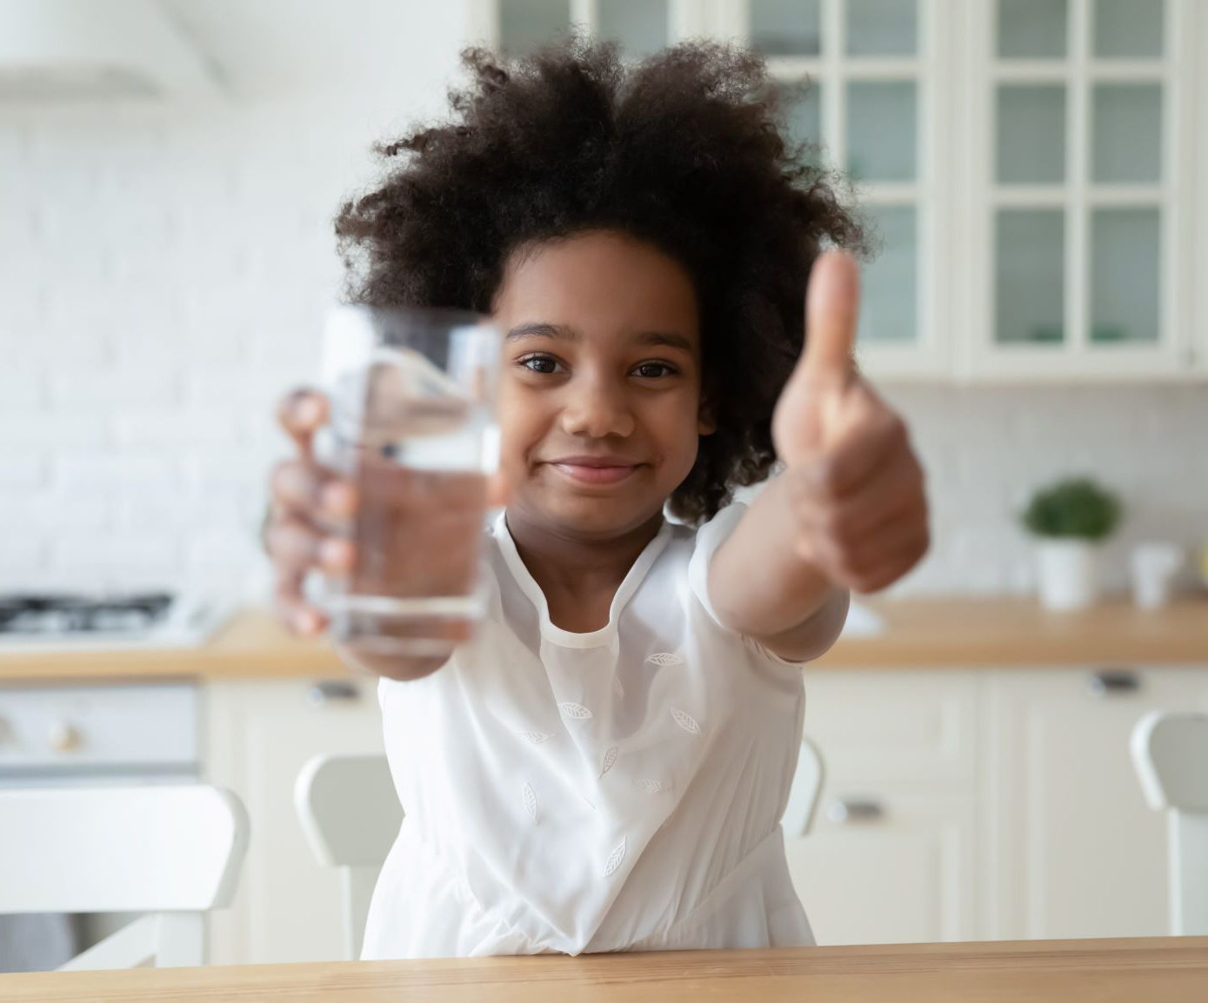

Know the facts
Drinks
How many should we have each day?
What are healthier drink choices?

Slide 14

How many drinks should we have each day?
A
B
C
2 - 4
4 - 6
6 - 8
After the count of three, show me with an action!

Slide 15

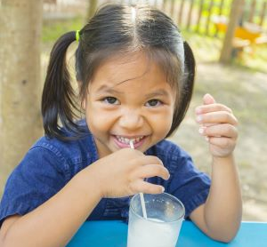

What are healthier drink choices?

Slide 16
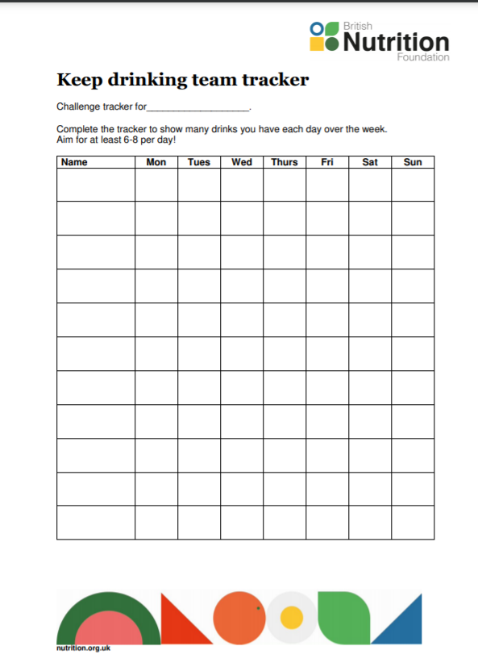

What can you do this week?
Have at least 6-8 healthier drinks every day!
Track your class drinking!
Swap a sweetened drink for a refreshing water infusion!

Slide 17
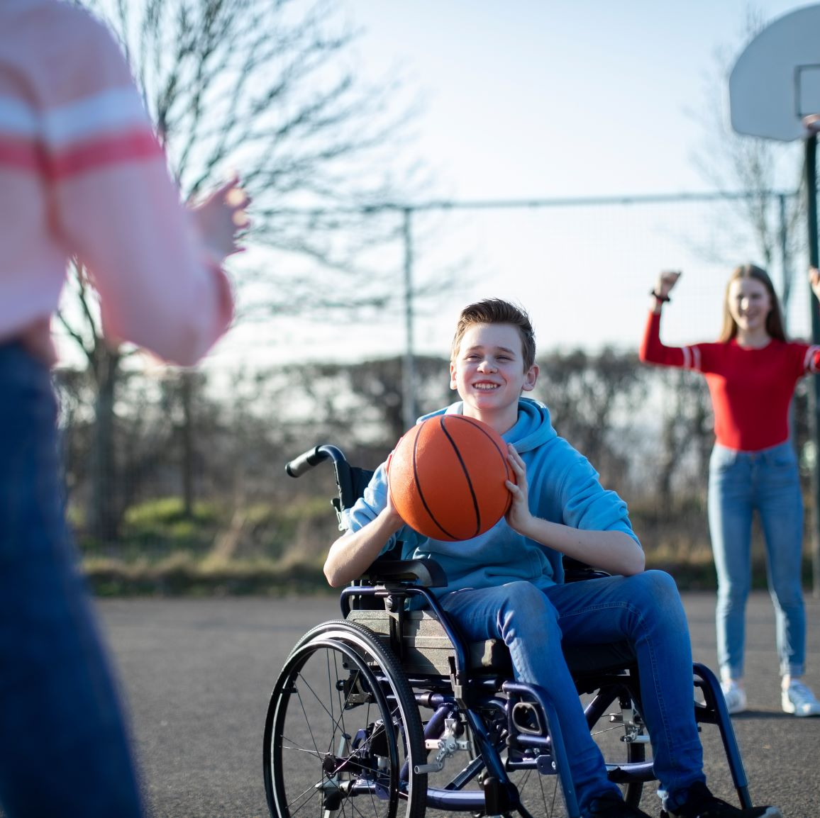

Keep moving
Move more!
How much do we need to move?
What counts?

Slide 18
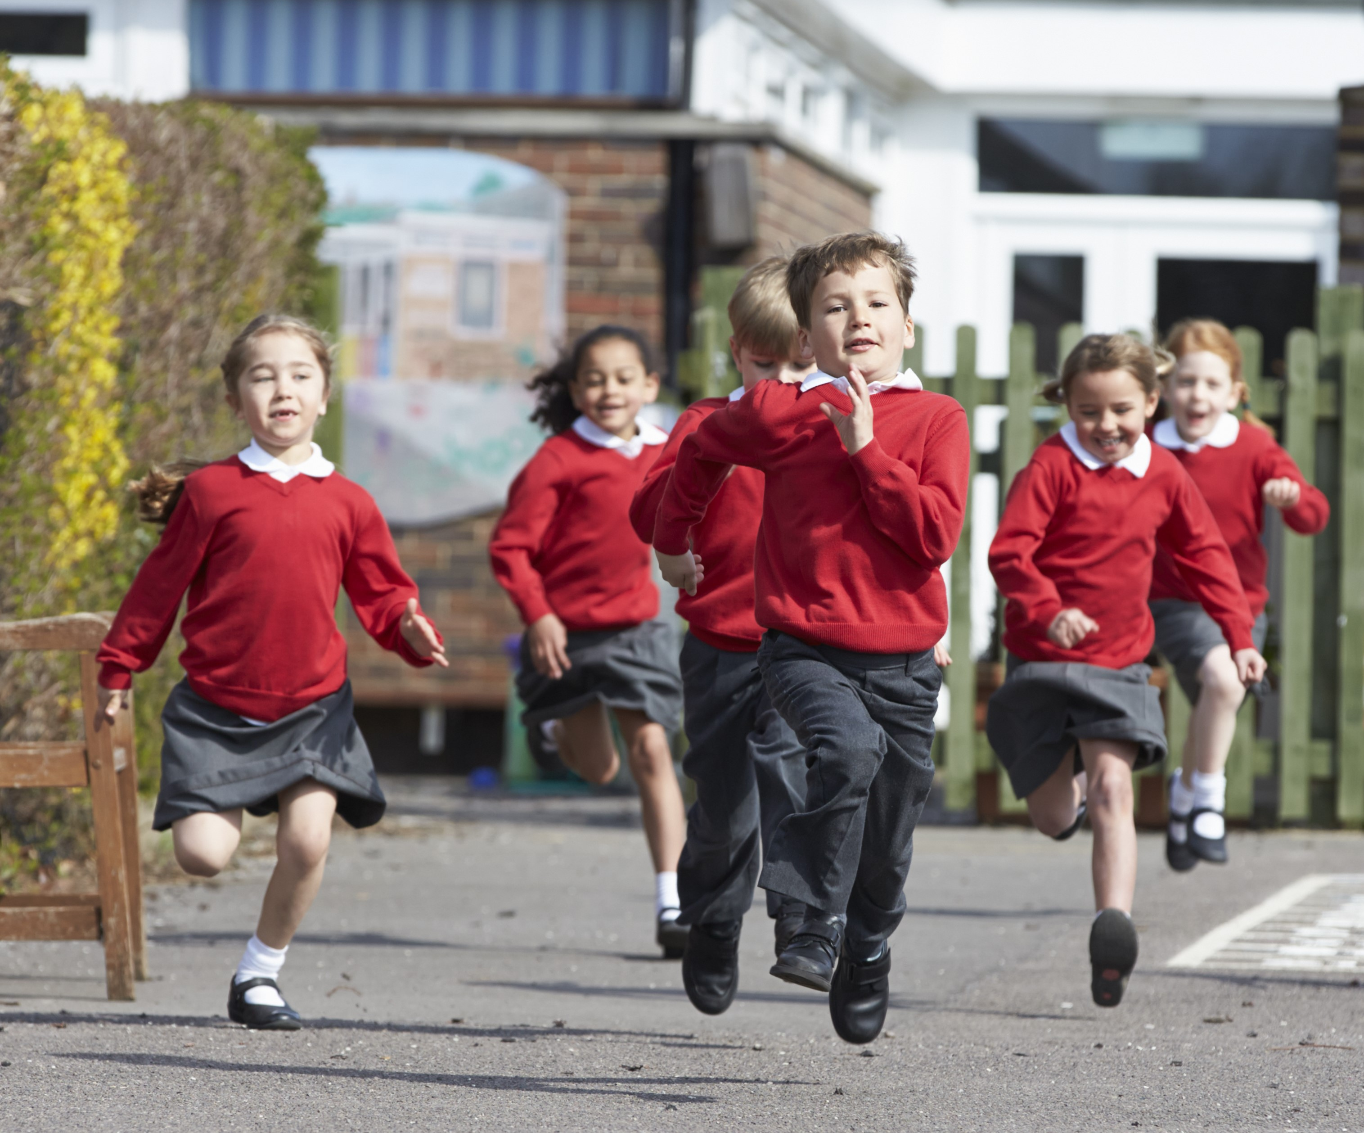
How should our 60 minutes feel?
We breathe harder
We feel warmer
Our heart beats faster
What activities make you feel like this?

Slide 19
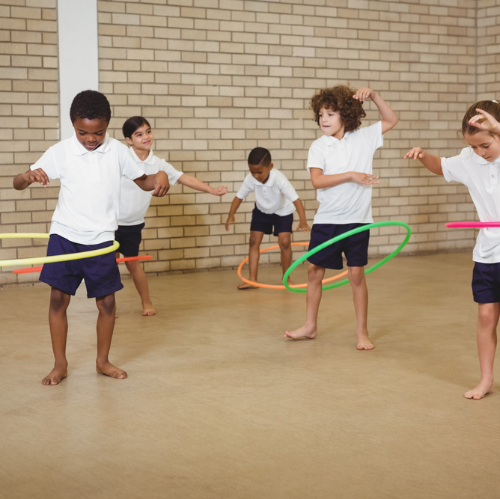
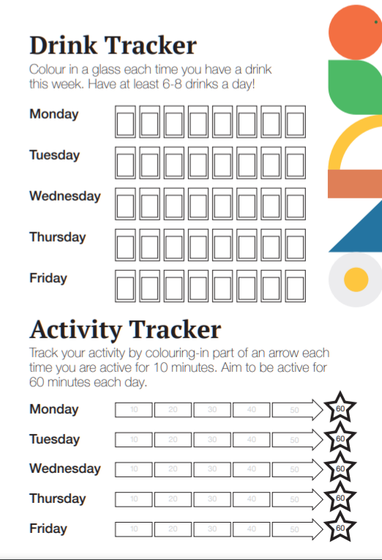
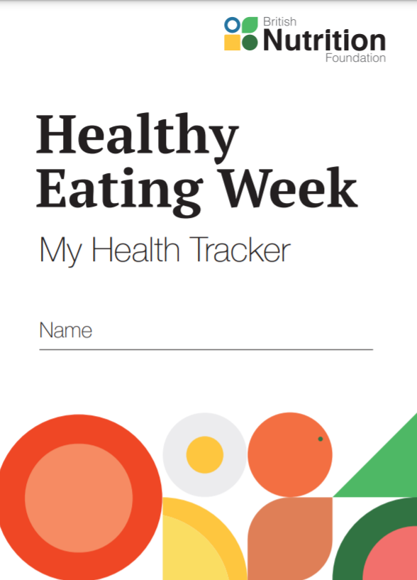
What can you do this week?
Move more!
Find new ways to be more active!
Track your activity to get your 60 minutes!

Slide 20

Wrap up!
This week Find your healthier you by:
Having at least 5 A DAY every day!
Making swaps to wholegrain varieties!
Having at least 6-8 drinks healthier drinks every day
Doing your 60 minutes of activity and moving more every day!
Try and earn your BNF Healthy Eating Week certificate!

Slide 21
A question for you…
Did you spot the pepper people on the slides?
How many did you see?

Slide 22
Have a great week!
Let us know what you are doing!
Send us a tweet: @Foodafactoflife #BNFHEW21
Drop us an email: postbox@nutrition.org.uk

