Slide 1
Rice

Slide 2
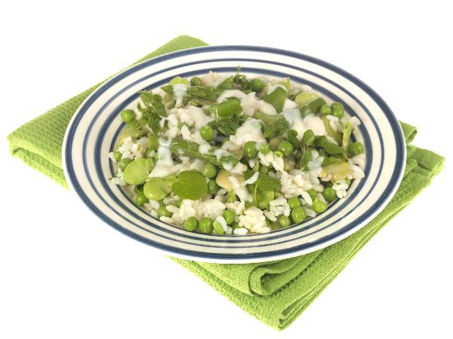
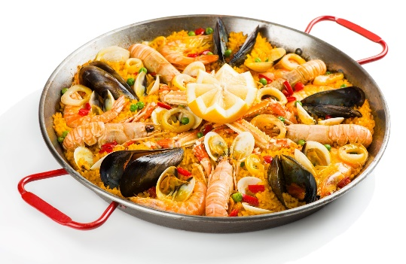
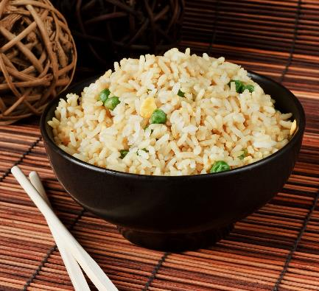
What do these have in common?
They all contain rice.

Slide 3
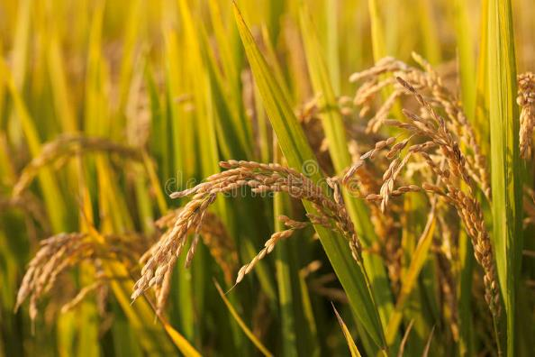
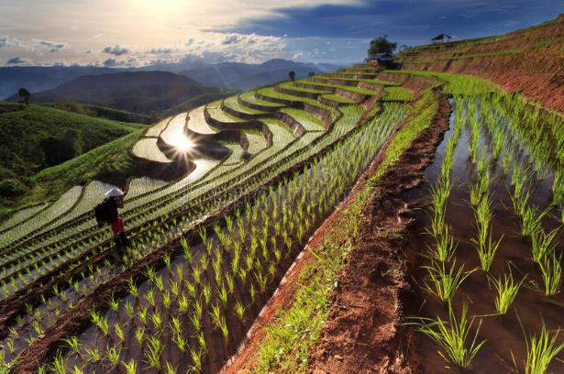
Where does rice come from?
Rice comes from a plant.

Slide 4
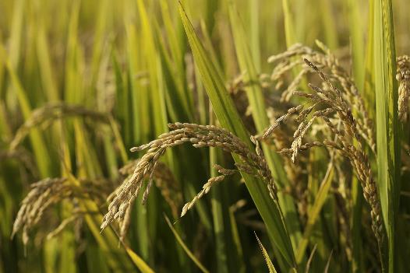
Where is rice grown?
Rice is grown in every continent of the world, except Antarctica.
When rice is harvested it is called ‘paddy'.
One grain of paddy contains one rice kernel.

Slide 5
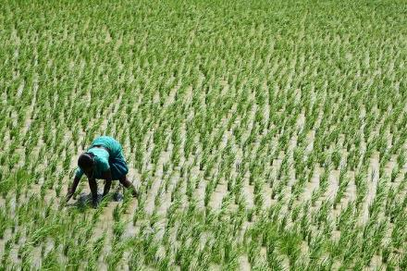
Farming rice
The rice fields are prepared by ploughing, fertilising and smoothing the soil.
Seedlings are started in beds.
After 30-50 days the seedlings are planted by hand in fields which have been flooded by rain or river water.
The fields are drained before the rice is cut.

Slide 6
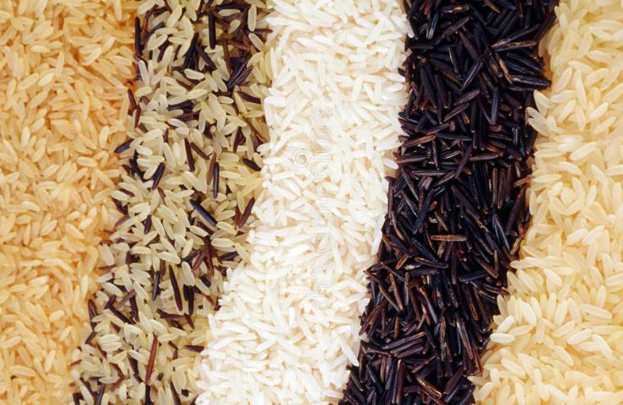
Rice varieties
There are three basic types of rice:
long grain (fluffy), e.g. served with main dishes that have sauces;
medium grain (creamy), e.g. risotto and puddings;
short grain (sticky), e.g. sushi and puddings.

Slide 7
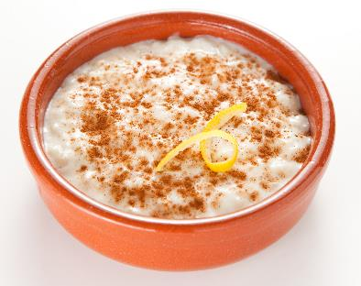
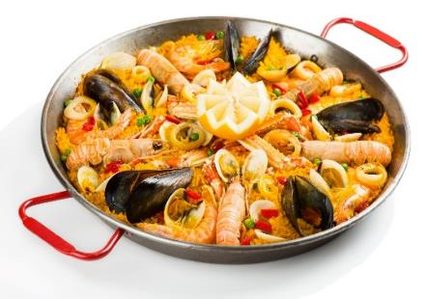
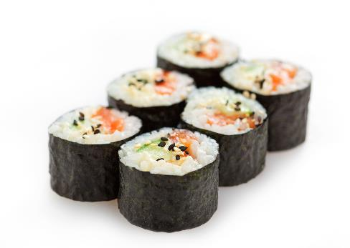
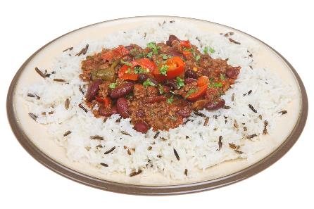
Dishes with rice
Rice can be used in lots of dishes.

Slide 8
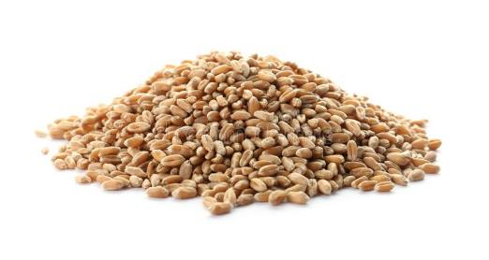
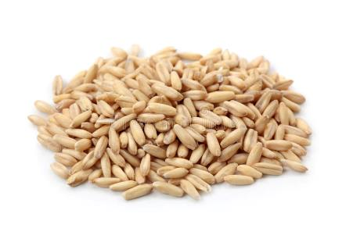
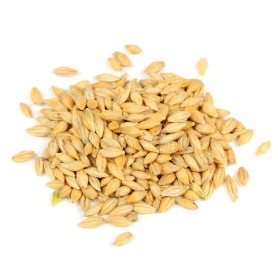
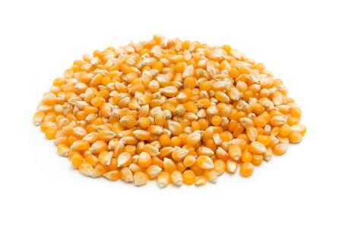
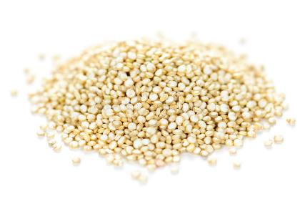
Similar plants
Wheat, barley, oats, maize and quinoa are all plants that produce grains, and are harvested, that are similar to rice.
Wheat
Oats
Maize
Barley
Quinoa

Slide 9
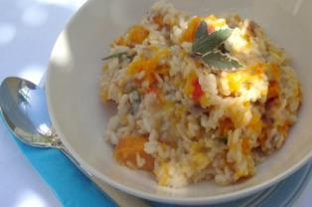
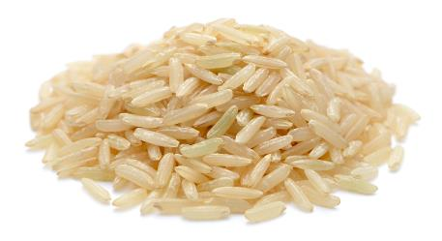
Summary
Rice is from plants.
Rice
Lots of meals are made with rice.

Slide 10
Rice
For further information, go to:
www.foodafactoflife.org.uk
This resource meets the Guidelines for producers and users of school education resources about food.

