Slide 1
Careers in hospitality and catering – opportunities for young people with additional needs
30/06/2021

Slide 2
Covered in today’s webinar
Understanding the role that young people with additional needs can play in catering or hospitality.
Building relationships with local charities and employers.
What schools can do to ensure that work experience and employment is positive and successful.
Practical examples from two organisations that support young people into meaningful employment
Resources for use with pupils with additional needs and professional development support available from Food – a fact of life.
Suggestions for further reading and sources of information.

Slide 3
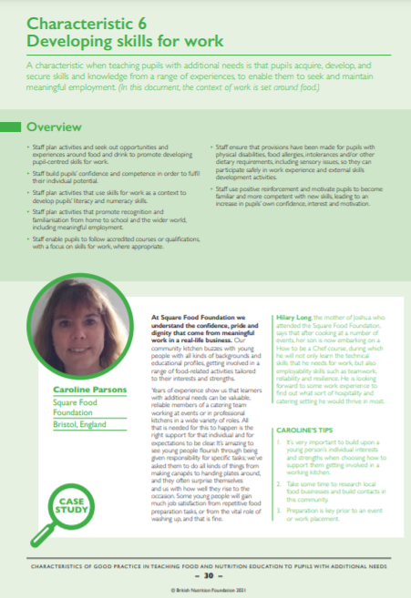
Characteristics of good practice in teaching food and nutrition education to pupils with additional needs
Defines the key characteristics of good practice that are specific to teaching food and nutrition to pupils with additional needs.
• Exemplifies these characteristics of good practice in UK schools, both special and mainstream.
Guide and supporting resources
The British Nutrition Foundation would like to gratefully acknowledge the financial support provided by the Savoy Educational Trust for the production of this Guide.

Slide 4
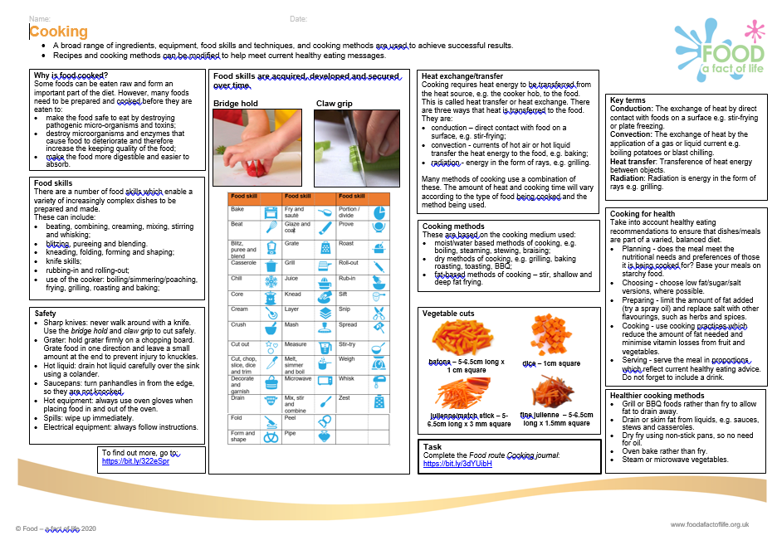
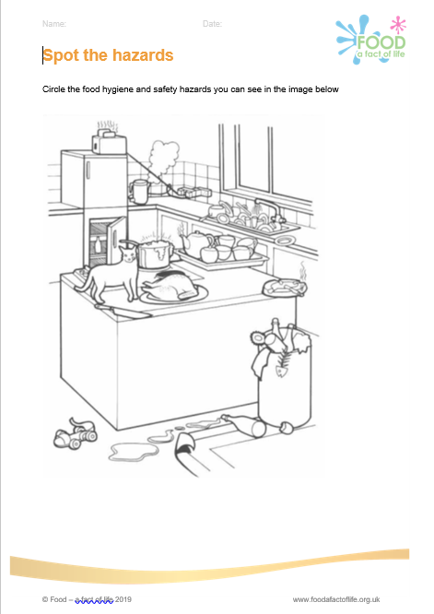
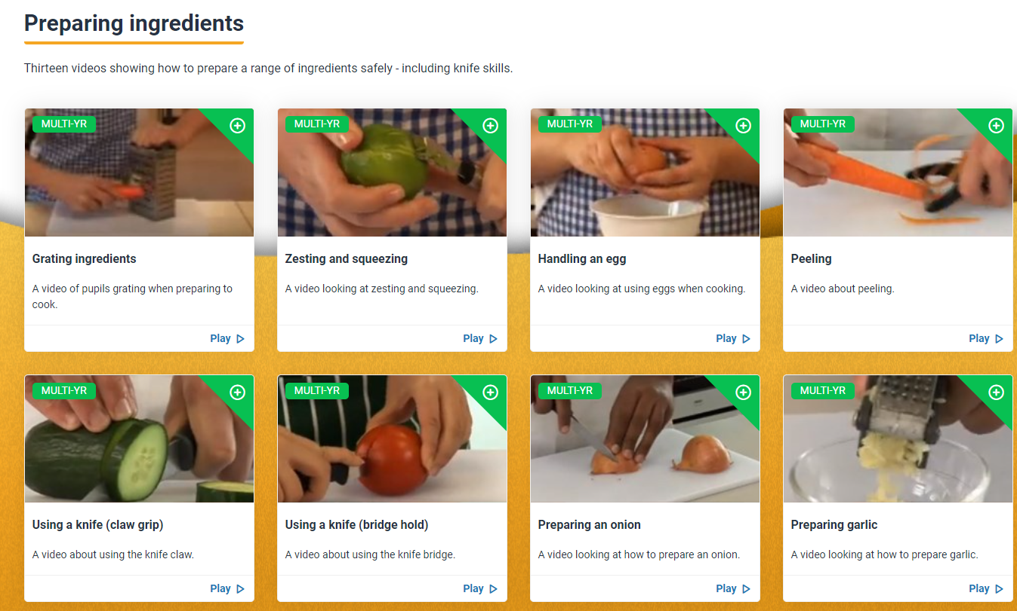
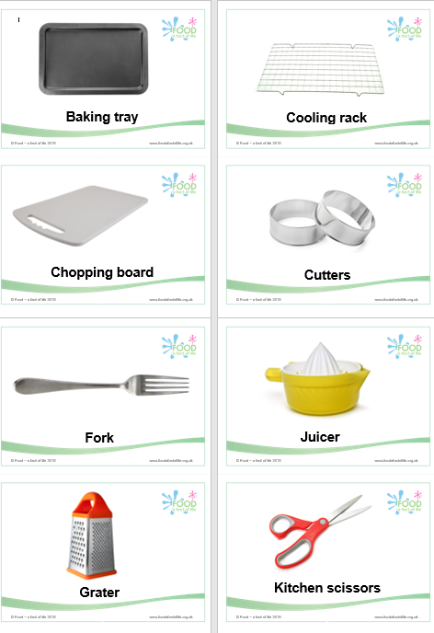
Food – a fact of life resources
All Food – a fact of life resources are editable!
Resources cover healthy eating, cooking and where food comes from, for ages 3-5 years to 14-16 years – you choose the resources to suit your pupils’ needs.
Knowledge organisers.
Recipes.
Food hygiene and safety.
Videos, interactive games and cards.
Practical food skills chart – teacher and pupil versions.
BTEC Home Cooking skills Level 1 and 2 resources mapping document.
How to videos

Slide 5
Support for your professional development
Reflection documents
Help develop reflective practice.
Ideal for staff at all career stages.
Provide an opportunity to reflect on personal practice and identify future actions.
There are also resources to support needs analysis and planning your own professional journey based on the Teaching food in primary/secondary schools: A framework of knowledge and skills.
Reflection documents

Slide 6
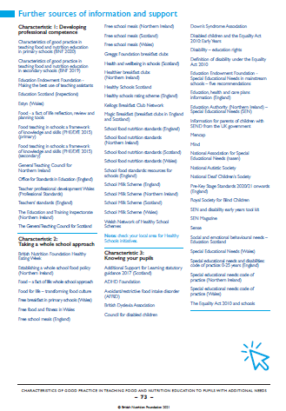
Sources of support and further information
Three pages of websites and useful information/ documents that support each of the characteristics can be found at the end of the Characteristics of good practice in teaching food and nutrition to pupils with additional needs guide.
The Gatsby Foundation
Good Career guidance – SEND

Slide 7
Careers in hospitality and catering – opportunities for young people with additional needs
For further information, go to:
www.foodafactoflife.org.uk
The British Nutrition Foundation gratefully acknowledges the support from the Savoy Educational Trust, which has enabled us to develop and produce the Characteristics of good practice in teaching food and nutrition education to pupils with additional needs guide, as well as host training events for teachers.

