Slide 1
Lunchtime learning
A Healthy eating and Cooking Challenge for pupils aged 5-7 years

Slide 2
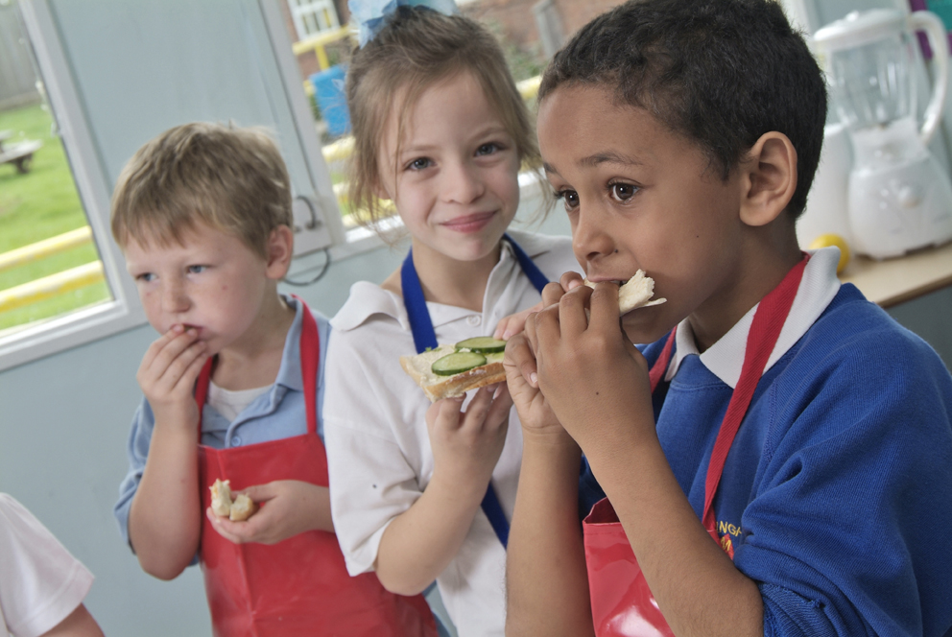
The challenge
Plan and make a healthy sandwich lunch for someone special.
Extension: Invite that person into school to enjoy what you have made.

Slide 3
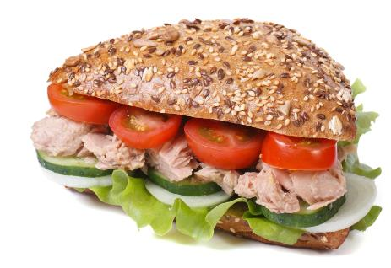
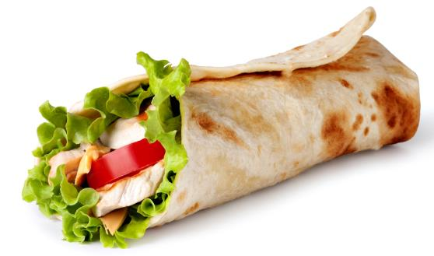
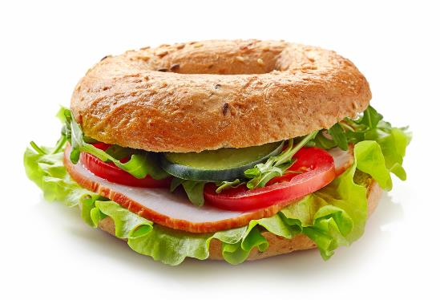
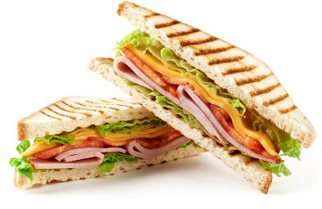
Let’s get started – the Challenge is on!
What is a sandwich?
Do all sandwiches look the same?
What food can we use to make a sandwich?

Slide 4
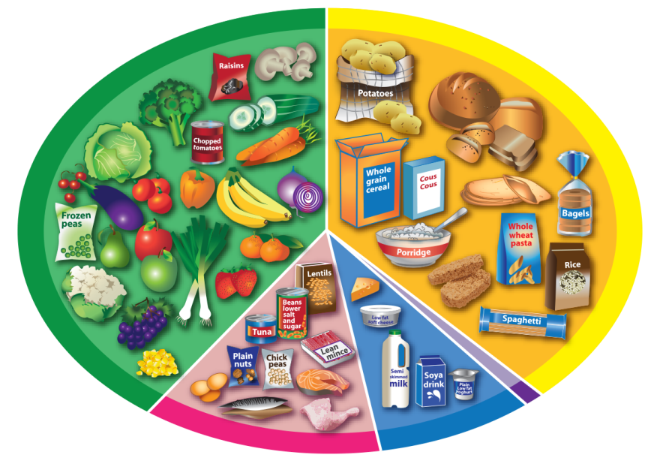
Healthy eating
This is the Eatwell Guide.
It helps us chose the right food to stay healthy.
What can you see?
There is a glass showing how many drinks we need each day.

Slide 5
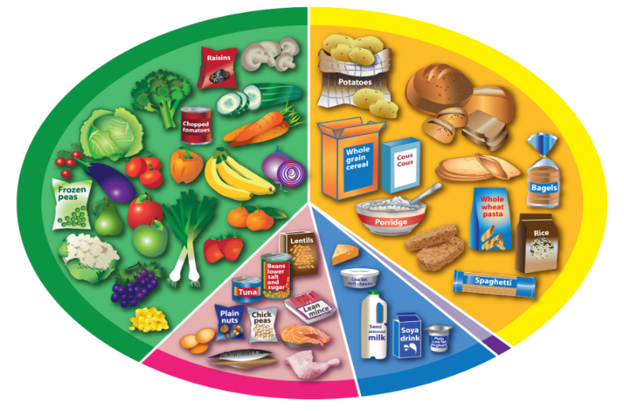
The Eatwell guide
Potatoes, bread, rice, pasta and other starchy carbohydrates
Fruit and vegetables
Each food group has a name.
Which is the largest group?
Which is the smallest group?
What does this mean?
We can sort the food we eat into the five groups.
Oil and spreads
Beans, pulses, fish, eggs, meat and other proteins
Dairy and alternatives

Slide 6
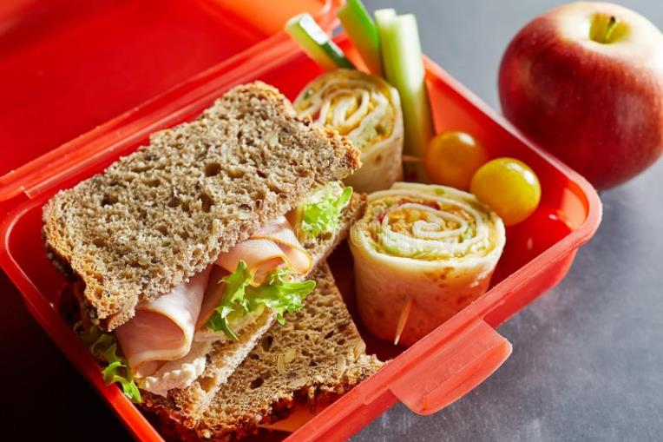
Did you know?
To stay healthy we need to eat different foods from the four largest food groups on the Eatwell Guide.
How can we use the Eatwell Guide to help us plan a healthy sandwich?

Slide 7
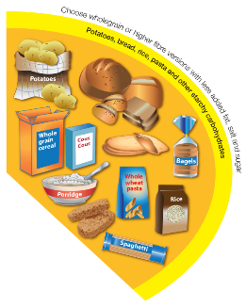
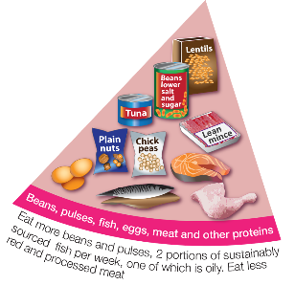
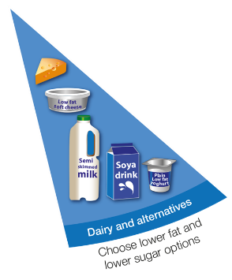
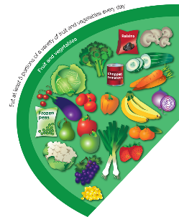
To make a healthy sandwich, we should include:
Bread
For example: a roll, wrap or bagel – choose wholemeal or brown!
A filling
For example: hummus, eggs, tuna, meat or cheese.
Vegetables or fruit
For example: lettuce, cucumber, tomatoes, sweetcorn – add plenty!

Slide 8
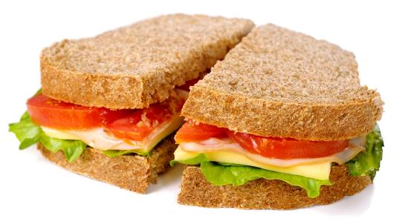
Is this a healthy sandwich?
Does the sandwich include:
bread;
a filling;
vegetables or fruit?
Where do the sandwich ingredients belong on the Eatwell Guide?

Slide 9
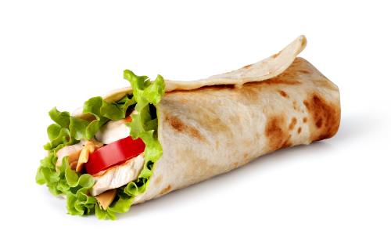
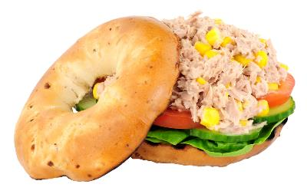
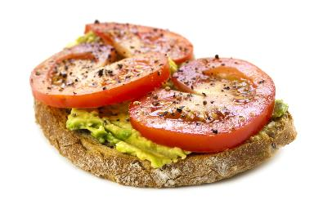
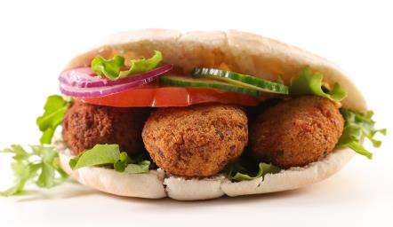
Did you know?
Sandwiches are eaten all over the world.
Different breads and fillings are used to make different types of sandwich.
What foods can you see in these sandwiches?
Name two different types of bread.

Slide 10
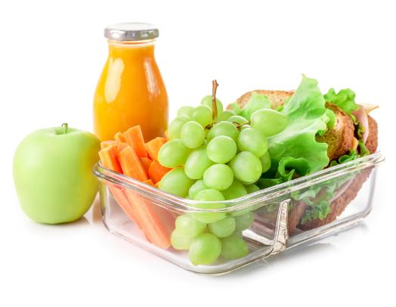
Food choice
We eat different food and have drinks at different times of the day.
What do people eat for:
breakfast;
lunch;
in the evening?
When might sandwiches be eaten?

Slide 11
Choices
What do we need to think about when planning to make our sandwich?
When will your ‘special person’ be eating the sandwich?
Is there any food which they do not like or cannot eat?
What ingredients are needed?
What equipment is needed?

Slide 12
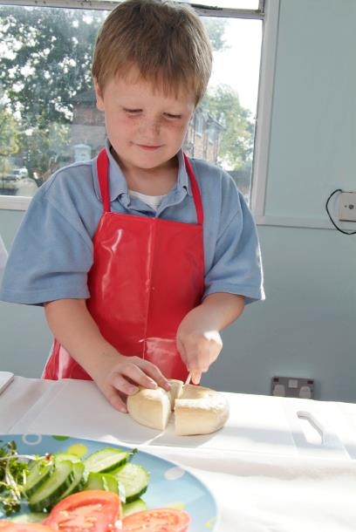
Make a plan
Decide what sandwich you are going to make and how you are going to make it.
Make a list of ingredients you will need.
Make a list of the equipment you will need.
Plan out step by step how you will make the sandwich. You could draw each step.

Slide 13
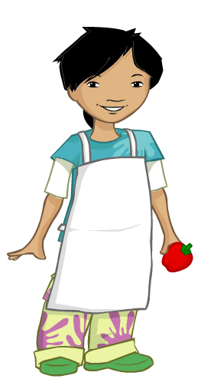
We need to get ready to cook so the food we make is safe to eat.
Tie back long hair
Roll up long sleeves
Remove jewellery
Put on an apron
Wash and dry hands

Slide 14
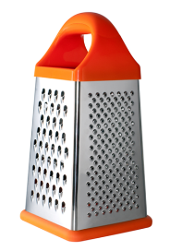
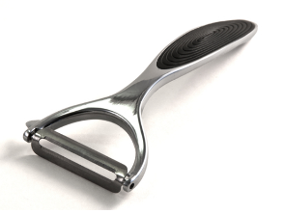
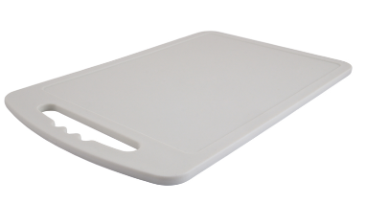
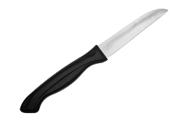
Equipment
Grater
Peeler
Kitchen scissors
There are lots of different pieces of equipment used to prepare food and some of them have special jobs.
What can you see?
What equipment will you need to make your sandwich?
Vegetable
knife
Colander
Chopping board

Slide 15
The challenge
Plan and make a healthy sandwich lunch for someone special.
Extension: Invite that person into school to enjoy what you have made.
Good luck!

Slide 16
Teachers’ guide

Slide 17
The Food – a fact of life Challenges
The Food – a fact of life Challenge activities have been written to support teachers not following the national curriculum for their specific country or those following a challenge or theme-based approach. However, they could be used in any school across the UK.
The Challenges cover Healthy eating, Cooking and Where food comes from and provide a wide range of activities that teachers can select depending on their pupils’ needs, age and abilities, and the time available.
There are 12 Challenges developed to be used with nursery, primary or secondary pupils.
Each Challenge comprises the Challenge, opportunities for learning and a variety of pupil activities that can be completed individually or in groups. Each Challenge culminates in a final outcome, which could be paper based, such as a report, poster, newspaper article or presentation, video, interactive activity, recipe, dish/range of dishes or menu depending on the theme of the Challenge.
An optional pupil certificate is available to download and personalise once the Challenge has been achieved.

Slide 18
The challenge
Plan and make a healthy sandwich lunch for someone special.
Extension: Invite that person into school to enjoy what you have made.

Slide 19
Opportunities for learning
By undertaking this challenge, the opportunities for learning include:
investigating the Eatwell Guide and food groups;
making healthier food choices;
exploring mealtime occasions and choices;
investigating ingredients used for sandwich making;
safely preparing and making a sandwich.

Slide 20
How can pupils complete the Challenge?
A range of activity suggestions have been provided – you can choose the ones that are most suitable for your pupils and the time that you have available to complete the challenge.
Activities include:
Finding out – investigating the Eatwell Guide and food groups, applying the Eatwell Guide messages when planning the sandwich, considering food choices and likes and dislikes, reviewing cooking equipment and its uses, how to prepare and cook safely and hygienically.
Making and evaluating – developing practical skills and use of equipment, planning and making a sandwich, food hygiene and safety.
Bringing it all together – planning and creating a sandwich that reflects the Eatwell Guide and is suitable for the chosen person.

Slide 21
Finding out - activities
Pupils, individually or in groups, could:
Food and drink:
use the Food – a fact of life presentation to introduce the children to food and drinks as the basic requirement for life.
discuss why we need food and what food does – use the How does food help my body? worksheet to record how food helps the body.
Eatwell Guide:
use The Eatwell Guide presentation (5-7) to introduce the concept of the guide and food groups.
use the Five food group cards to review the foods in each group. Create displays about the five food groups in the classroom.

Slide 22
Finding out - activities
use the Eatwell Guide poster (basic) and the Eatwell guide food cards to match the food and groups.
place the foods and drinks shown on the Food selection worksheet in the correct groups on the blank Eatwell Guide worksheet.
play the interactive game - The Eatwell Challenge (scroll to bottom of page for the game).
use the Amazing lunchbox story to introduce the concept of a healthy lunch underpinned by the Eatwell guide. (Teacher guide)
complete the FFL Workbook 1 - an 8-page workbook covering healthy eating, drinking and being active.

Slide 23
Finding out - activities
Food choice:
discuss what they eat and drink at different times of the day, use the Mealtimes presentation and Mealtime cards to support the discussion.
record what they eat and drink throughout the day on the Mealtimes worksheet.
use the Super Sandwich worksheet to plan suitable sandwiches for different people.
Preparing to cook:
use the Recipe planning worksheet to help plan writing a recipe for the sandwich.
look through the Hygiene presentation and at the Let’s get ready to cook poster to review and establish the rules before cooking. Discuss hygiene rules which must be followed during food work.
use the Kitchen equipment cards or the Kitchen equipment presentation to review the names and when/how different equipment is used.

Slide 24
Making and evaluating - activities
learn or recap basic skills (Skills guide) through watching a demonstration (Demonstration guide) or watching the appropriate skills videos.
use or adapt a recipe for a sandwich/wrap – salmon and cucumber bagel, hummus and carrot wrap, triple decker sandwich, pitta pockets.
revise the names and uses for different piece of equipment. Use some of the activities suggested in the Cooking plenary, but substitute the ingredients for the equipment.
discuss the Food hygiene, safety and cooking knowledge organiser which provides key facts around food hygiene, safety and cooking to consolidate learning.

Slide 25
Teacher resources
Cooking: A guide about cooking in the primary school classroom.
Demonstration guide: A guide about cooking demonstrations in the primary classroom.
Ingredient check letter: A template letter to send home about pupils handling and/or eating different ingredients.
Creative cook certificate: A certificate to award creative cooking.
Recipes: A range of recipes that can be sorted by age range, commodity, complexity, food skills and cooking methods.
Food skills guide: A guide highlighting key food skills that can be taught.

Slide 26
Bringing it all together
Pupils should:
Plan and make a healthy sandwich lunch for someone special.
The planning and making should demonstrate their knowledge and skill development of:
making healthier food choices in the context of the Eatwell Guide;
why we chose food;
safely and hygienically preparing food;
developing and practising appropriate food skills.

Slide 27
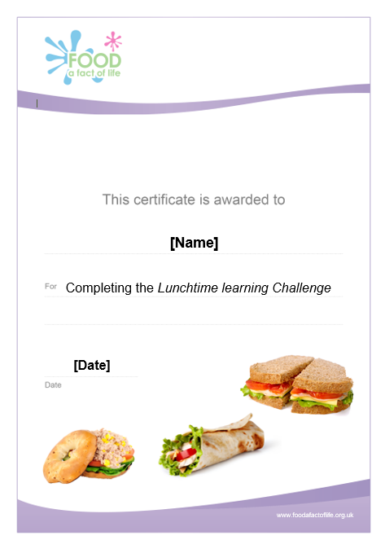
Celebrate!
An optional pupil certificate is available to download and personalise once the Challenge has been achieved.
Why not present the certificate at a celebration assembly?

Slide 28
Lunchtime learning
For further information, go to:
www.foodafactoflife.org.uk
This resource meets the Guidelines for producers and users of school education resources about food.

